Slide 1
Automated Essay Evaluation and feedback systems: Are they useful for ESL test takers and ESL teachers? Antony John Kunnan
Talk at the 14th National China Conference on Computational Linguistics
GDUFS, November, 2015

Slide 2
Part 1
Introduction

Slide 3
AES/AEE definition
Ware (2011, p. 769) defines two aspects of AES as
the provision of automated scores derived from mathematical models built on organizational, syntactic, and mechanical aspects of writing
automated feedback as computer tools for writing assistance
A major shift from essay scoring to essay evaluation;
A long way from Ellis Page’s Project Essay Grade (PEG) developed in 1966 which was implemented in 1973

Slide 4
AEE and related software
Educational Testing Service, Princeton: E-rater and Criterion
Pearson’s Intelligent Essay Assessor; IEA and WriteToLearn
Vantage’s Intellimetric; IntelliMetric and MyAccess!
William and Flora Hewlett’s LightSIDE, Carnegie Mellon (Open source)
BETSY (Open source)
Autoscore, American Institutes of Research
Bookette, CTB McGrawHill
Intelligent Academic Discourse Evaluator (IADE)
Lexile, MetaMetrics
Coh-Metrix, Univ. of Tennessee (Open source): identifies textual features
SourceRater: identifies the grade level of a text

Slide 5
Research reports of applications of AEE
Chen and Cheng (2008) in Taiwan
Grimes and Warshauer (2010) in southern California
Helps motivation
WriteToLearn in South Dakota in school system
Schultz in China
West Virginia Writes (customized version of CTB’s Writing Road Map, 2010

Slide 6
Example of AEE: E-rater (ETS)
E-rater uses NLP methods to identify construct-relevant linguistic properties in text.
Statistical and rule-based methods are two approaches that are used with NLP tools to analyze texts.
Statistical methods can be supervised (human annotated data human-scores essays) and unsupervised modeling (content vector analysis; for example, word frequency to evaluate similarity between two documents; example, Safe Assignment or Turnitin)
Machine translation & Automated summarization (Columbia Univ.’s NewsBlaster
Internet search engines: Google, Yahoo!, Bing
Automated question-answering: IBM’s Watson for Jeopardy; Siri, Iris, etc.

Slide 7
E-rater features
Grammatical errors (e.g., Subject-verb agreement; their for there) using syntactic parsers; sentence fragments, determiner, preposition, etc.; statistical methods: parts of speech pairs, adjacent pairs
Discourse structures/Organizational development (thesis, main points, supporting details, conclusions); presence of thesis idea, three longer main ideas more developed than only main idea
Topic-relevant word usage (specialized topic vocabulary better than less specific words
Style-related word usage (repeating words): collocations; NofN swarm of bees, Adj+N strong tea, N+N house arrest
Register and word usage (powerful computer vs. strong computer)

Slide 8
E-rater Model building and advisories
Topic-specific models based on human score essays on a particular topic; need to have this data from hundreds of essays
Generic models: based on human-scored essays written by test takers from the same populations from a number of essays; need data from thousands of essays
Hybrid model like the generic model but across multiple topics

Slide 9
E-rater advisories
Off-topic essays
Keyboard banging essays; aljsdhfeu aojfoerue aofjdajfjda
Copied-prompt essays
Unexpected-topic essays: misunderstood prompt or wrong question response: CVA method
Bad-faith essays: chunks of text not related to the topic: CVA method
Essay similarity:
Chunks of text are unusual amounts of texts that are similar across prompts; maybe memorized chunks; checked with Essay Similarity Detector using NLP

Slide 10
Applications of E-rater, Bridgeman (2013)
For all essays in GRE, GMAT, TOEFL/iBT: One human rater + E-rater
GRE example: Issue prompt type: difference between human and machine scores were quite small (d = .15) across the top 15 countries
BUT the difference between human and machine scores for Chinese test takers were high (d= .60); higher scores from e-rater for 9000 cases
Longer essays (they can get higher points from human and machine ratings
Large chunks of memorized chunks; human raters see these as slightly off-topic but not completely off-topic and therefore will give low scores but machine scores cannot see the difference between off-topic and slightly off-topic
For argument prompt type: difference between human and machine scores for Chinese test takers was high (d = .38)
TOEFL example: the difference between human and machine scores for Chinese test takers was the highest for all countries (d= .25)

Slide 11
WriteToLearn: How LSA works (Foltz, Streeter, Lochbaum, & Landauer, 2013)
Uses a Latent semantic model (LSA) as a basis for scoring features
Co-occurrence matrix of words and their usage in paragraphs
Then reduces the matrix by Singular Value Decomposition like factor analysis
Output is several hundred dimensional sematic space in which every word, paragraph, essay or document is represented by a vector of rea number to represent its meaning
LSA derives measures of content, organization, and development-based features of writing
A content score is assigned to an essay based on the scores of the most similar essays on semantic similarity scale
Lexical sophistication, grammatical, mechanic, stylistic, and organizational aspects of essays is also assessed

Slide 12
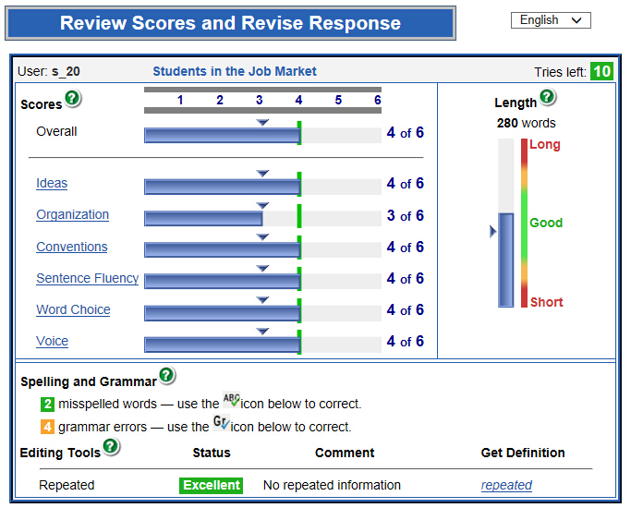
WriteToLearn scoreboard
From Liu (2014)

Slide 13
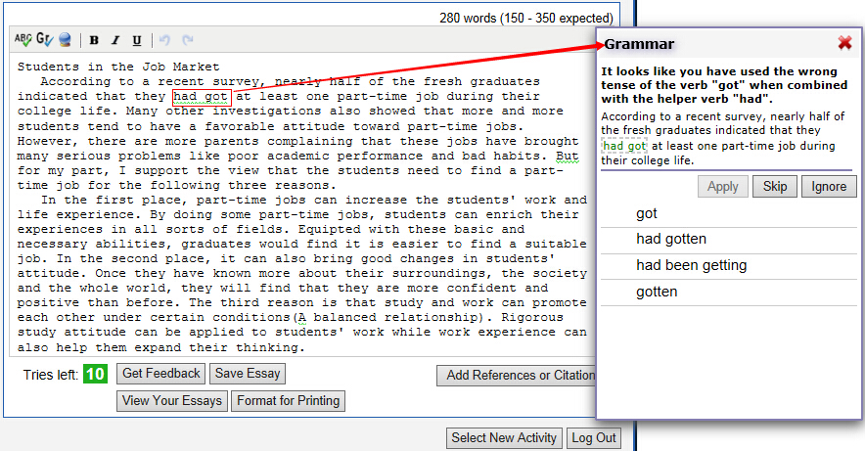
WriteToLearn feedback
From Liu (2014)

Slide 14
MyAccess: How IntelliMetric works (Schultz, 2013)
Application of MyAccess on a Chinese essay prompt
Data: 613 essays
Topic: Environmental protection
Sample essay: Shermis & Burstein (2103), p. 95
Correlations on training sample, N=493
Human-Human: r=.95
Human-MyAccess: r=.86
Correlations on validation sample, N=120
Human-Human: r=.96
Human-MyAccess: r=.93

Slide 15
Examples of problems
Chodorow et al., (2010): “I fond car”
Misspelling “found” and a missing article: “I found the car” or missing preposition copula, preposition and plural marking: “I am fond of cars”
ETS (website materials):
“Monkey see, monkey do” – subject/verb agreement errors but from a pragmatic perspective, the sentence is well formed evoking the world knowledge about monkey behavior and the use of provers in writing
Weigle, 2013
“He lead a good life” – subject/verb agreement error or a tense error
“Major syntax error”

Slide 16
Part 2
AEE concerns and issues

Slide 17
Concerns about AEE (Shermis, Burstein & Bursky (2013) and Xi (2010)
Can automated evaluation systems be gamed?
Will the use of AEE foster attention to formal aspects of writing excluding richer aspects of the writing construct?
Will AEE subvert the writing act fundamentally depriving the writer from a true audience?
Are AEE/NLP systems/methods limited to superficial or literal linguistic analyses?
Does the use of assessment tasks constrained by AEE technologies lead to construct under- or misrepresentation? (Domain representation)
Do the AEE features under- or misrepresent the construct of interest? (Explanation)

Slide 18
On automated scoring and validation (Xi, 2010)
The way AEE features are combined to generate automated scores – are they consistent with theoretical expectations of the relationships between the scoring features and the construct of interest? (Explanation)
Does the use of AEE change the meaning and interpretation of scores provided by trained raters? Are the scores accurate indicators of the quality of a test performance sample? (Explanation)
Would test taker’s knowledge of the scoring algorithms of an AEE system impact the way they interact with the test tasks, thus negatively affecting the accuracy of the scores? (Evaluation)
Does AEE yield scores that are sufficiently consistent across measurement contexts (e.g., across test forms, across tasks in the same form)? (Generalization)

Slide 19
On automated scoring and validation 2 (Xi, 2010)
Does AEE yield scores that have expected relationships with other test or non-test indicators of the targeted language ability? (Extrapolation)
Do AEE lead to appropriate score-based decisions? (Utilization)
Does the use of AEE have a positive impact on test taker’s test preparation practices? (Utilization)
Does the use of AEE have a positive impact on teaching and learning practices? (Utilization)

Slide 20
On automated feedback and validation (Xi, 2010)
Does the AEE system accurately identify learner performance characteristics or errors? (Evaluation)
Does the AEE feedback system consistently identify learner performance characteristics or errors across performance samples? (Generalization)
Is AEE feedback meaningful to students’ learning? (Explanation)
Does AEE feedback lead to improvements in learners’ performances? (Utilization)
Does AEE feedback lead to gains in targeted areas of language ability that are sustainable in the long term? (Utilization)
Does AEE feedback have a positive impact on teaching and learning? (Utilization)

Slide 21
Some Common Human-Rater Errors and Biases (Zhang, 2013)
Severity/Leniency: Refers to a phenomenon when raters make judgments on a common dimension, but some raters consistently give high scores (leniency) while other raters consistently give low scores (severity), thereby introducing systematic biases.
Scale Shrinkage: Occurs when human raters don’t use the low and high ends on a scale.
Inconsistency: Occurs when raters are either judging erratically, or along different dimensions, because of their different understandings and interpretations of the rubric.
Halo Effect: Occurs when the rater’s impression from one characteristic of an essay is generalized to the essay as a whole.
Stereotyping: Refers to the predetermined impression that human raters may have formed about a particular group that can influence their judgment of individuals in that group.
Perception Difference: Appears when immediately prior grading experiences influence a human rater’s current grading judgments.
Rater Drift: Refers to the tendency for individual or groups of raters to apply inconsistent scoring criteria over time.

Slide 22
Strengths and weaknesses (Zhang, 2013)
Human Raters
Potential Measurement Strengths
Are able to: Comprehend the meaning of the text being graded; Make reasonable and logical judgments on the overall quality of the essay
Are able to incorporate as part of a holistic judgment: Artistic/ironic/rhetorical styles; Audience awareness; Content relevance (in depth);
Creativity; Critical thinking; Logic and argument quality; Factual correctness of content and claims

Slide 23
Strengths and weaknesses (Zhang, 2013)
Potential Measurement Weaknesses
Are subject to: Severity error; Scale shrinkage error; Inconsistency error; Halo effect; Stereotyping error; Perception difference error; Drift error;
Subjectivity
Logistical Weaknesses
Will require: Attention to basic human needs (e.g., housing, subsistence level);
Recruiting, training, calibration, and monitoring; Intensive direct labor and time

Slide 24
Strengths and weaknesses (Zhang, 2013)
Automated system
Potential Measurement Strengths
Are able to assess: Surface-level content relevance; Development; Grammar; Mechanics; Organization; Plagiarism; Limited aspects of style; Word usage
Are able to more efficiently (than humans) provide Granularity (evaluate essays with detailed specifications with precision); Objectivity (evaluate essays without being influenced by emotions and/or perceptions);
Consistency (apply exactly the same grading criteria to all submissions);
Reproducibility (an essay would receive exactly the same score over time and across occasions from automated scoring systems); Tractability (the basis and reasoning of automated essay scores are explainable)

Slide 25
Strengths and weaknesses (Zhang, 2013)
Potential Measurement Weaknesses
Are unlikely to: Have background knowledge; Assess creativity, logic, quality of ideas, unquantifiable features; directly assess cognitively demanding aspects of writing such as audience awareness, argumentation, critical thinking, and creativity
And: Inherit biases/errors from human raters
Logistical Strengths
Can allow: Quick re-scoring; reduced cost (particularly in large-scale assessments); Timely reporting including possibility of instantaneous feedback
Will require: Expensive system development; System maintenance and enhancement (indirect labor and time)

Slide 26
Part 3
Empirical studies

Slide 27
Applications
MyAccess – Vantage learning;
WriteToLearn - Pearson
Automated scoring of writing tools like MyAccess and WriteToLearn also claim to be instructional tools by providing automated diagnostic feedback

Slide 28
Empirical studies
1. Consistency of scores
Consistency evidence: Automated scoring
Hoang & Kunnan (2015): MyAccess
Liu & Kunnan (2015): WriteToLearn
2. Opportunity to Learn
OTL evidence: Automated feedback
Hoang & Kunnan (2015): MyAccess
Liu & Kunnan (2015): WriteToLearn

Slide 29
Toulmin’s (1953) argumentation model (Kane, Bachman)
Grounds
Fair and just
support
Claim
OTL
Meaningful
Consistent
Free of bias, etc.
Warrants
relevant claims
Qualifier
presumably, possibly, etc.
Backing evidence
from empirical studies
Rebuttal evidence
from empirical studies

Slide 30
MyAccess (Hoang & Kunnan, 2015)
Agreement between human raters and automated scoring
Off-topic essays
Comparisons between human feedback and automated feedback
Data: ESL writers from Vietnam and California (N=105)

Slide 31
Human-MyAccess rating agreements, correlation, and difference; Hoang & Kunnan (2015)
_____________________________________________________________________________________________________
Human Rating 1 vs. Human Rating Average
Human Rating 2 vs. MyAccess (MA)
_________________________________________________________________________
Cases % Cases %
Exact agreement 10 9.5 2 1.9
Adjacent agreement 80 76.2 73 69.5
Disparate ratings 15 14.3 30 28.6
_________________________________________________________________________
Correlation Mean difference
MyAccess HR AVE MyAccess
HRAVE .688 Mean 3.76 4.09*
SD 1.18 1.19
_________________________________________________________________________
N=105; * = p.<.05

Slide 32
Off-topic essays: Comparison of human and MyAccess ratings
_________________________________________________
Essay HR 1 HR 2 MyAccess _________________________________________________
ESL1-4 2.5 1.0 4.9
ESL1-5 2.0 2.5 4.2
EFL1-37 2.3 3.5 4.0
EFL2-27 3.8 4.0 4.6
__________________________________________________
Notes: HR = Human Rating; scale is 0-6 points

Slide 33
Comparison between human and MyAccess feedback
______________________________________________________________________
Error type Human MyAccess MyAccess MyAccess
feedback feedback Precision Recall
Hits % %
______________________________________________________________________
Spelling 7 2 2 100 28.6
Articles 124 32 31 96.9 25.0
Capitalization 38 19 17 89.5 44.7
Spelling 26 24 20 83.3 76.9
Run-ons 39 27 22 81.5 56.4
Preposition 36 9 7 77.8 19.4
Contractions 18 9 7 77.8 38.9
Punctuation 39 26 20 76.9 51.3
Fragments 25 16 12 75.0 48.0
S-V agreement 37 25 18 72.0 48.6
Word form 24 11 4 36.4 16.7
Mass/Count Ns 5 10 3 30.0 60.0
Wrong words 18 7 2 28.6 11.1
Comparatives 5 0 0 0 0
Total 465 252 184 72.4 39.6 _________________________________________________________________________

Slide 34
WriteToLearn: Liu & Kunnan (2015)
Human raters and automated ratings on analytic scoring system
Comparisons between human feedback and automated feedback
Data: ESL writers from Sichuan province (N=186)
Precision = Hits divided by software’s total (For example, the precision of capitalization: 96÷104 = 92.3);
Recall = Hits divided by human feedback’s total (For example, the recall of capitalization: 96 ÷115 = 83.5).

Slide 35
Descriptive statistics for human ratings and WriteToLearn; Liu & Kunnan (2015)
 | HR1 |  |  | HR2 |  |  | HR3 |  |  | HR4 |  |  | WTL
 | M | SD |  | M | SD |  | M | SD |  | M | SD |  | M | SD
Ideas | 3.77 | 0.67 |  | 4.01 | 0.92 |  | 3.77 | 0.78 |  | 4.05 | 0.94 |  | 2.92 | 0.59
Organization | 3.91 | 0.45 |  | 4.33 | 0.91 |  | 3.95 | 0.75 |  | 3.96 | 0.90 |  | 2.93 | 0.47
Conventions | 4.02 | 0.32 |  | 4.03 | 1.06 |  | 3.66 | 0.90 |  | 3.80 | 0.85 |  | 3.74 | 0.64
Sentence Fluency | 3.52 | 0.64 |  | 4.06 | 0.99 |  | 3.62 | 0.75 |  | 3.92 | 0.90 |  | 3.63 | 0.65
Word Choice | 3.34 | 0.58 |  | 3.87 | 0.90 |  | 3.48 | 0.76 |  | 3.88 | 0.79 |  | 3.40 | 0.58
Voice | 3.80 | 0.51 |  | 3.96 | 0.98 |  | 3.70 | 0.77 |  | 3.75 | 0.91 |  | 3.04 | 0.63

Slide 36
Comparison between human and WriteToLearn feedback
Error type | Human rater’s feedback Total | WriteToLearn’s feedback
 |  | Total | Precision Hits | Precision % | Recall %
Connecting words | 18 | 1 | 1 | 100.0 | 5.6
Capitalization | 115 | 104 | 96 | 92.3 | 83.5
Subject-verb agreement | 42 | 19 | 15 | 79.0 | 35.7
Comma splice | 10 | 8 | 6 | 75.0 | 60.0
Singular/plural | 86 | 12 | 9 | 75.0 | 10.5
Article | 115 | 10 | 7 | 70.0 | 6.1
Run-on sentences | 8 | 14 | 6 | 42.9 | 75.0
Punctuation | 54 | 92 | 34 | 37.0 | 63.0
Spelling | 52 | 93 | 18 | 19.4 | 34.7
Pronoun | 60 | 7 | 1 | 14.3 | 1.7
Other categories…….
Total | 1032 | 394 | 193 | 48.9 | 18.7

Slide 37
Consistency: Hoang & Kunnan, 2015; Liu & Kunnan, 2015)
Grounds
An assessment ought to be fair to all test takers
Sub-claim 1
MyAccess and WriteLearn are consistent in scoring
Warrants
MyAccess and WriteLearn have high inter-rater consistency between human ratings and automated ratings
Rebuttal
Hoang & Kunnan: Exact and adj. agreement were only 71.4%; r = .688; mean diff between HR and MA ratings (sig.)
Liu & Kunnan: WTL severe in ratings on ideas, organization and voice; and overall (+0.95 logits); separation between severe raters is 18.42 (sig.)
Backing
Liu & Kunnan: Reliability 1.00; infit and outfit (1.01 and 1.02 logits)
Observed exact agreement among raters (37.8%); expected agreement (37.7%).

Slide 38
Opportunity to Learn: Hoang & Kunnan, 2015; Liu & Kunnan, 2015
Grounds
An assessment ought to be fair to all test takers
Sub-claim 2
MyAccess and WriteLearn provide adequate opportunity to learn
Warrants
Automated scoring systems (My Access and WritetoLearn) provide comparable diagnostic feedback to human diagnostic feedback
Rebuttal
Off topic essays consistently receive high ratings (over 4.0) from My Access compared to human ratings (1.0 to 4.0).
Comparison of human annotations and My Access’s shows 73% in precision and 39.6% in recall
Comparison of human annotations and WritetoLearn’s shows 49% in precision and 18.7% in recall.
Backing
Precision hits and %s are moderately high (73%) although it does not meet the threshold of 90%.

Slide 39
Part 4
Summary, conclusion & references

Slide 40
Summary
What AEE can do
Parse sentences
Identify propositions
What AEE cannot do
Relate propositions to world knowledge
Judge the strength or reasonableness of support for an argument
Evaluate authorial voice
Assumptions shared between author and reader
Allusions to literature, people or events
Relate to humor or irony or general pragmatics

Slide 41
Practical findings
In terms of scoring, use human scoring along with automated scoring software; not to use automated scoring all by itself
Provide transparent lists of features and algorithms for scoring to stakeholders
In terms of feedback, human assessors (teachers) should re-interpret or restate error feedback from the automated feedback

Slide 42
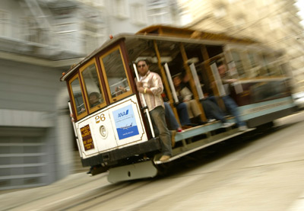
Evaluating systems: Arguments from philosophy
Main theoretical perspectives and proponents:
Utilitarianism (outcomes-based; Bentham, Mill)
Social contract/deontology (duty-based; Kant, Rawls, Sen)
The Trolley problem (Foot, 1967)
illustration:
5 v. 1: two different tracks
5 v. 1: 1 fat man on the track
5 v. 1: 5 transplants v. 1 healthy person

Slide 43
Final thought
Once a new technology rolls over you,
if you are not part of the steamroller,
you are part of the road
- Stewart Brand, in Whole Earth, 2012

Slide 44
Selected references
Hoang, G., & Kunnan, A. J. (in press). Automated writing instructional tool for English language learners: A case study of MyAccess. Language Assessment Quarterly.
Liu, S. & Kunnan, A. J. (in press). Automated scoring of writing: A case study of WriteToLearn. CALICO journal.
Shermis, M. & Burstein, J. (2013). Handbook of automated essay evaluation. Mahwah, NJ: Routledge.

Slide 45
The end
Thank You!
For more details, see:
www.antonykunnan.com

