Slide 1
A Study of Machine Reading:
Solving Math Word Problems in a Human Comprehensible Way
Keh-Yih Su
Institute of Information Science, Academia Sinica
CCL-15, November 14, 2015

Slide 2


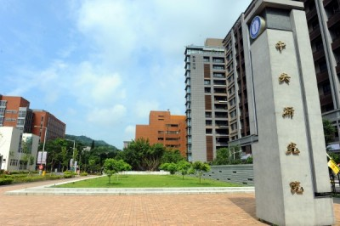
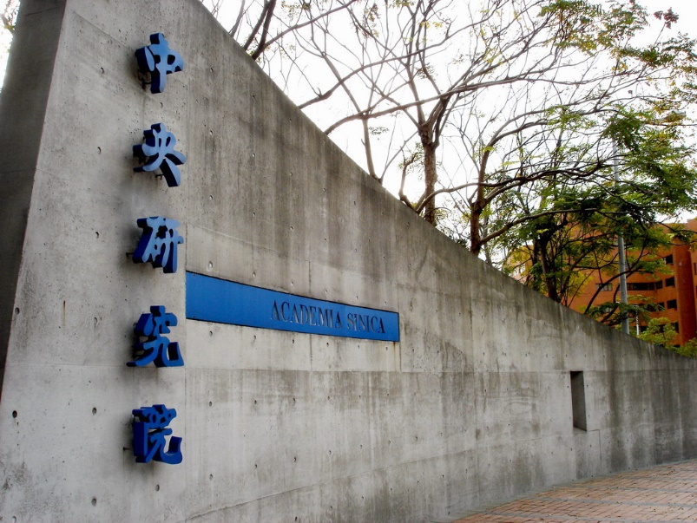
Academia Sinica
Founded on June 9, 1928
The highest Research Organization in Taiwan
24 research institutes & 7 research centers
Taiwan International Graduate Program (TIGP) with domestic Universities since 2002; 12 Cross-Domain PhD programs; 253(56%) students from 41 countries
Researcher | Research technicians | Postdoc | Admin | RA | Graduate
924 | 95 | 1,063 | 273 | 3,475 | 1,921
Ref: 2014/11

Slide 3

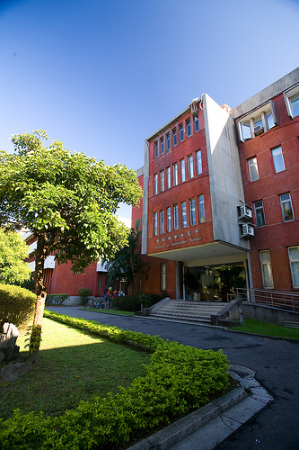
Institute of Information Science
Established in September 1982
PhD program established in
「Social Networks & Human-Centered
Computing」& Bioinformatics
under the auspices of TIGP since 2002,
34 students currently
Research Groups
Bioinformatics Group | Computer System Group
Data Management and Information Discovery Group | Multimedia Technologies Group
Natural Language and Knowledge Processing Group | Network System and Service Group
Programming Languages and Formal Methods Group | Computation Theory and Algorithms Group
Ref: http://douglas-cyli.blogspot.tw/2008/12/cover-photo-iis-academia-sinica.html
Researcher | Postdoc | RA & Admin | TIGP Student
40 | 43 | 270 | 34
Ref: https://iiswww.iis.sinica.edu.tw/page/aboutus/DirectorsMessage.html?lang=zh

Slide 4



Natural Language & Knowledge Processing Group
Research on
  Knowledge Acquisition
  Knowledge Representation
  Knowledge Utilization
Laboratories, 5 Researchers
Project – Machine Reading (3 PIs)
Chinese Document Processing Lab | Chinese Knowledge & Information Processing
Machine Learning and Classification Lab | Intelligent Agent Systems Lab
Speech, Language, and Music Processing Lab | Natural Language Understanding Lab
http://thumbs.dreamstime.com/z/o-rob-branco-leu-o-livro-19714258.jpg
https://cheap.buyessay.org/blog/wp-content/uploads/2015/02/robot_book.jpg

Slide 5
A Group Project
  Project： Designing and Building a Domain Dependent Machine Reading System
  Principal Investigator： Keh-Yih Su (蘇克毅)
  Members： Lun-Wei Ku (古倫維)， Wei-Yun Ma (馬偉雲)
Goal：Design and build a Natural Language Understanding (NLU) platform, and then construct a domain-dependent Machine Reading system on it.
Period：3 Years (2015-2017)

Slide 6
    What is Machine Reading (MR)?
  Read the given text/document, convert the content into logical form, and then perform inference on it.
  Evaluated by Reading Comprehension Test
  An inter-discipline research (NLP+KRR+ML)
    Natural Language Processing (NLP)
    Knowledge Representation and Reasoning (KRR)
    Machine Learning (ML)

Slide 7
    Why Machine Reading? (1)
  Big Mechanism
    DARPA, July 2014
    Seek “why” behind big data
  Big Data alone is not enough
    Aims to explore the correlation between surface features, not their causality relationship
    Only provide surface information, not true knowledge
      Event_A -> Event_B: O(mxn)
    The causality relationship can greatly reduce the complexity that we need to handle, and can interpret the observed phenomena concisely and easily

Slide 8
    Why Machine Reading? (2)
  Why Big Mechanism?
    Evolution of our brain capability cannot compete with the knowledge growing speed
    Each researcher is forced to focus on a very narrow topic, unaware of progress in other disciplines
    Many complicated systems are studied piecewisely, and their literatures and data are fragmented
    Need a mechanism to handle complicated systems in which interactions have important causal effects.
  Emphasize signaling pathways in cancer biology

Slide 9
    Why Machine Reading? (3)
  How is Machine Reading related to Big Mechanism?
    The pre-requisite for Big Mechanism that is that we can read each document and learn its associated knowledge
    Machine Reading is able to give the answer that is implied in the text
      Open-domain Q&A only aims to find out the text passage that contains the answer

Slide 10
    Related Work (1)
  Related preliminary researches (IE, Q&A)
    Information Extraction
      Fill in specified templates for a given domain
      Switching domains implies to re-train the system
    Open Domain Question and Answering
      Extract desired answer passage from the text
      Cannot answer even the simple problem if the desired answer is not included in the text

Slide 11
    Related Work (2)
  MR related research activities
    A MR program was initiated at DARPA (2009/6 – 2012/1)
      Learn to read, and read to learn what they need in order to answer questions or perform some reasoning tasks
    Under another project called Deep Exploration and Filtering of Text (DEFT) since June 2012
    Conducted at Europe under the CLEF Initiative (Conference and Labs of the Evaluation Forum
    At NTCIR in Japan, and under the Forum for Information Retrieval Evaluation (FIRE) in India

Slide 12

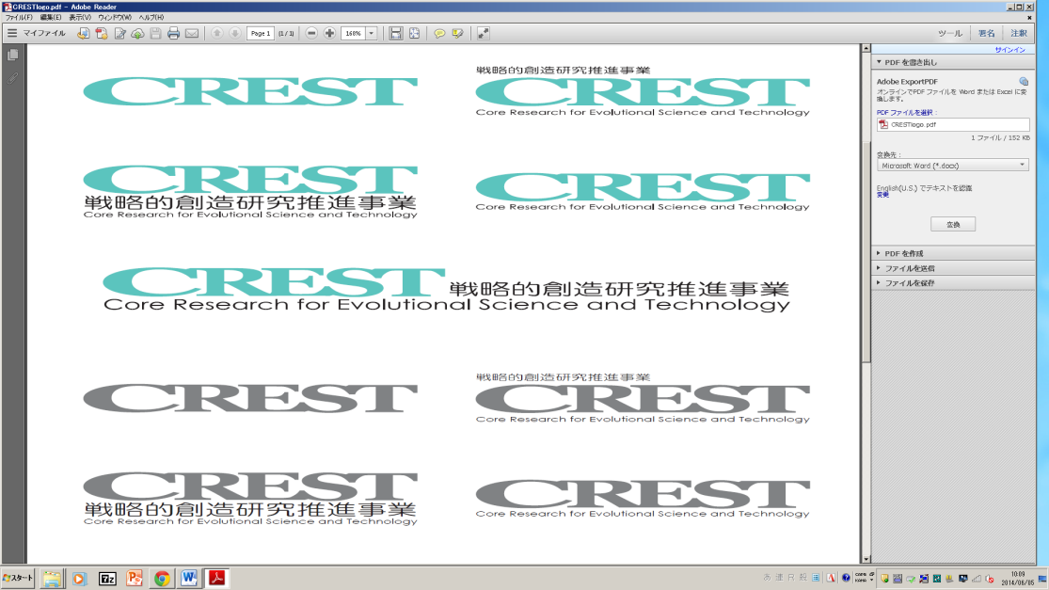
Knowledge Discovery through
Structural Document Understanding
Yuji Matsumoto
(Nara Institute of Science and Technology)
Big Data Application
（2015.10-2021.3)
October 27, 2015
Academia Sinica
Background
Rapid increase of scientific / technical documents
Web of Science and Scopus cover 23M and 53M technical papers
Unable for researchers to read all of related papers
Aim
Developing and deepening Text/Document analysis technologies
Implementing content-aware document retrieval and recommendation
Enabling novel knowledge acquisition and surveillance
All of those will be done through various levels of structure analysis of documents

Slide 13
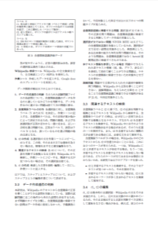
Overview of the Project
Text/Document Analysis
(T1, T5)
Knowledge Base Construction
(T2, T3, T4)
Structural Similarity Analysis
(T6, T7)
User Interface / Survey Generation
(T8, T9)
Inner-Document Analysis
Inter-Document Analysis
Text/Document
Analysis
Concept/Relation
Analysis
Event Chain Analysis
Document Structure Analysis
Document Summarization
Citation Analysis
Document Relation
Document Similarity
Multi-Document Summarization
Survey Generation
User Interface / Document Visualization

Slide 14

Robot for
College Entrance Examination
Fu Hongguang
University of Electronic Science and Technology of China
2015/11/13

Slide 15
Mainland 863 Project
  “Key technologies of simulating human intelligence based on big data”
  How to test these technologies in AI?
  Robot for College Entrance Examination:
      Chinese – HIT(Harbin Inst. of Technology)
      History – ISCAS(Inst. Of Software CAS)
      Geography – Nanjing University
      Mathematics – UESTC
Notes:
类人答题过程-即像中学生一样的解题过程。

Slide 16






Reasoning Engine & ML
NLP
Knowledge Base
Rules & Functions

Slide 17
System Conceptual Diagram
User
DIKB
KB Constructor
Text
DDKB
Query-Sentence
~
QLF
Query Logic Form
Constructed KB
Inference Engine
ANS
Dialogue Manager
ALF
QLF
Dialogue History

Slide 18
KB Constructor (DI)
Operation Flow Controller
Component Processor (1)
Instantiated with a specified list which specifies the sequence of component processors
Constructed KB Sequence
Component Processor (2)
KB (1), KB (2), …
…
Component Processor (M)

Slide 19
Component Processors (1)
Sentence Segmenter
Named Entity Recognizer
Tokenizer (Chinese Word Segmenter)
POS-tagger
Parser/Chunker
Deep Syntactic Tree Converter (Insert Pro)
Lexicon/Word Sense Disambiguation
Semantic Role Labeling (Assign Case)

Slide 20
Component Processors (2)
Anaphora/Co-reference Resolver
Discourse Structure Analyzer
Sentiment Analyzer
Question Type Identifier
Logic Form Converter
Answer Verifier
…

Slide 21
MWP: A First Case for MR
The math word problem (MWP) is chosen as the first test case to study MR.
  The answer cannot be extracted by simply performing keyword matching (beyond Q&A).
  Adopts less complicated syntax; Requires less amount of domain knowledge.
  Body part of MWP usually consists of only a few sentences.
  Standalone applications. (e.g. computer tutor)

Slide 22
What are Math Word Problems ?
Math Word Problems:
Not Math Word Problems:
文具店進貨2361枝紅筆和1587枝藍筆, 文具店共進貨幾枝筆?
原子筆每枝20元，鉛筆每枝5元，姐姐買了24枝筆，共付了270元， 兩種筆各買幾枝？
一艘輪船20分鐘可以行駛25公里，2.5小時可以行駛多少公里？
小天的跳遠紀錄是1.3公尺，小美的紀錄是1.03公尺，小綜的紀錄是1.33公尺。三人中誰跳得最遠？
2 x 3 +5 = ?

Slide 23
Previous Approaches (1)
Rule-based approaches with logic inference (Bobrow, 1964): STUDENT
  Use “Format Matching” to convert a sentence into logic statements
  Input:
    “The price of a radio is 69.70 dollars. If this price is 15 percent less than the marked price, find the marked price.”
  Equations:
    (EQUAL X00001 (Marked Price) )
    (EQUAL (Price of Radio) (TIMES 0.85 (Marked Price) ) )
    (EQUAL (Price of Radio) (TIMES 69.70 (Dollars) ) )
  Answer:
    “The marked price is 82 dollars.”

Slide 24
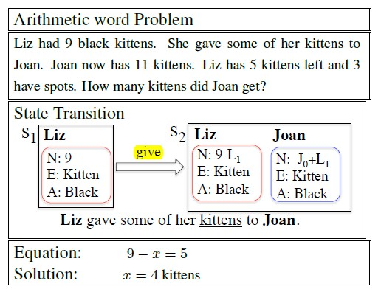
Previous Approaches (2)
Rule-based approaches without logic inference (Charniak, 1968; Dellarosa, 1986; …., Hosseini, 2014):
  Arithmetic word problems(additions, subtractions)
  Describe a partial world state
  Update or elaborations on the state (Verb classify)
  End with linear algebraic equations

Slide 25
Hosseini, 2014 (1/2)
Category | Example
Observation | There were 28 bales of hay in the barn.
Positive | Joan went to 4 football games this year.
Negative | Joan lost 3 of the violet balloons.
Positive Transfer | Mike’s dad borrowed 7 nickels from Mike.
Negative Transfer | Jason placed 131 erasers in the drawer.
Construct | Karen added 1/4 of a cup of walnut to a batch of trail mix.
Destroy | The rabbits ate 4 of Dan’s potatoes.
One container
Two container

Slide 26
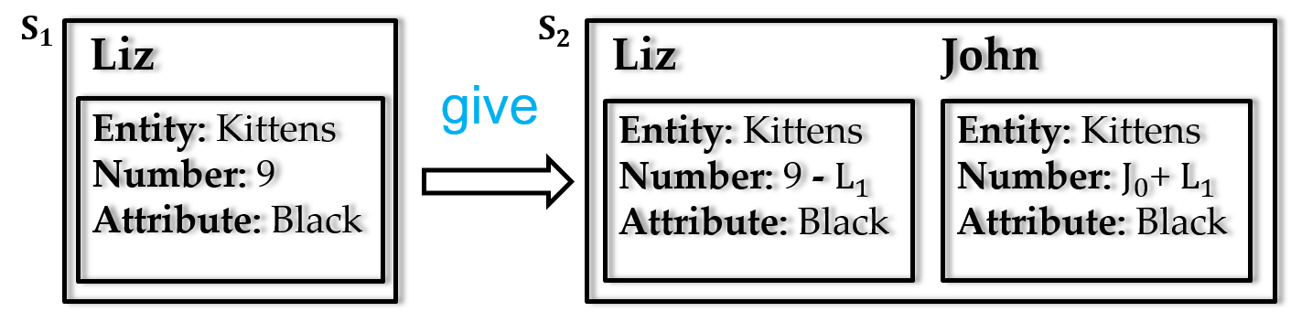
Hosseini, 2014 (2/2)
Liz had 9 black kittens. She gave some of her kittens to John.
Grounding into Entities and Containers
[ give, 9 black kittens, Liz, John ]
Classify Verb Categories
(Liz, give): Negative
(John, give): Positive
Forming State Transitions and Equations

Slide 27
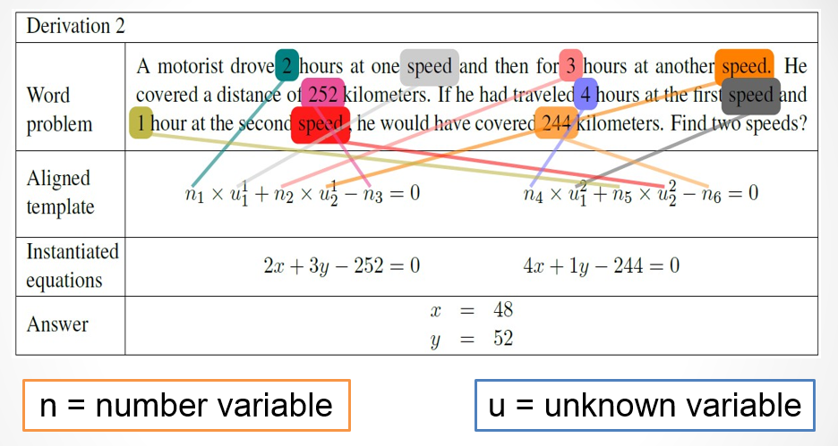
Previous Approaches (3)
Purely statistical approaches (Kushman etc., 2014; Roy et al., 2015):
  Linear algebraic questions
  Mapping problem to a set of equations
  Generate numerical answers

Slide 28

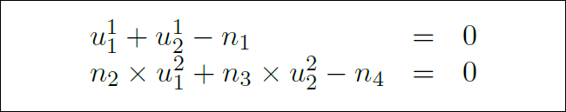
Kushman et al., 2014 (1/4)
Dataset: Algebra.com
  Linear algebra question (#514)
Manually label equation
Generalize equation to a template with two rules

Slide 29
Kushman et al., 2014 (2/4)
  Try each template and variable alignment with a score
u1 + u2 = n1
n3*u1 + n4*u2 = n5
u1 + n1*u2 = n2
n3*u1 + n4*u2 = n5
Word problem
. . . .
2X + 3Y = 252
4X + Y = 244
. . . .
u1 + u2 = n1
u1 + u2 = n2

Slide 30
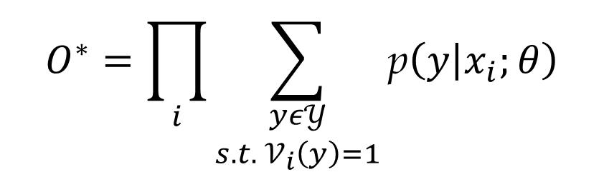
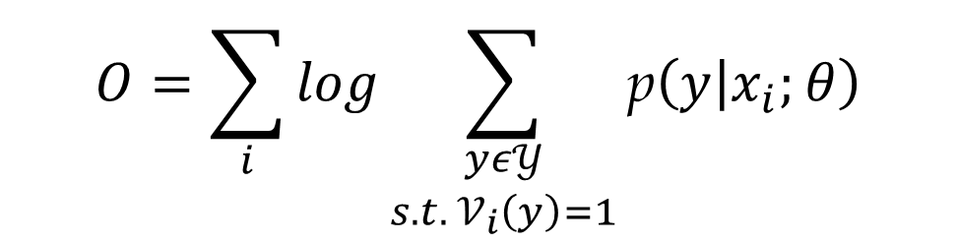
Kushman et al., 2014 (3/4)
  Objective function
$$O^{∗}=\prod_{i}{\sum_{\begin{aligned}yε𝒴 \\ s.t. 𝒱_{i}\left(y\right)=1\end{aligned}}{\text{p}\left(y | x_{i};θ\right)}}$$
$$O=\sum_{i}{log\sum_{\begin{aligned}yε𝒴 \\ s.t. 𝒱_{i}\left(y\right)=1\end{aligned}}{\text{p}\left(y | x_{i};θ\right)}}$$

Slide 31


Kushman et al., 2014 (4/4)
Parameter estimation
  Fully supervised
    Only expanding variable alignment
  Semi-supervised
    Expanding both template matching and variable alignment
V: validation function

Slide 32
Experiment and Result (1/7)
Dataset: Algebra.com
  Get only linear algebra question
  Randomly chose 1024 question.
  Amazon Mechanical Turk workers clean dataset.
    Problem
    Equation
    Numeric answer
  Left problems which the associated system template appeared over than 6 time.

Slide 33
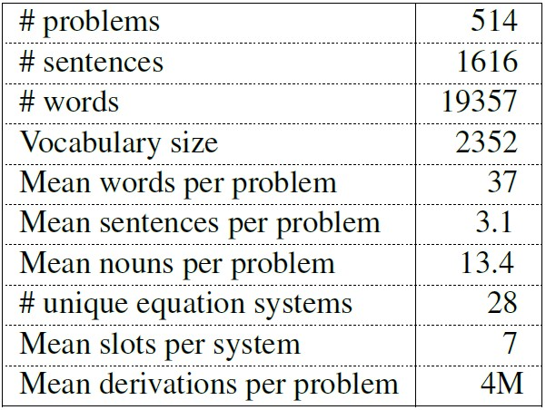
Experiment and Result (2/7)

Slide 34
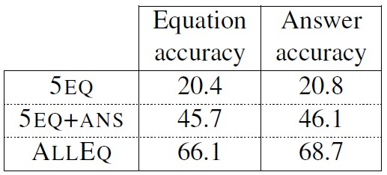
Experiment and Result (3/7)
5-fold cross-validation (Train #400, Test #100)
Semi-supervised
  5EQ: 5 seed questions annotated with equation
  5EQ+ANS: 5 seed questions annotated with equation
  + answers of remaining problems
Fully supervised
  ALLEQ: full equation systems

Slide 35
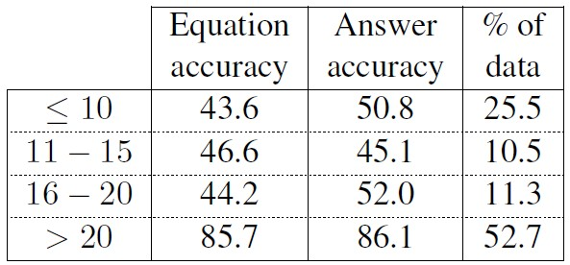
Experiment and Result (4/7)
Performance on different template frequencies for ALLEQ

Slide 36
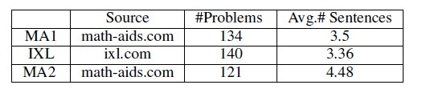
Experiment and Result (1/2)
MA1: Simple Problems
IXL: More complicated sentences
MA2: Irrelevant info
395 problems, 13,632 words, 188 verbs, and 1,483 sentences.

Slide 37
Experiment and Result (1/2)
Joan found 70 seashells on the beach . she gave Sam some of her seashells . She has 27 seashell . How many seashells did she give to Sam ?
MA1: Simple Problems
IXL: More complicated sentences
MA2: Irrelevant info
395 problems, 13,632 words, 188 verbs, and 1,483 sentences.

Slide 38
Experiment and Result (1/2)
Joan found 70 seashells on the beach . she gave Sam some of her seashells . She has 27 seashell . How many seashells did she give to Sam ?
MA1: Simple Problems
IXL: More complicated sentences
MA2: Irrelevant info
395 problems, 13,632 words, 188 verbs, and 1,483 sentences.
A ship is filled with 5973 tons of cargo . It stops in the Bahamas , where sailors load 8723 tons of cargo onboard . How many tons of cargo does the ship hold now ?

Slide 39
Experiment and Result (1/2)
Joan found 70 seashells on the beach . she gave Sam some of her seashells . She has 27 seashell . How many seashells did she give to Sam ?
MA1: Simple Problems
IXL: More complicated sentences
MA2: Irrelevant info
395 problems, 13,632 words, 188 verbs, and 1,483 sentences.
A ship is filled with 5973 tons of cargo . It stops in the Bahamas , where sailors load 8723 tons of cargo onboard . How many tons of cargo does the ship hold now ?
Jason found 49 seashells and 48 starfish on the beach . He gave 13 of the seashells to Tim . How many seashells does Jason now have ?

Slide 40
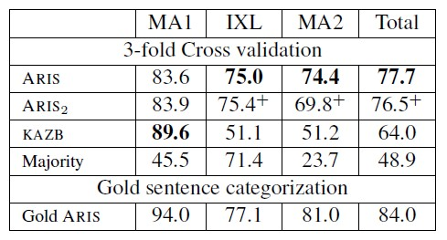
Experiment and Result (2/2)
KAZB: Learning to align problems to templates
ARIS2: No verb is repeated in train and test set
Majority: All verbs are assumed to be positive
Gold ARIS: Uses correct verb categories

Slide 41
Drawback of Previous Works
Weakness of rule-based approaches:
  Difficult to raise the coverage rate and deal with ambiguities.
  Expensive to construct.
Weakness of not adopting logic inference:
  Need to implement a new handling procedure for each new type of problems (as the general logic inference mechanism is not adopted).
  No inference engine to generate the reasoning chain, additional effort would be required for generating the explanation.
Weakness of purely statistical approaches:
  No understanding.
  System is sensitive to irrelevant information.

Slide 42
Design Principles (1/2)
Problems should be solved via understanding and inference
  versus the purely statistical approach which does not perform language analysis
  MWP is only our first task for MR
Able to handle various kinds of questions
文具店進貨2361枝紅筆和1587枝藍筆，賣了100枝藍筆，
還剩幾枝筆?還剩幾枝藍筆?共進貨幾枝紅筆? 共進貨幾枝筆?
共賣了幾枝筆? 小明共進貨幾枝筆?
Ref: "Seminar 2015-03-17 ProposedApproach.ppt" by Dr. Lin

Slide 43
Design Principles (2/2)
Not favor any specific kind of problem/question
  Inference Engine (IE) should not adopt a pre-specified hierarchical structure
IE should only deal with domain dependent generic concepts (instead of complicated problem dependent concepts)
  Example: “100顆糖裝成5盒糖, 1盒糖裝幾顆糖?”
  Not “裝成(100,顆,糖,5,盒)”
  Prefer “quan(q1,顆,糖) = 100” AND “quan(q2,盒,糖) = 5” AND “qmap(m1,q1,q2)” AND “verb(m1,裝成)”
Ref: "Seminar 2015-03-17 ProposedApproach.ppt" by Dr. Lin

Slide 44
How Human Solve a MWP ?
Math Word Problem
Understand Meaning
Figure out How to Solve It
Math lesson learnt from a math class
Elaborate Detailed Steps
Turning MWP into math equations
Calculation
Solving the equation

Slide 45
Framework
Math Word Problem Paragraph
(body text and questions)
Language Analysis
Semantic Sequences
Solution Type Classifier
Logic Form Converter
Inference Engine
Question-Answer Pairs
Explanation Texts
Explanation Generation

Slide 46
Task
Math word problem (MWP):
文具店進貨2361枝紅筆和1587枝藍筆, 文具店共進貨幾枝筆?
Language Analysis:
S(agent:NP(Head:Ncb:文具店)|Head:VA4:進貨|theme….
{進貨.buy|買:agent={[x1]文具店.{商店|shop:predication={or({buy|買},……
Logic Form (LF):
LF1: verb(v1,進貨)&agent(v1,文具店)&theme(v1,n1)& …
LF2: quan(q1,枝,n1)=2361&verb(q1,進貨)&agent(q1,文具店)&role(q1,theme) …
ASK Sum(quan(?q,枝,n3), verb(?q,進貨)&agent(?q,文具店))
Logic Inference Engine (IE):
(quan(q1,枝,n1_{p})=2361) + (quan(q2,枝,n2_{p})=1587) = 3948
Explanation generation:
共進貨 2361枝紅筆 + 1587枝藍筆 = 3948枝筆

Slide 47
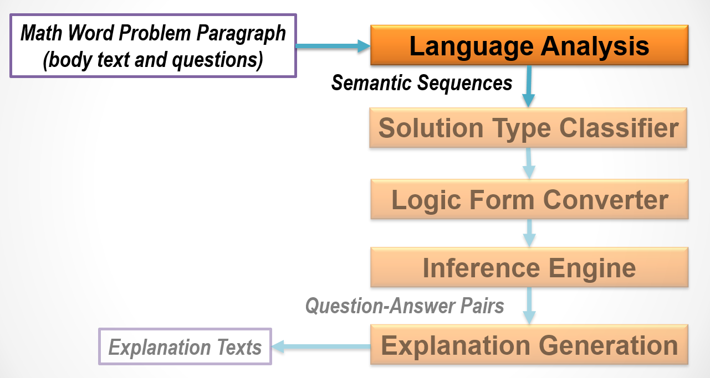

Slide 48
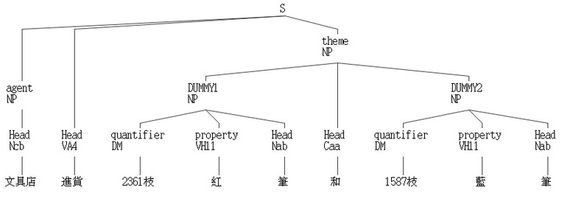
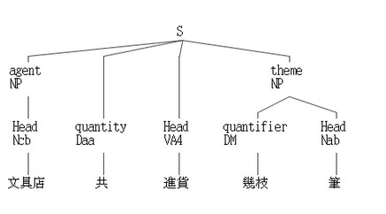
Syntactic/Semantic analysis (1/4)
CKIP Chinese parser
  Generate syntactic structure
Semantic Role Labeling
文具店進貨2361枝紅筆和1587枝藍筆，文具店共進貨幾枝筆？

Slide 49
Syntactic/Semantic Analysis (2/4)
E-Hownet Semantic Composition
  Anaphora: Finding the antecedent for a pronoun.
木工拿出一塊長40cm、寬20cm的長方形木板，他想從中裁出幾個半徑2cm的圓，他最多可以裁出幾個圓形？
{拿出.take|取:
agent={[x1]木工.工人|worker},
theme={[x2]木板.wood|木:
一.quantity={1},
長.length={cm.{公分}:
quantity={40}
},
寬.width={cm.{公分}:
quantity={20}
},
長方形.shape={square|方:length={LengthLong|長}}
},
source={[x]}
{想.{expect|期望}:
experiencer={[x1]他.3rdPerson|他人},
content={裁出.{cut|切削}:
從中.source={[x2]},
patient={[x3]圓.image|圖像:
幾.quantity={Ques|疑問},
半徑.length({[x3]})={cm.{公分}:
quantity={2}
}
},
agent={[x1]}
}
{裁出.{cut|切削}:
agent={[x1]他.3rdPerson|他人},
最多.range={extensive|泛:degree={extreme|極}},
可以.possibility={ish|稍},
patient={[x3]圓形.ShapeValue|形狀值:
幾.quantity={Ques|疑問}
}
}
}

Slide 50
Syntactic/Semantic Analysis (3/4)
Semantic Composition
  Zero-Anaphora:
妹妹1天存150元，365天共可存幾元？
{存.store|保存:
agent={[x1]妹妹.妹妹|YoungerSister},
duration={天.day|日:
quantity={1}
},
theme={元.money|貨幣:
quantity={150}
},
location={[x]}
}
{存.store|保存:
duration={天.day|日:
quantity={365}
},
共.quantity={all|全},
可.possibility={ish|稍},
theme={元.money|貨幣:
幾.quantity={Ques|疑問}
},
agent={[x1]},
location={[x]}
}

Slide 51
Syntactic/Semantic Analysis (4/4)
Semantic Composition
  Co-reference:
    Finding referring expressions that refer to the same entity.
文具店進貨2361枝紅筆和1587枝藍筆，該店共進貨幾枝筆？
{進貨.buy|買:
agent={[x1]文具店},
theme={和.and(
{筆.PenInk|筆墨:
quantity={2361},
color={紅.red|紅}
},
{筆.PenInk|筆墨:
quantity={1587},
color={藍.blue|藍}
}
)},
}
{進貨.buy|買:
agent={[x1]文具店},
共.quantity={all|全},
theme={筆.PenInk|筆墨:
幾.quantity={Ques|疑問}
},
}

Slide 52
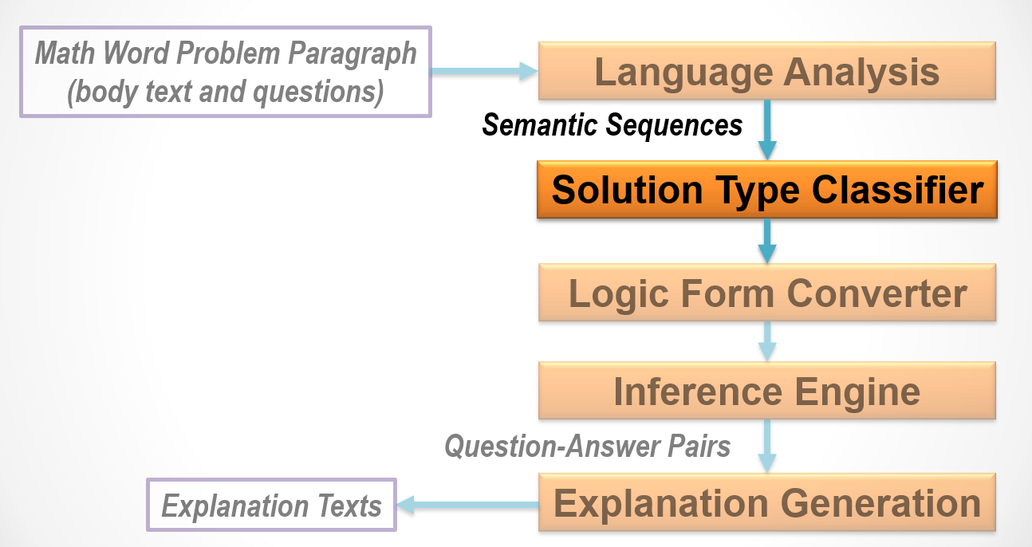
Notes:
到stc

Slide 53
Solution Type Identification (1/3)
For identifying a specific stereotype-solution
  To solve a MWP, it’s not enough to know what MWP means. We need to collect various types of math operations, aggregative operations and specific problem types.
16 different kinds solution types are specified
  Cover a wide variety of questions found in our elementary math corpus.

Slide 54
Solution Type Identification (2/3)
Solution type (ST) with frequency in seed corpus (manually annotated 75 samples).
Multiplication (24%) | Utility (6%) | Surplus (4%) | L.C.M (2%)
Sum (14%) | Algebra (5%) | Difference (4%) | G.C.D (2%)
Subtraction (12%) | Comparison (5%) | Ceil-Division (3%) | Addition (1%)
Floor-Division (7%) | Ratio (5%) | Common-Division (3%) | Set-Operation (1%)
Notes:
在我們的seed corpus裡面 ,
multiplication和sum佔了較大的比例

Slide 55
Solution Type Identification (1/2)
Currently, a SVM classifier with linear kernel function is used and four different kinds of feature-sets are adopted
  Lexicon.
    Ques part with lexicon “共”
  Lexicon pair.
    lexicon pair like “?比?便宜”
  Lexicon and POS pair.
    Pair [Verb, asking unit in Ques part] e.g. [ VC(修築), 天]
  Pattern-matching indicators.
    Relation between object-unit in question sentences and object-unit in body sentences (currently manually created).
動作及物動詞
Notes:
目前stc 是採用svm with linear kernel,
還有四種不同的feature set下去train,
像是unig……

Slide 56
Solution Type Identification (2/2)
Examples:
  Lexicon:
    Example:哥哥買了一本329元的故事書和一枝465元的鋼筆，共花了幾元？Type: Sum
  Lexicon pair:
    Example: 姐姐上個月電話費是562元，這個月比上個月便宜127元，這個月的電話費是幾元？ Type: Subtraction
  <Verb: Lexicon, POS> and <Ques: Unit-Lexicon>pair:
    Example: 一座長8360公尺的高架橋，工人每天修築88公尺，共要花幾天才可以全部修築完成？ [ VC(修築), 天] Type: CeilDiv
  Pattern-matching indicators:
    Example: 妹妹1天存150元，365天共可存幾元？ Type: Multiplication
    “Is the problem contains “two same unit with quantity =1 && quantity > 1”?
Notes:
目前stc 是採用svm with linear kernel,
還有四種不同的feature set下去train,
像是unig……

Slide 57
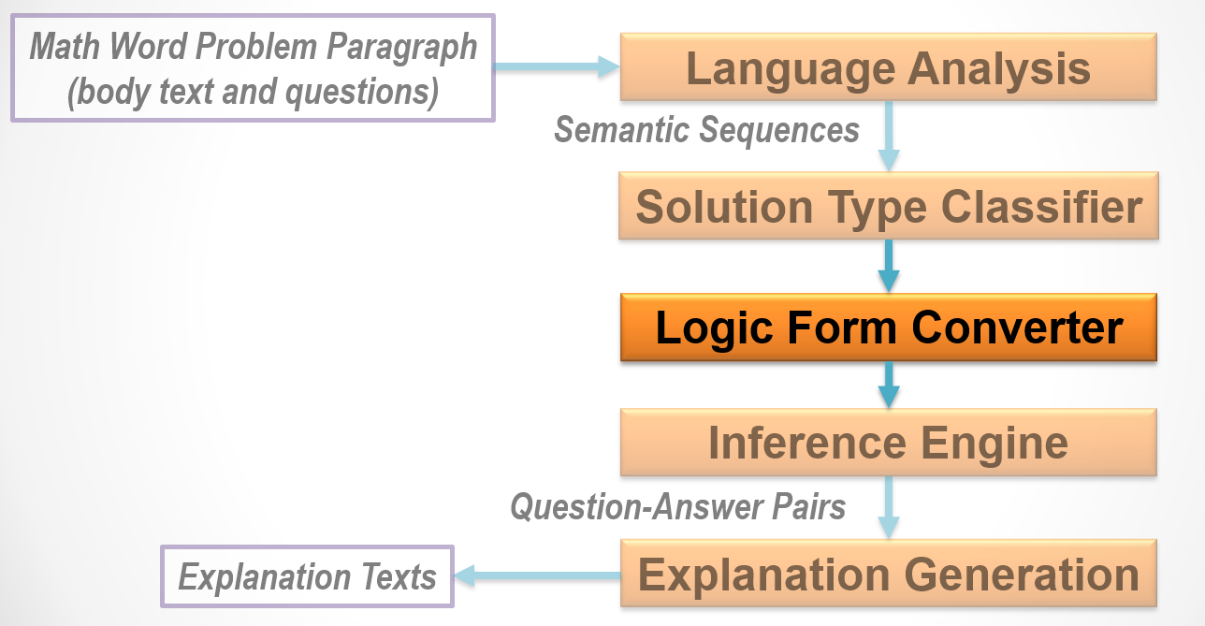

Slide 58
Math Concepts
Math Concepts
300朵玫瑰
→quan(q1,朵,玫瑰)=300
quan(id, unit, obj)=value
q_map(id, quan1, quan2)
u_map(id, unit1, obj1, unit2, obj2)=value
has(container, unit,obj, time-index)=value
circle(id, obj)
regular_triangle(id, obj)
trapezoid(id, obj)
radius(id, unit)=value
diameter(id, unit)=value
top_base(id, unit)=value
bottom_base(id, unit)=value
height(id, unit)=value
circumference(id, unit)=value
side_length(id, unit)=value
area(id, unit)=value
set(id)
member(id, obj)
Notes:
在lfc 有很多的math concepts
利入quantity, 舉個例子, 300朵玫瑰….

Slide 59
Input/Output of Logical Form Converter
SR:
{進貨:
agent={文具店},
theme={和.and(
{筆:
quantity={2361}, unit={枝}, color={紅}},
{筆:
quantity={1587}, unit={枝}, color={藍}})},
…
Semantic
Sequences
(Input)
Logic Form
Converter
LF1:
verb(v1,進貨)&agent(v1,文具店)&theme(v1,j1)
cj_op(j1,and)&cj_arg(j1,n1)&cj_arg(j1,n2)
head(n1,筆)&quantity(n1,2361)&unit(n1,枝)&color(n1,紅)
head(n2,筆)&quantity(n2,1587)&unit(n2,枝)&color(n2,藍)
LF2:
quan(q1,枝,n1)=2361&verb(q1,進貨)&agent(q1,文具店)&role(q1,theme)
quan(q2,枝,n2)=1587&verb(q2,進貨)&agent(q2,文具店)&role(q2,theme)
...
ANS=Sum(quan(?q,枝,n3),verb(?q,進貨)&agent(?q,文具店))
First order
logic
(FOL)-like
statements
(Output)

Slide 60
Logical Form Converter (1/4)
Deterministically convert a tree-like semantic representation into a list of FOL-like statements. (Moldovan, 2011)
文具店 進貨
theme
n1
n2
SR:
{進貨:
agent={文具店},
theme={和.and(
{筆:
quantity={2361}, unit={枝}, color={紅}},
{筆:
quantity={1587}, unit={枝}, color={藍}})},
…
2361 枝 紅 筆
1587 枝 藍 筆
LF1:
verb(v1,進貨)&agent(v1,文具店)&theme(v1,j1)
cj_op(j1,and)&cj_arg(j1,n1)&cj_arg(j1,n2)
head(n1,筆)&quantity(n1,2361)&unit(n1,枝)&color(n1,紅)
head(n2,筆)&quantity(n2,1587)&unit(n2,枝)&color(n2,藍)

Slide 61
Logical Form Converter (2/4)
Non-deterministically detect/extract math concepts and generate associated FOL-like statements.
verb(v1,進貨)&agent(v1,文具店)&theme(v1,j1)
cj_op(j1,and)&cj_arg(j1,n1)&cj_arg(j1,n2)
head(n1,筆)&quantity(n1,2361)&unit(n1,枝)&color(n1,紅)
head(n2,筆)&quantity(n2,1587)&unit(n2,枝)&color(n2,藍)
LF1
&
quan(q1,枝,n1)=2361&verb(q1,進貨)&agent(q1,文具店)&role(q1,theme)
quan(q2,枝,n2)=1587&verb(q2,進貨)&agent(q2,文具店)&role(q2,theme)
LF2

Slide 62
Logical Form Converter (3/4)
Non-deterministically find the arguments of Math operation utilities according to the given “Solution Type”.
文具店共進貨幾枝筆？
SR:
{進貨.buy|買:
agent={文具店….,
共.quantity={all|全},
theme={筆.PenInk|筆墨:
幾.quantity={Ques|疑問}
},
…
LF1:
verb(v2,進貨)&agent(v2,文具店)&mod(v2,共)&
theme(v2,n3)&head(n3,筆)&mod(n3,幾)&unit(n3,枝)
LF2:
ANS=Sum(quan(?q,枝,n3),verb(?q,進貨)&agent(?q,文具店))
Solution Type: Sum

Slide 63
Logical Form Converter (4/4)
Different Questions with the Same Body Text.
Q1: 共進貨幾枝筆?
LF1:
verb(v2,進貨)&agent(v2,文具店)&mod(v2,共)&theme(v2,n3)&
head(n3,筆)&mod(n3,幾)&unit(n3,枝)
LF2:
ANS=Sum(quan(?q,枝, n3),verb(?q,進貨)&agent(?q,文具店))
I.E. binds quan(?q,枝,n3) to
both quan(q1,枝,n1) and quan(q2,枝,n2)
Q2: 共進貨幾枝紅筆?
LF1:
verb(v2,進貨)&agent(v2,文具店)&mod(v2,共)&theme(v2,n3)&
head(n3,筆)&mod(n3,幾)&unit(n3,枝)&color(n3,紅)
LF2:
ANS=Sum(quan(?q,枝,n3),verb(?q,進貨)&agent(?q,文具店))
I.E. binds quan(?q,枝,n3) to quan(q2,枝,n1) only

Slide 64
Operation Utilities
Operation Utilities
Sum(function, condition)=value
Addition(value1, value2)=value
Subtraction(value1, value2)=value
Difference(value1, value2)=value
Multiplication(value1, value2)=value
CommonDiv(value1, value2)=value
FloorDiv(value1, value2)=value
CeilDiv(value1, value2)=value
Surplus(value1, value2)=value
ArgMin(arg,function, condition)=value
ArgMax(arg,function, condition)=value
Get(function, condition)=value

Slide 65
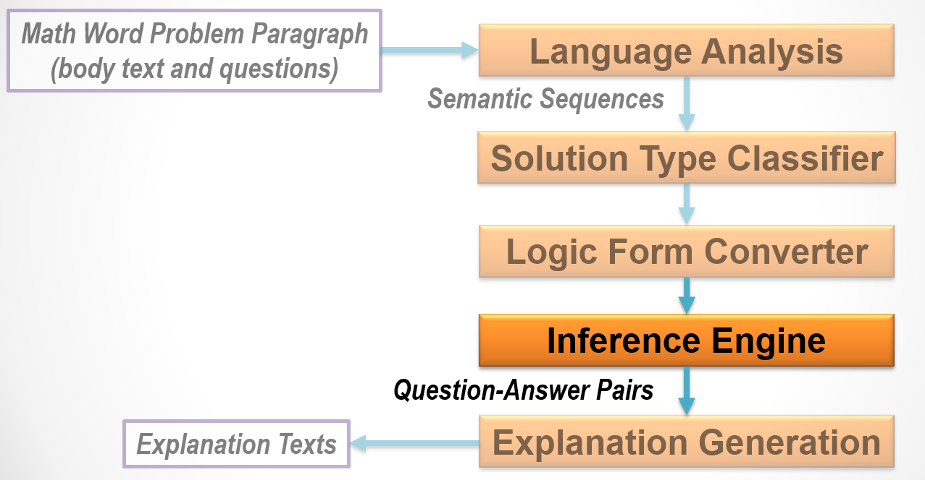

Slide 66
Logic Inference (1/8)
In our design, an Inference Engine (IE) is used to find out the solution for an MWP.
  Capabilities :
  Facts and inference rules are represented in first-order logic (FOL).
Binding variables.
Using inference rules to derive new facts from the old ones provided by LFC.
Providing utilities to perform math operations on related facts.
Notes:
在ie 用來solve mwp
他有幾個goals
像是提供operation utilities, 根據相關的fact找到ans
產生新的fact
做logic binding

Slide 67
Logic Inference (2/8)
The problem which can be calculated from the facts directly derived from MWP:
花店進貨300朵玫瑰和600朵百合, 上午賣出186朵百合,下午賣出234朵，問花店共賣出幾朵百合?
quan(q1,朵,玫瑰)=300&verb(q1,進貨)&agent(q1,花店)&…
quan(q2,朵,百合)=600&verb(q2,進貨)&agent(q2,花店)&…
quan(q3,朵,百合)=186&verb(q3,賣出)&agent(q3,花店)&…
quan(q4,朵,百合)=234&verb(q4,賣出)&agent(q4,花店)&…
ASK Sum(quan(?q,朵,百合),verb(?q,賣出)&agent(?q,花店))
quan3 + quan4 = 186 + 234
= 420
Notes:
這樣的一個mwp , ie 根據lfc 產生的fact做binding
可以看到 最後問的是 “賣出, 花店”
Ie 在座binding 就不會去找到 不相關的 quantity (進貨) 可以filter掉 irrelevant information
相較於 以前的work, 不知道這些attribute, 就可能會把irrelevant quantity 來做計算.

Slide 68
Logic Inference (3/8)
The problem which needs to derive new facts according to background knowledge:.
爸爸買了3本329元的故事書和2枝465元的鋼筆，爸爸共要付幾元?
quan(q1,本,n1_{p})=3&verb(q1,買)&agent(q1,爸爸)&
head(n1_{p},故事書)&price(n1_{p},329)
quan(q2,枝,n2_{p})=2&verb(q2,買)&agent(q2,爸爸)&
head(n2_{p},鋼筆)&price(n1_{p},465)
ASK Sum(quan(?q,元,#),verb(?q,付)&agent(?q,爸爸))
quan(q1,本,n1)&verb(q1,買)&agent(q1,爸爸)&price(n1,329)
→quan(q3,元,#)=quan(q1,本,n1)×329&verb(q3,付)&agent(q3,爸爸)
quan(q1,本,n1)×329=3×329=987
→quan(q3,元,#)=987&verb(q3,付)&agent(q3,爸爸)
Notes:
Ie 還會根據lfc 給的fact 產生新的fact,
像是”3本329元”
在lfc 會得到的fact 就是 q1…….q2……

Slide 69
Verb entailment (1/2)
The MWP might adopt different verbs among body text and question text.
爸爸買了3本329元的故事書和2枝465元的鋼筆，爸爸共要付幾元?
quan(?q,?u,?o)&verb(?q,買)&agent(?q,?a)&price(?o,?p)
→quan($q,元,#)=quan(?q,?u,?o)×?p&verb($q,付)&agent($q,?a)
Verb entailment required
Notes:
有些問題, 在q的verb 和 body 的verb 不一樣, 在binding 的時候可能會miss match
例如, 因為”買” , 所以要”付” ie 必須要了解 verb之間存在有意義的關係, 用v e

Slide 70
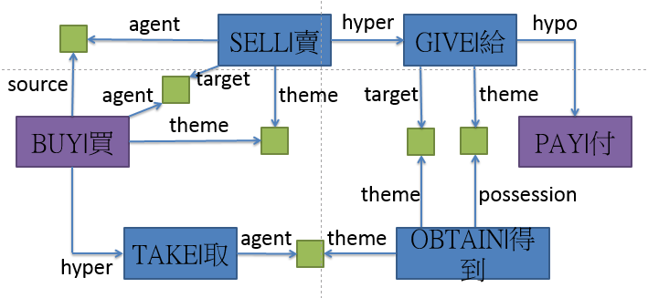
Verb entailment (2/2)
Given an order verb pair (買, 付) as input, we want to detect whether the entailment relation ‘買→付’ holds for this pair.
  E-HowNet is adopted as the knowledge base for solving this problems.

Slide 71
Logical Form Converter (4/8)
E.g.奇幻森林裡有4256棵樹，每38棵劃分成1區，共可劃分成幾區？
共可劃分成幾區？
SR:
{劃分成(3):
quantity={共(1)},
epistemics={可(2)},
range={區(5):
quantifier={幾(4}
},
theme={[x1]}
}
共(1,Daa): {all|全}
可(2,Dbaa): possibility={ish|稍}
劃分成(3,VG2): {become|成為:means={classify|分類}}
幾(4,Neqa): quantity={Ques|疑問}
區(5,Ncb): {district|區}
LF1:
verb(v3,劃分成)&quantity(v3,共)&epistemics(v3,可)&
range(v3,n4)&head(n4,區)&quantity(n4,幾)
LF2:
ANS=CeilDiv(quan(q1,棵,樹),u_map(?m,#,區,棵,樹)&
verb(?m,劃分成))
quan(q1,棵,樹)=4256 & quan(q2,棵,樹)=38 & qmap(m1,q1,q2) & verb(m1,劃分成)
=> u_map(m1, #,區,棵,樹): 1區樹?棵
Solution Type: CeilDiv
Notes:
另外lfc 還會根據stc 所給的type
找到operation utilities 的argument.

Slide 72
Logical Form Converter (5/8)
E.g. 1個平年有365天，3個平年共有幾天？
3個平年共有幾天？
SR:
{有(4):
theme={平年(2):
quantifier={３個(1)}
},
quantity={共(3)},
range={幾天(5)}
}
３個(1,DM): quantifier={個.null|無義:quantity={3}}
平年(2,Nac): {year|年:predication={exist|存在:theme={day|日:quantity={365}},topic={~}}}
共(3,Daa): {all|全}
有(4,V_2): {exist|存在}
幾天(5,DM): 天.time={day|日:幾.quantity={Ques|疑問}}
LF1:
verb(v2,有)&topic(v2,n3)&quantity(v2,共)&theme(v2,n4)&head(n3,平年)&quantity(n3,3)&unit(n3,個)&head(n4,天)&quantity(n4,幾)
LF2:
ANS=Multiplication(quan(q3,個,平年),u_map(?m,個,平年,天,#)&verb(?m,有))
quan(q1,個,平年)=1 & quan(q2,天,#)=365 & qmap(m1,q1,q2) & verb(m1,有)
=> u_map(m1, 個,平年,天,#): 1個平年?天
Solution Type: Multiplication
Notes:
另外lfc 還會根據stc 所給的type
找到operation utilities 的argument.

Slide 73
Logical Form Converter (6/8)
E.g. 2.32公升的水和2.294公升的果汁，哪一種比較少？
哪一種比較少？
SR:
{少(3):
theme={飲料(1.1):
quantifier={[x1,x2]哪一種(1)}
},
degree={比較(2)}
}
哪一種(1,DM): quantifier={種.kind({entity|事物}):一.quantity={1}},哪.quantifier={Ques|疑問}
飲料(1.1,Naa): {drinks|飲品}
比較(2,Dfa): degree={more|較}
少(3,VH13): {few|少}
LF1:
verb(v1,少)&theme(v1,n3)&degree(v1,比較)&head(n3,j1)&quantifier(n3,哪)&qualification(n3,u3)&head(u3,種)&quantity(u3,1)
LF2:
set(s1)&member(s1,水)&member(s1,果汁)
Ans=ArgMin(quan(?q,?u,?o)&member(s1,?o))
Solution Type: Comparison
Notes:
另外lfc 還會根據stc 所給的type
找到operation utilities 的argument.

Slide 74
Logical Form Converter (7/8)
E.g.長３公尺、寬２公尺的長方形，面積是多少平方公尺？
面積是多少平方公尺？
SR:
{是(2):
theme={[x2]面積(1)},
range={多少平方公尺(3)}
}
面積(1,Nad): {area([x1])}
是(2,V_11): {be|是}
多少平方公尺(3,DM): 平方公尺.size={平方公尺:多少.quantity={Ques|疑問}}
長3公尺、寬2公尺的長方型，
SR:
{[x1]長方形(7):
property={的(6):
head={、(3):
DUMMY1={長(1):
range={３公尺(2)},
theme={[x1]}…,
DUMMY2={寬(4):
range={２公尺(5)},
theme={[x1]}
}…
長(1,VH12): length={}
３公尺(2,DM): 公尺.length…
、(3,Caa): {and()}
寬(4,VH12): width={}
２公尺(5,DM): 公尺.length…
的(6,DE): relation({entity|事物})
長方形(7,Nac): shape={square|方:length={LengthLong|長}}
LF1:
head(n1,長方形)&property(n1,的)&head(n1,、)&verb(n1,長)&range(n1,公尺)&quantity(n1,3)&theme(n1,長方形)&verb(n1,寬)&range(n1,公尺)&quantity(n1,2)&theme(n1,長方形)
LF2:
  quan(q1,公尺,#)=3&quan(q2,公尺,#)=2
  rectangle(o1)&length(o1,公尺)=3&width(o1,公尺)=2
LF1:
verb(v1,是)&theme(v1,n2)&range(v1,n2)&
head(n2,面積)&unit(n2,平方公尺)&quantity(n2,多少)
LF2:
ANS=Area(o1,平方公尺)
Solution Type: Utility
Notes:
另外lfc 還會根據stc 所給的type
找到operation utilities 的argument.

Slide 75
Logical Form Converter (8/8)
E.g.每邊長13公分的正三角形和每邊長10公分的正三角形，周長相差幾公分？
周長相差幾公分？
SR:
{相差(2):
theme={周長(1)},
range={幾公分(3)}
}
周長(1,Nad): length({edge([x1,x2])})
相差(2,VJ3): {different|異:range={}}
幾公分(3,DM): 公分.length={公分:幾.quantity={Ques|疑問}}
LF1:
verb(v1,相差)&theme(v1,周長)&range(v1,n3)&unit(n3,公分)&quantity(n3,幾)
LF2:
regular_triangle(o1) & length(o1,公分)=13
regular_triangle(o2) & length(o2,公分)=10
ANS=Difference(circumference(o1,公分), circumference(o2,公分))
Solution Type: Difference
Notes:
另外lfc 還會根據stc 所給的type
找到operation utilities 的argument.

Slide 76
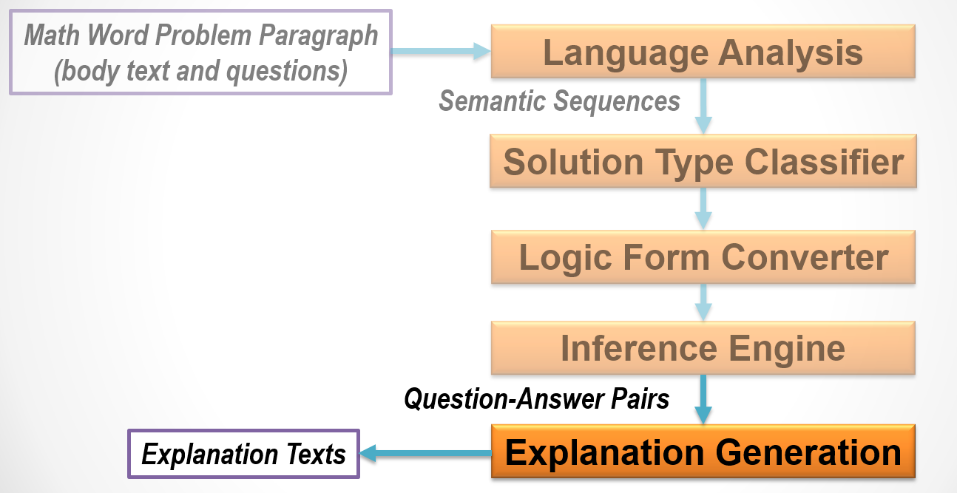

Slide 77
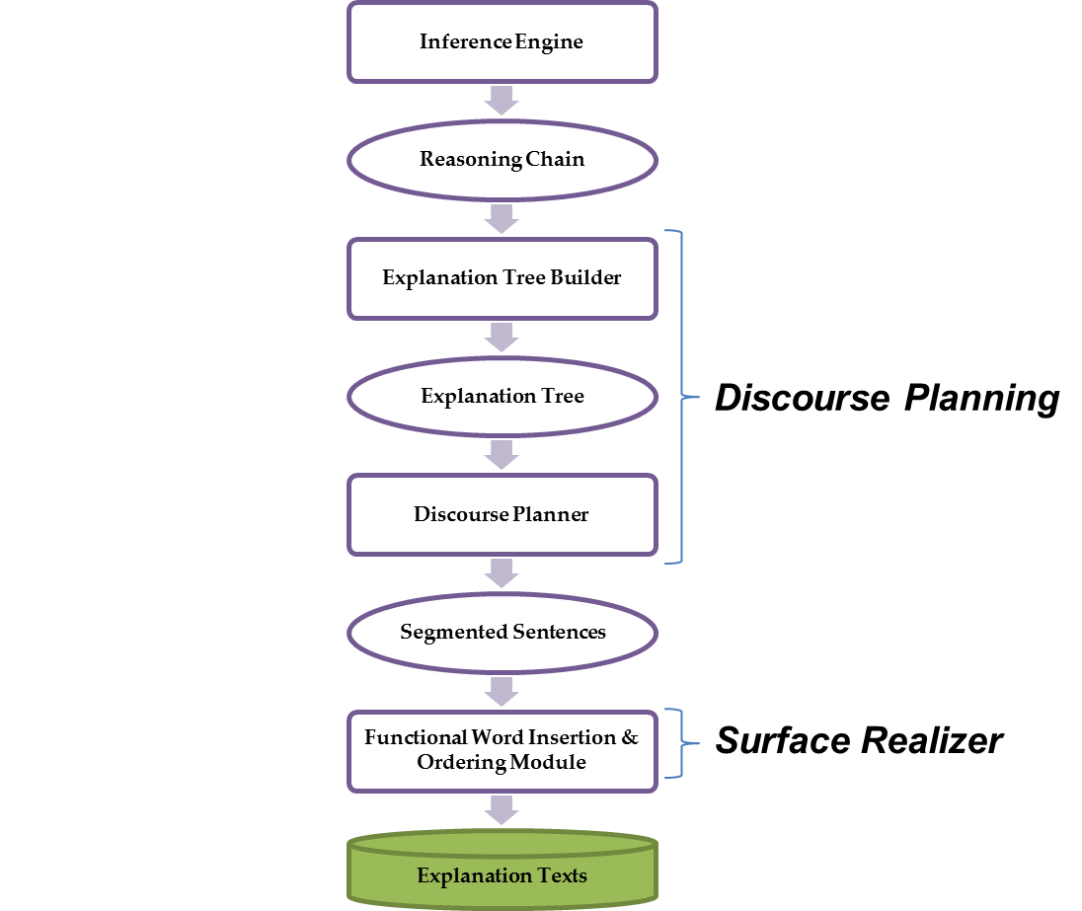
Explanation Generation (1/4)
EG Architecture of MWP
MWP Explanation
Generator
(Text Generator)
Notes:
Figure 3 shows the block diagram of our proposed EG.
First, the Inference Engine generates the answer and its associated reasoning chain for the given math problem. To ease the operation of the EG, we first convert the given reasoning chain into its corresponding Explanation Tree (shown at Figure 5) to center on each operator appearing in the MWP (which is convenient to perform sentence segmentation later).
Next, the Explanation Tree will be fed as input of Discourse Planner. The last stage is the Function Word Insertion & Ordering Module, which inserts the necessary functional words to the segmented sentences (resulted from Discourse Planner) and generates the Explanation Texts.

Slide 78
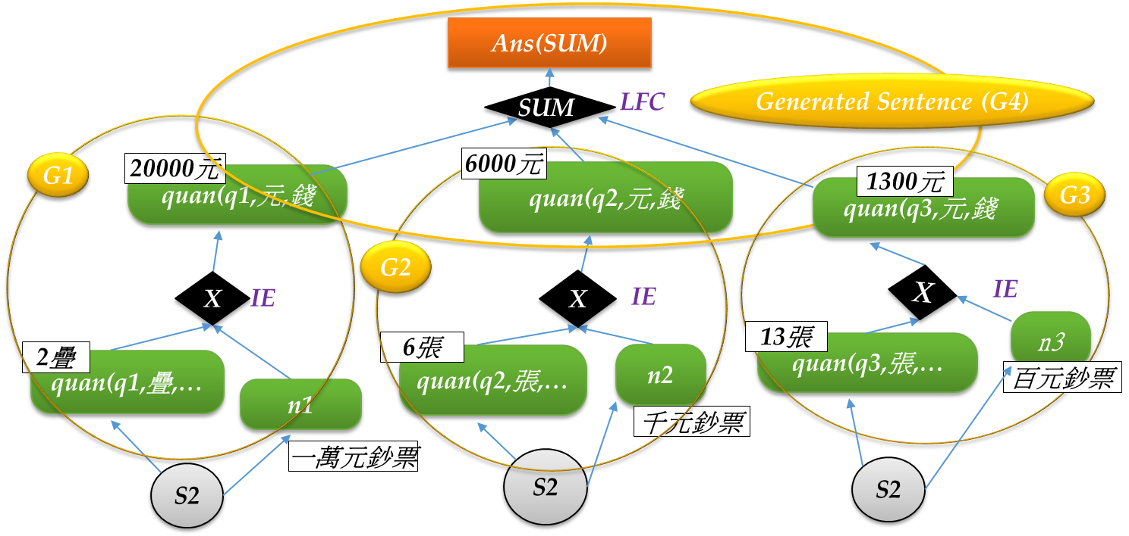
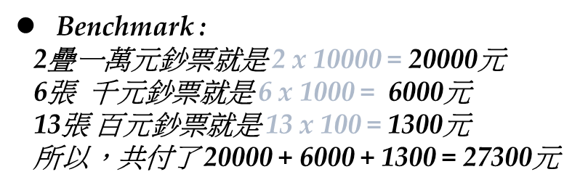
Explanation Generation (2/4)
1. 阿志買一臺冰箱和一臺電視機， 付2疊一萬元鈔票、6張千元鈔票和13張百元鈔票， 阿志共付了幾元？
SUM(quan(q?,…))
Notes:
Figure shows that three sets of facts are originated from the 2nd body sentence (indicated by three S2 nodes). Each set contains a corresponding quantity-fact (e.g.,
q1(疊), q2(元), and q3(張)) and its associated object (e.g., n1, n2, and n3). For example, the first set (the left most one) contains q1(疊) (for “2 疊”) and n1 (for “一萬元鈔票”). This figure also shows that the outputs of three IE-Multiplication operators (i.e., “20,000 元”, “6,000 元”, and “1,300 元”) will be fed into the last LFC-Sum to get the final desired result “27,300 元” (denoted by the “Ans(SUM)” node in the figure).

Slide 79
Explanation Generation (3/4)
OP Oriented Template -- OP_SUM
所以，共Verb
+ + … =
4
1
2
3
27,300元
SUM
6,
20
1,3
MUL
2疊
10,000元鈔票
MUL
6張
1,000元鈔票
13張
100元鈔票
MUL
4
1
2
3

Slide 80
Explanation Generation (4/4)
[Sample1] 阿志買一臺冰箱和一臺電視機，付2疊一萬元鈔票、6張千元鈔票和13張百元鈔票，阿志共付了幾元？
Benchmark:
2疊 10,000元鈔票 就是 2 x 10,000 = 20,000元
6張 1,000元鈔票 就是 6 x 1,000 = 6,000元
13張 100元鈔票 就是 13 x 100 = 1,300元
所以，共付
20,000 + 6,000 + 1,300 = 27,300元
27,300元
SUM
6,000元
20,000元
1,300元
MUL
2疊
10,000元鈔票
MUL
6張
1,000元鈔票
13張
100元鈔票
MUL
Notes:
付怎麼來的要記得講

Slide 81
Current Status and On-going Work (1/5)
MWP corpus statistics
Average length per problem
Corpus | Num. of problems
Training Set | 20,093
Develop Set | 1,700
Test Set | 1,700
Total | 23,493
Corpus | Avg. Chinese Chars. | Avg. Chinese Words
Body | 27 | 18.2
Question | 9.4 | 6.8

Slide 82
Current Status and On-going Work (2/5)
Current Status:
  Completed all associated modules.
    Syntactic Parser
    Semantic Role Labeling
    Semantic Composer
    Solution Type Classifier, Logic Form Converter, Inference Engine and Explanation Generator
  Completed integration flow test.
  Manually annotated 75 samples (seed corpus)
  Manually annotated 200 development set.

Slide 83

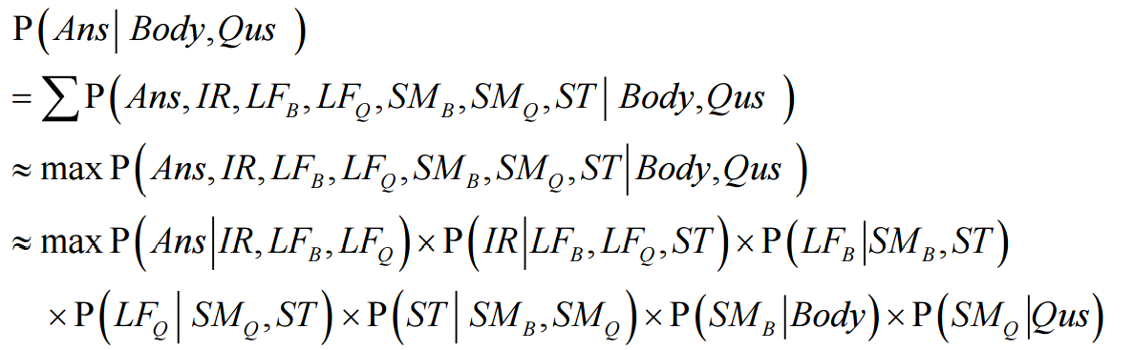

Current Status and On-going Work (3/5)
On-going work:
  Perform weakly supervised learning (with Beam-Search) and fine tune the system.
  Statistical framework.
: The obtained answer
Ans: A specific possible answer
Body: The given body text of the problem
Qus: The question text of the problem.
IR : Inference Rules.
LF_{B} : Logic Form of Body text.
LF_{Q} : Logic Form of Question text.
SM_{B} : Semantic Representation of Body text.
SM_{Q} : Semantic Representation of Question text.
ST : Solution Type.

Slide 84
Current Status and On-going Work (4/5)
On-going work (Cont.):
  Learn patterns and parameters from the training-set.
  Bootstrapping Procedure:
    (0) Get initial features/parameters, and start from Level-1
    (1) Start with a small training-set in the specified level
    (2) Execute the program to generate various answers (with multiple output candidates in each phase)
    (3) Select the most likely path which matches the given answer
    (4) Extract new features (e.g., lexicon patterns) via pre-specified generic patterns
    (5) Extract associated outcomes (including new features) to re-estimate the parameters
    (6) Repeat steps (2) to (5) on a larger corpus of the same level
    (7) Repeat steps (2) to (6) from Level-1 to Level-6

Slide 85
Conclusion
A tag-based statistical framework is proposed to perform understanding and reasoning for solving MWP.
Main contributions
  Proposing a tag-based approach to:
    Provide the answer more precisely,
    Make the system less sensitive to the irrelevant information
    Provide the flexibility for handling various kinds of possible questions.
  Proposing a statistical framework to perform reasoning from the given text, and automatically learning patterns/parameters from the training-set.

Slide 86
Thanks for Listening !

Slide 87
Error Analysis

Slide 88
Without Co-reference Problem(1/4)
S20: 花園裡有35朵玫瑰花和2朵百合花，花園裡一共有幾朵花？
  Sent1:
    玫瑰花(5): {FlowerGrass|花草}
    百合花(8): {FlowerGrass|花草}
  Sent2:
    花(6): {FlowerGrass|花草}
      無法指回Sent-1中的”玫瑰花”與”百合花”
S63: 操場上有40個小朋友：每20人分成一組，可以分成多少組？
  Sent-2 ”20人”中的”人”指的是Sent-1中的”小朋友”
    Subset 無法co-refer (by SuChu)
人(3): {human|人}
小朋友(5): {human|人:age={child|少兒}}

Slide 89
Without Co-reference Problem(2/4)
原子筆(1): {PenInk|筆墨:telic={write|寫:instrument={~}}}
S199: 原子筆每枝20元，鉛筆每枝5元，姐姐買了24枝筆，共付了270元， 兩種筆各買幾枝？
  Sent-3 ”姐姐買了24枝筆”中的”筆”, 指的是Sent-1中的”原子筆”, 與Sent-2中的” 鉛筆”
    Sent-3 的筆指的是原子筆和鉛筆，但不是Sent-1, Sent-2中一般性論述的原子筆和鉛筆，無法co-refer。
  Sent-4”共付了270元”, 指的是Sent-3 “買了24枝筆”所付的錢
    "買"的event frame只有agent, theme，錢(270元)不屬於其中，但可由適當的entailment得知。
  Sent-5 “兩種筆” , 指的是Sent-1中的”原子筆”, 與Sent-2中的” 鉛筆”
    標記已涵蓋。
鉛筆(1): {PenInk|筆墨}
筆(5): {PenInk|筆墨}

Slide 90
Without Co-reference Problem(3/4)
輪胎(2): {輪胎|tire}
輪(6): {輪子|wheel}
S186: 有100個輪胎，正好可組裝在六輪小貨車和四輪汽車共22輛上， 組裝好的六輪小貨車和四輪汽車各有幾輛？
  Sent-2 ”正好可組裝在六輪小貨車和四輪汽車” 中 “六輪小貨車”所需的”輪胎” 與“四輪汽車”所需的” 輪胎”指的是Sent-1中的” 100個輪胎”中的”輪胎”
    因 "四輪" 與 "六輪" 汽車所指涉的輪胎是一般指稱，並不為Sent-1所提的100個輪胎，不為co-reference。
  Sent-3 “六輪小貨車和四輪汽車” , 指的是Sent-2中的”六輪小貨車” 和” 四輪汽車”
    目前的標記已涵蓋。

Slide 91
Without Co-reference Problem(4/4)
X001: 雞兔共35隻，已知腳數共104隻，問雞兔各有幾隻？
  Sent-2 “腳數共104隻”中的”腳數”, 指的是Sent-1中的” 雞”與”兔” 的腳
    "腳"的 whole/host 的確可以refer回 Sent-1中"雞"和"兔"的腳，但目前要填回 host 並 co-refer 的只有"長"、"寬"、"高"等那二十幾個詞彙，並不包含"腳"。所以依照現在的標記原則不需要在語意上標記共同指稱。
      Append [x1] ("雞""兔"這個複合體) in the next example
  Sent-3 “雞兔各有幾隻”, 指的是Sent-1中的” 雞”與”兔”
    目前標記涵蓋該資訊。其中[x1]指的就是"雞""兔"這個複合體。

Slide 92
Extract and construct quantitative relations
There are some chickens and rabbits in a cage, we can see 35 heads and 94 legs. How many chickens and rabbits?
(若干只鸡兔同在一个笼子里，总共有35个头，有94只脚。问笼中各有多少只鸡和兔？)
Solving: Let chicken x, rabbit y.
x+y=35
2x+4y=94
So, x=23, y=12
Answer: Rabbits 12, Chickens 23.
Chicken
2
Rabbit
4
Slegs
Slegs
Chicken heads + Rabbit heads = Heads
Chicken legs + Rabbit legs = legs

