Slide 1

第三届基于自然标注大数据的自然语言处理国际学术研讨会（NLP-NABD2015）,
中国中文信息学会2015年学术年会（CIPS 2015）,
第十四届全国计算语言学学术会议（CCL2015）,
广东外语外贸大学 2015.11.13 。
LANGUAGE & the COMPUTER,
a personal journey.
王士元
香港理工大学
wsywang@polyu.edu.hk

Slide 2
Evolutionary background. Standing up, increased brain size for mental tools, e.g., language, skillful hands for physical tools, e.g., computer.
Early days of the computer. Babbage, Turing, von Neumann, brain.
A linguist’s first efforts to harness the computer. DOC database, sinogram, translation.
Lexical & syntactic ambiguities. Hierarchies & dependencies.
Language & the brain. Brain growth, limbic system, hippocampus & amygdala.
Electric signals in the brain. Hans Berger, EEG, ERP, Kuhl, Friederici.
Brain differences & brain impairment. Current research, Alzheimer’s Disease, future research.

Slide 3
Gorilla Chimpanzee Homo
Which two primates are the closest relatives?

Slide 4
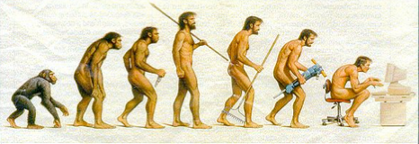
6 Mya 3.5+ Mya 2.8+ Mya . . . . 150+ Kya . . . . . . . 1946 C.E.
Australopithecus genus Homo species sapiens split bipedalism tool making Anatomically electronic from Modern communication chimpanzees Humans

Slide 5
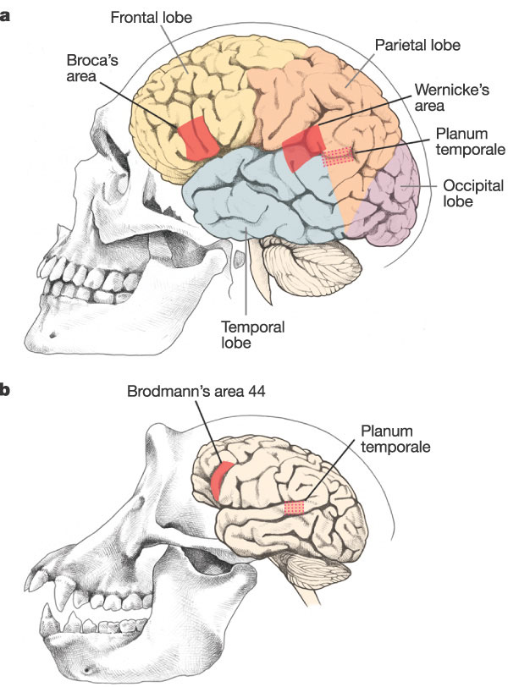
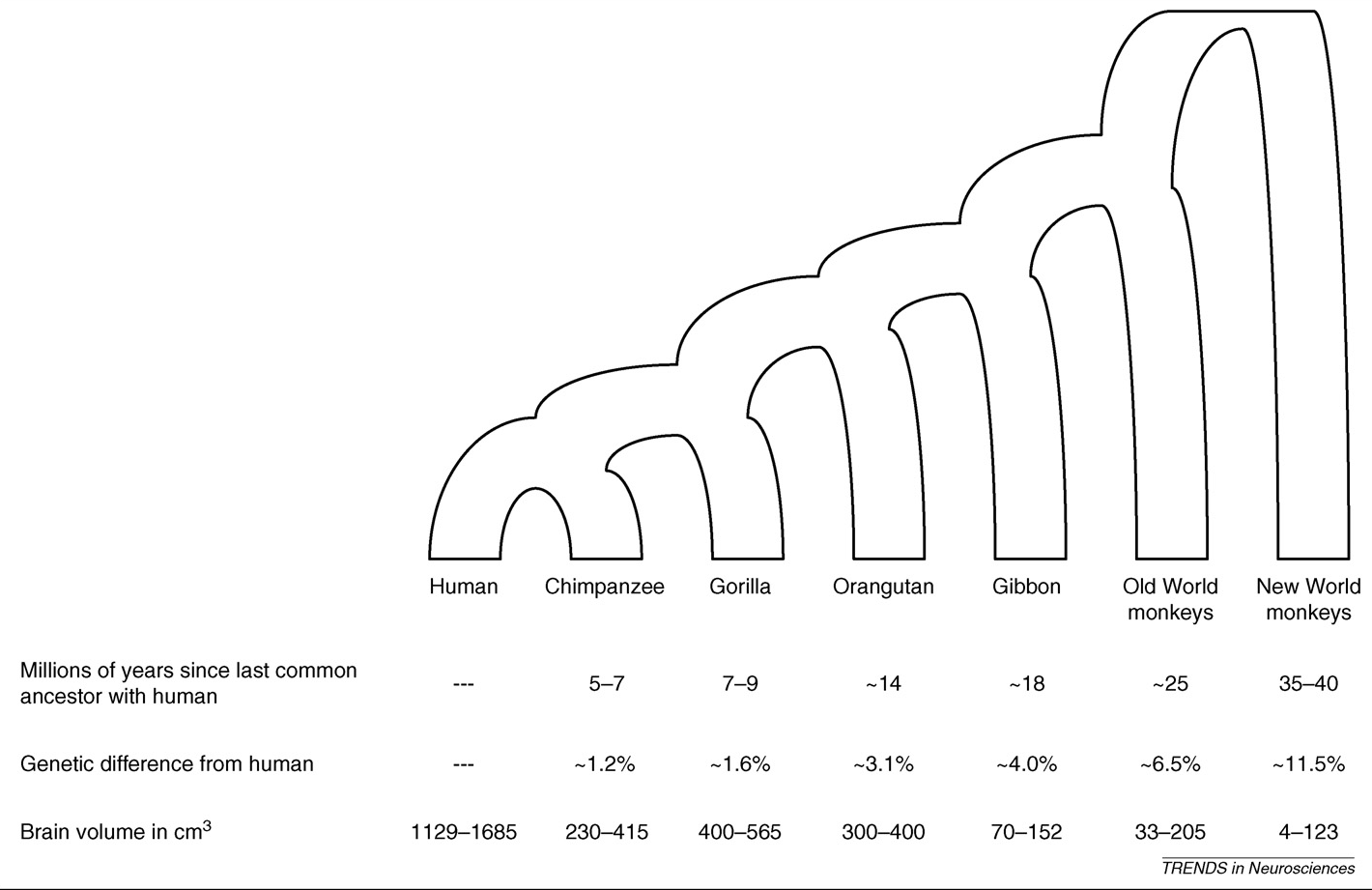
Genetic basis of human brain evolution.
Vallander, Eric, et al. 2008.
Trends in Neuroscience.
S.B.Carroll. Nature. 2003.

Slide 6
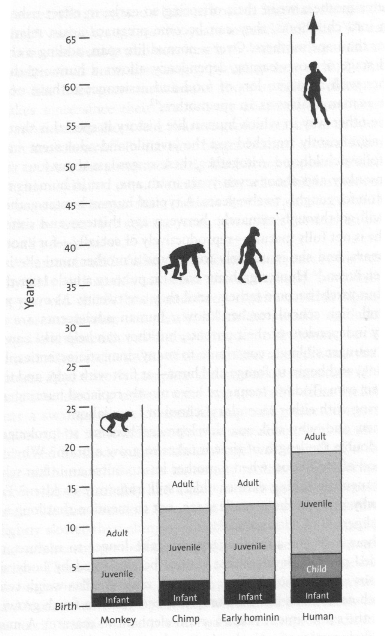
Lieberman, D.E. 2013.
Figure 13.
The Story of the Human Body:
Evolution, health, and disease.
Pantheon.
《论语》：
“吾十有五而志于学，
三十而立，
四十而不惑，
五十而知天命，
六十而耳顺，
七十而从心所欲，不踰矩。”
而如今百岁人瑞已越来越多！
Notes:
FIGURE 13. Different life histories. Humans have a more prolonged life history with an added stage of childhood and a longer period of being a juvenile prior to adulthood. Australopiths and early Homo erectus had a generally chimplike life history. Life history probably slowed down in species of archaic Homo, but exactly when and how much is still unclear.

Slide 7
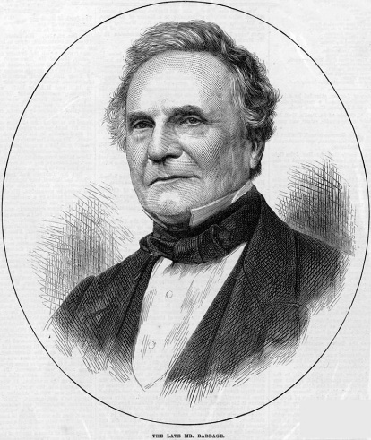
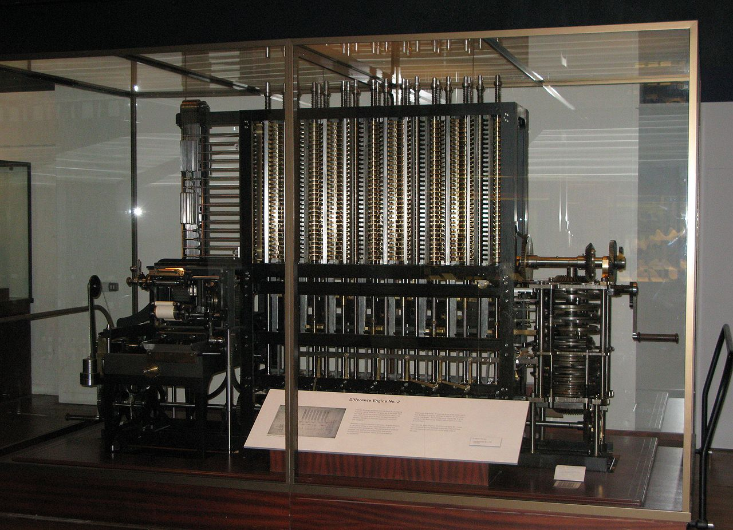
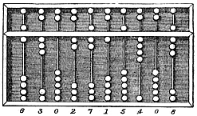
The Englishman Charles Babbage (1791-1871) designed a machine for mathematical operations, e.g., to solve polynomial equations. This machine was based on his design, completed in 1991, and displayed in the London Science Museum. "Babbage Difference Engine." Photo by User:geni.
The 算盘 suanpan was first described during the Eastern Han dynasty (25-220). Its design of 2 beads on top and 5 beads below facilitates calculations in both decimal and hexadecimal systems.
A traditional system of weights in China is based on the hexadecimal system: 1 斤 jin = 16 两 liang。

Slide 8
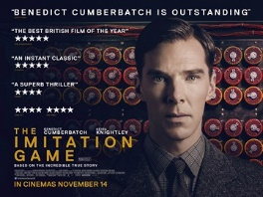
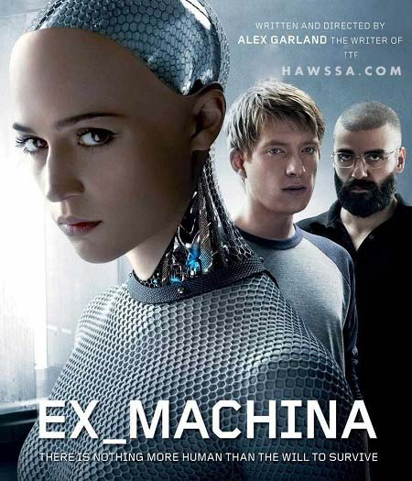
Alan Turing (1912-54) used a computer to crack codes addressed the problem of artificial intelligence, and proposed an experiment which became known as the Turing test, an attempt to define a standard for a machine to be called "intelligent". The idea was that a computer could be said to "think" if a human interrogator could not tell it apart, through conversation, from a human being.

Slide 9
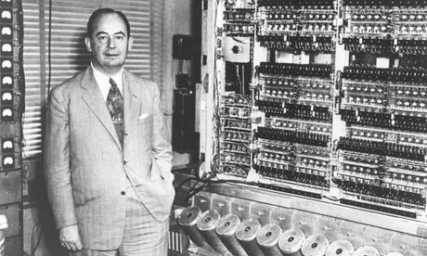
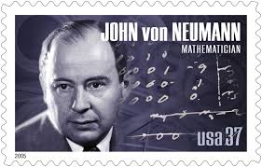
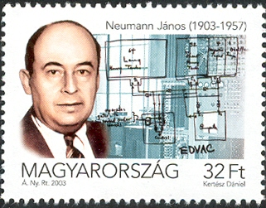
John von Neumann (1903-57)
EDVAC: Electronic Discrete Variable Automatic Computer.
ENIAC: Electronic Numerical Integrator And Computer.
UNIVAC: UNIVersal Automatic Computer.
First commercial computer produced in the U.S. Used by CBS to successfully predict the presidential election of 1952.
The von Neumann architecture was described in 1945 by John von Neumann and others in the First Draft of a Report on the EDVAC. This describes a design architecture for an electronic digital computer with parts consisting of [1] a processing unit containing a logic unit and processor registers, [2] a control unit containing an instruction register and program counter, [3] a memory to store both data and instructions, [4] external mass storage, and [5] input and output mechanisms.

Slide 10
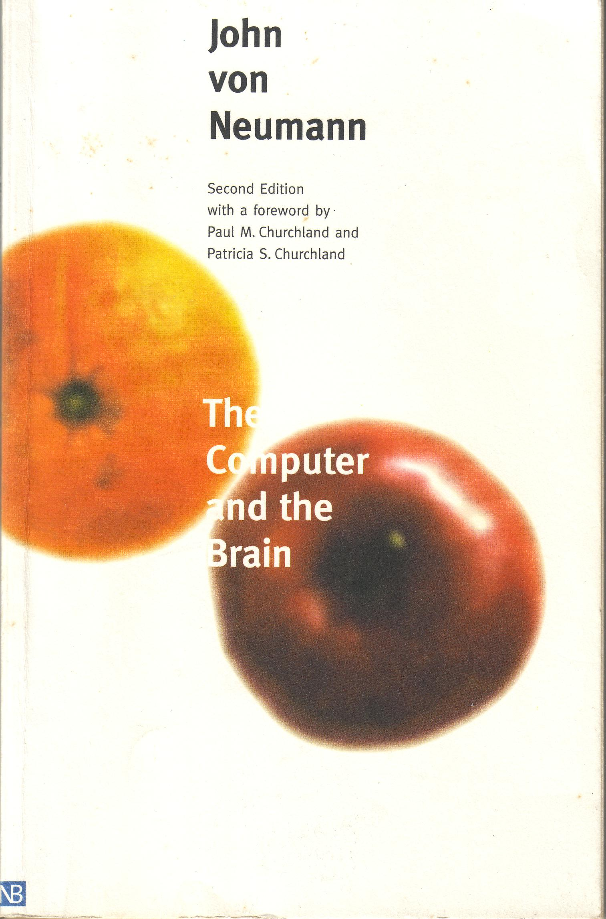
“If the brain is a digital computer with a von Neumann architecture, it is doomed to be a computational tortoise by comparison. ... Conjointly, these two severe limitations – one on speed, and the other on accuracy – drive von Neumann to the conclusion that whatever computational regime the brain is using, it must be one that somehow involves a minimum of what he calls “logical depth”. That is, whatever the brain is doing, it cannot be sequentially performing thousands upon thousands of sequentially computational steps ... Given the slowness of its neuronal activities, there isn’t enough time for the brain to complete any but the most trivial of computations. And given the low accuracy of its typical representations, it would be computationally incompetent even if it did have enough time.
... As we now know, the brain contains roughly 10¹⁴ synaptic connections, each of which modulates the arriving axonal signal before passing it on to the receiving neuron. ... Most important, these tiny modulatory actions all take place simultaneously. This means that, with each synapse being active perhaps 100 times per second ... the total number of basic information-processing actions performed by the brain must be roughly 10² times 10¹⁴, or 10¹⁶ operations per second. This is a striking achievement for any system, and it compares very favorably with our earlier count on 10⁹ basic operations per second for a cutting edge desktop machine. The brain is neither a tortoise nor a dunce after all, for it was never a serial digital machine to begin with: it is a massively parallel analog machine.”
The Computer and the Brain
1st edition 1958.
Yale University Press.
2nd edition 2000;
with foreword by
Churchland, Paul & Patricia.

Slide 11
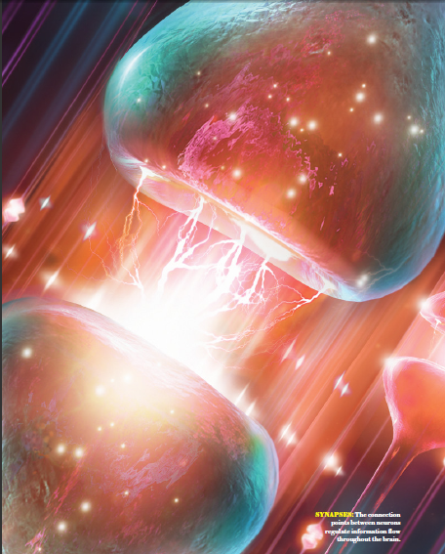
Sejnowski, Terry &
Tobi Delbruck.
THE LANGUAGE OF THE BRAIN.
Scientific American
October 2012.

Slide 12
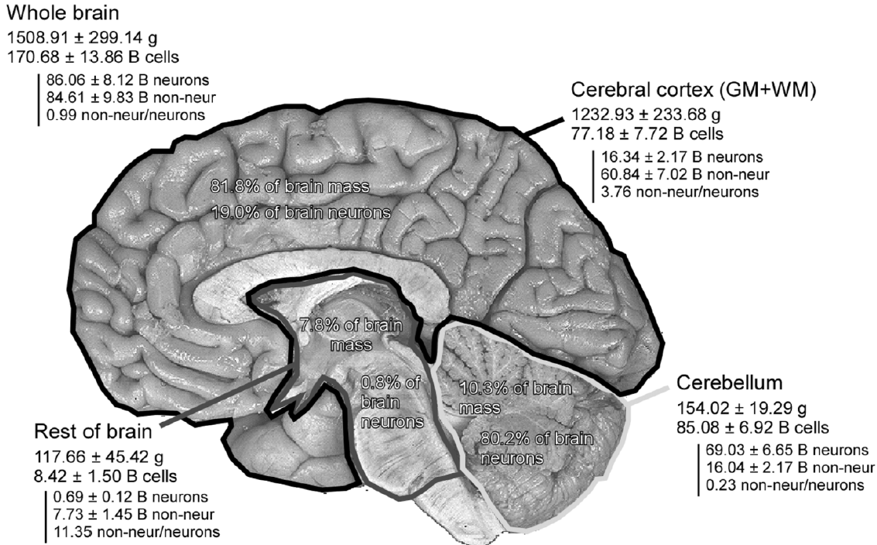
Azevedo, F. et al. 2009. Equal numbers of neuronal and nonneuronal cells make the human brain an isometrically scaled-up primate brain. Journal of Comparative Neurology 513.532-41.
81.8% mass
19.0% neur
7.8% mass
0.8% neur
10.3% mass; 80.2% neur

Slide 13
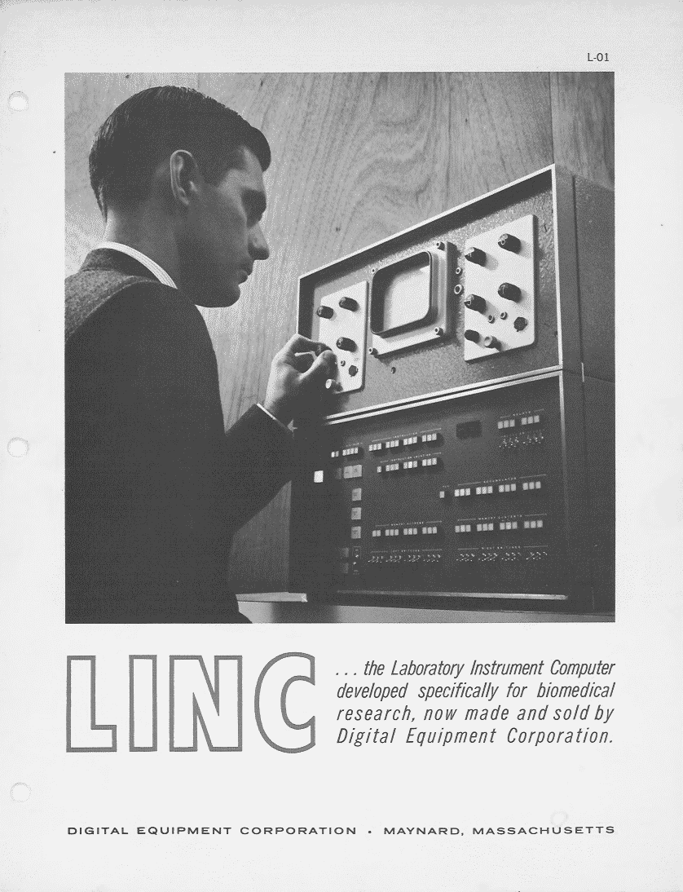
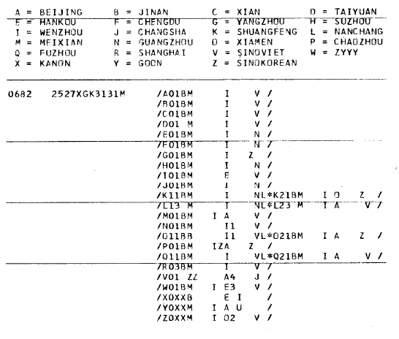
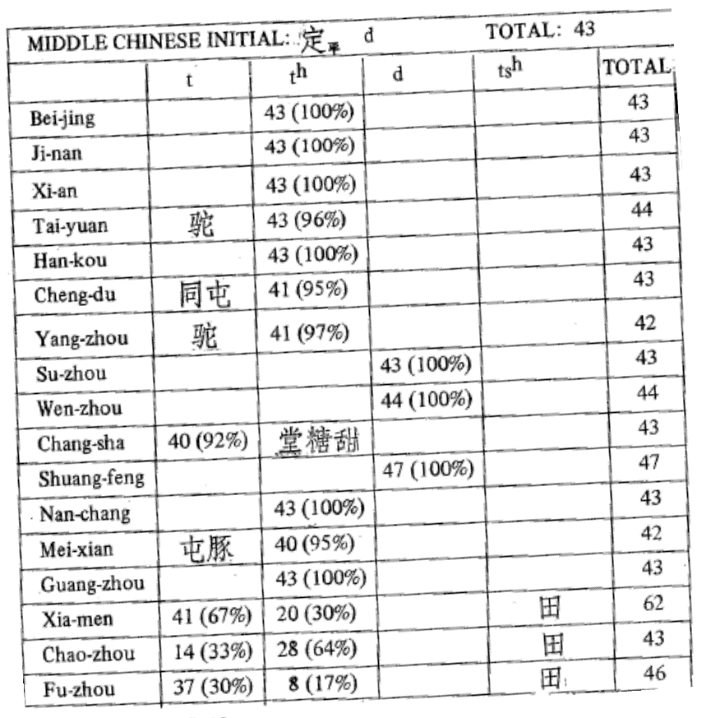
The Linc computer in the service of Chinese linguistics 1.
Streeter, Mary L. 1972. DOC 1971: a Chinese Dialect Dictionary on Computer. Computers and Humanities 6.259-70. Cheng, Chin-Chuan. 1994. DOC: lts Birth and Life. IN HONOR OF WILLIAM S- Y. WANG: INTERDISCIPLINARY STUDIES ON LANGUAGE AND LANGUAGE CHANGE, ed. by M.Y. Chen & O.J.L. Tzeng. Pyramid Press.

Slide 14
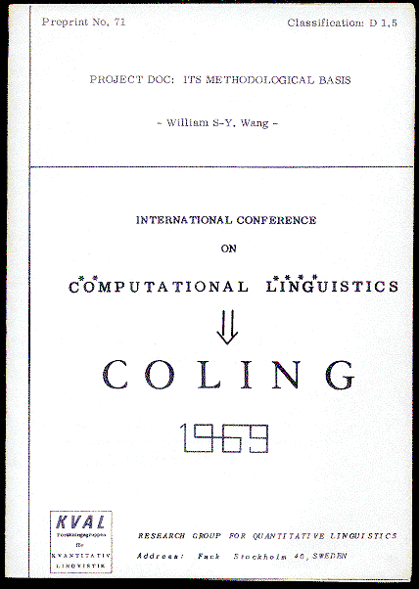
COLING,
Stockholm
1969
Wang, W.S-Y. 1970.
Project DOC: its methodological basis.
Journal of American Oriental Society 90.57-66.

Slide 15
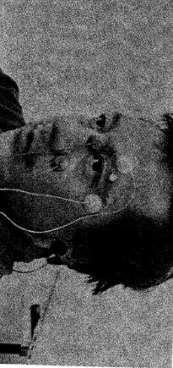
The Linc computer in the service of Chinese linguistics 2.
Wang, W.S-Y. 1974. 语言研究讲话. Journal of Chinese Linguistics 2.1-24.

Slide 16
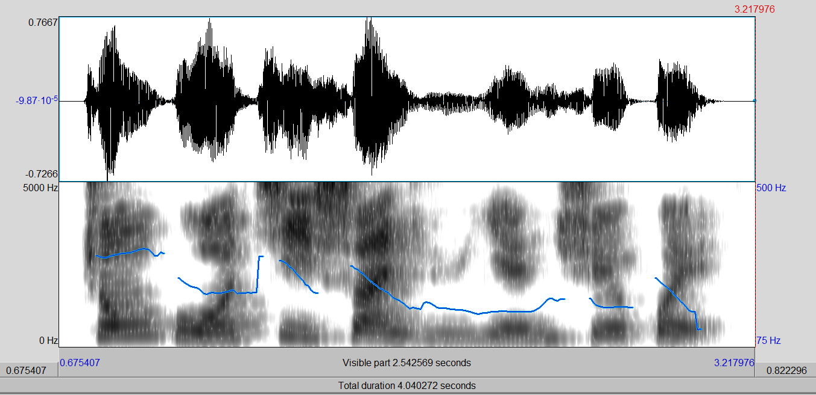
中
国
计
算
语
言
学
会
中
中
zhong guo ji suan yu yan xue hui

Slide 17
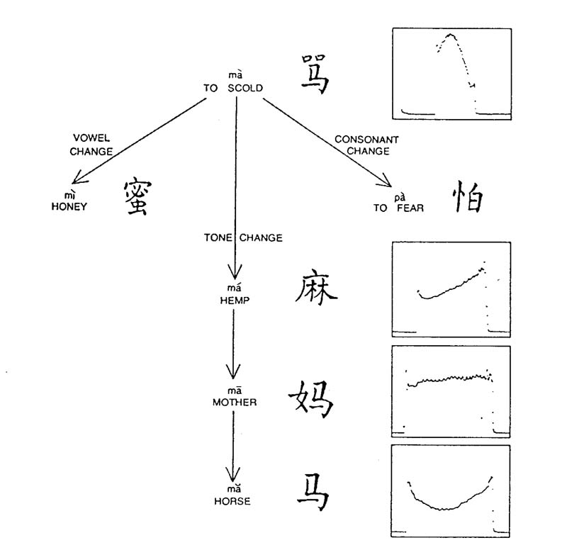
W.S-Y.Wang.Feb.1973.
Scientific American.

Slide 18
Computer translation from Chinese to English:
Wang, W.S-Y. 1973. The Chinese language. Scientific American 228.53-62. February issue. Follow-up discussion in May 1973, 228.8-9.
Wang, W.S-Y., S.W. Chan & B.K. T'sou. 1973. Chinese linguistics and the computer. Linguistics 118.89-117.

Slide 19
赵元任，语言问题。1980：149
施氏食狮史
石室诗士施氏，嗜狮，誓食十狮。氏时时适市视狮。十时，适十狮适市。是时，适施氏适市。氏视是十狮，恃矢势，使是十狮逝世。氏拾是十狮尸，适石室。石室湿，氏使侍拭石室。石室拭，氏始试食十狮尸。食时，始识是十狮尸，实十石狮尸。试释是事。
“Stone house poet Mr. Shih was fond of lions and resolved to eat ten lions. The gentleman from time to time went to the market to look for lions. When at ten o‘clock he went to the market, it happened that ten big lions went to the market. Thereupon, the gentleman looked at the ten lions and , relying on the momenta of ten stone arrows, caused the ten lions to depart from this world. …” English translation from Chao, Y.R. 1955. Meaning in language and how it is acquired. Cybernetics, Transactions of the Tenth Conference, ed. by H.v. Foerster, et al. 49-83. New York.

Slide 20
赵元任，语言问题。1980：149
施氏食狮史
石室诗士施氏，嗜狮，誓食十狮。氏时时适市视狮。十时，适十狮适市。是时，适施氏适市。氏视是十狮，恃矢势，使是十狮逝世。氏拾是十狮尸，适石室。石室湿，氏使侍拭石室。石室拭，氏始试食十狮尸。食时，始识是十狮尸，实十石狮尸。试释是事。

Slide 21
Ambiguity in Chinese.
雞 不 吃 了.
chicken not eat particle.
cf: 媽 媽 不 吃 了。
牛 肉 不 吃 了。

Slide 22
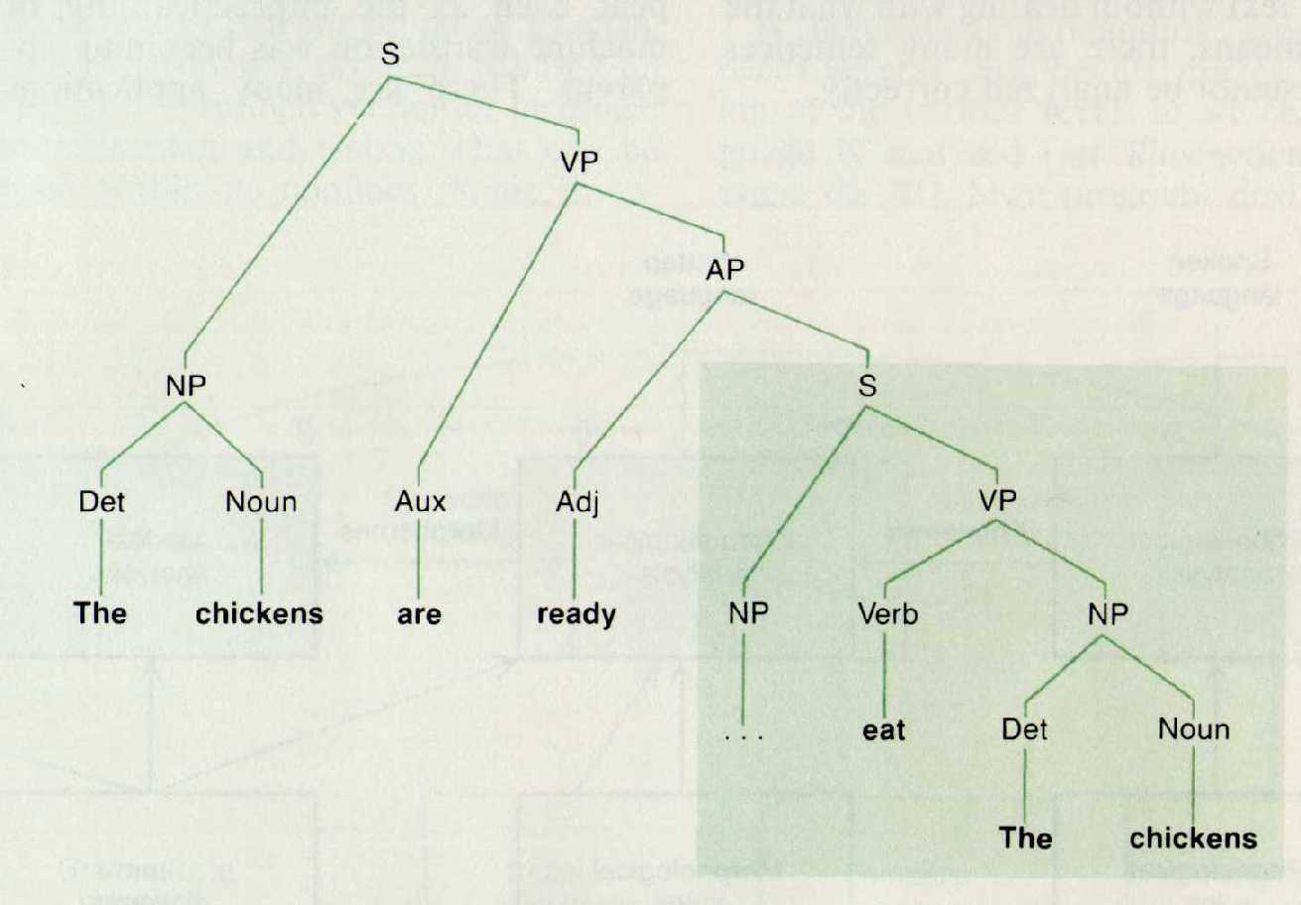
T.Winograd. 1984.
Scientific American

Slide 23
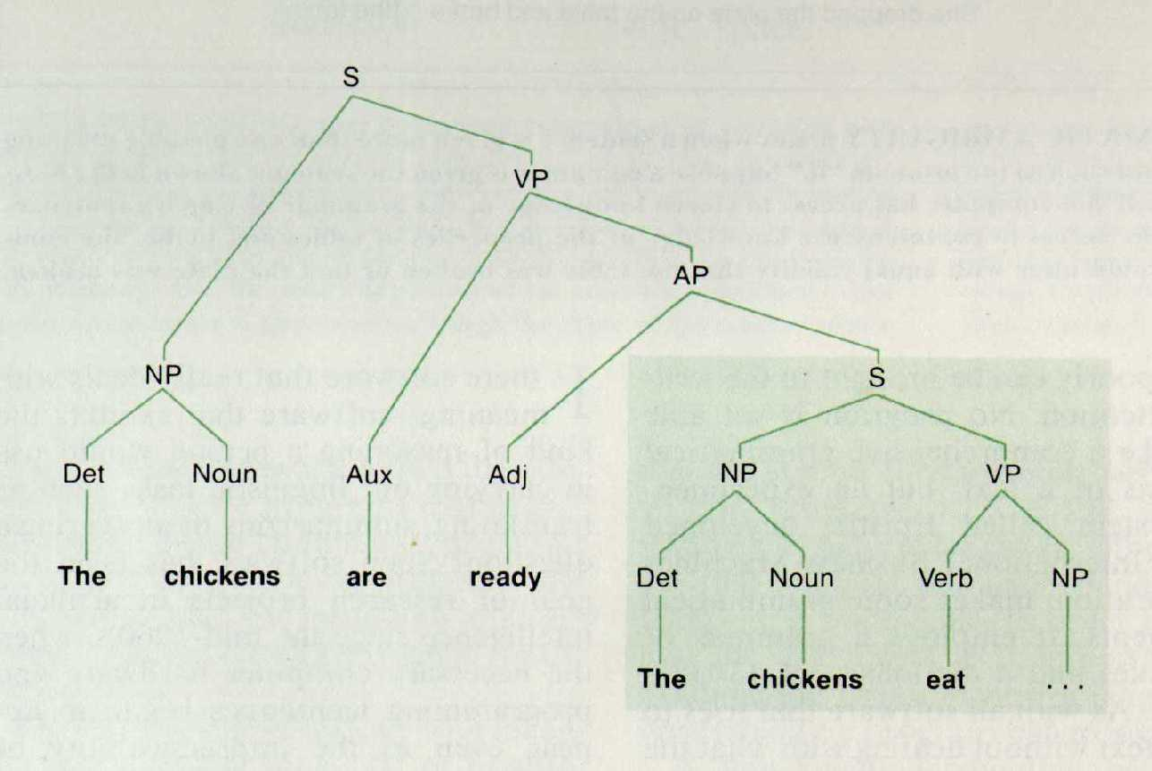
T.Winograd. 1984.
Scientific American

Slide 24
It’s too hot to eat.
food temperature
weather spice
animal

Slide 25
I know a man with a wooden leg called Peter
what’s the name of his other leg?

Slide 26
a.我們 沒 有做 不 好 的 事情。
Pro Neg V V Neg Adv part. N
b.我們 沒 有 做 不 好 的 事情。
Pro Neg Asp V Neg Adj part. N

Slide 27
The dog₁ chased₁ the cat.
The dog₁ the horse₂ kicked₂ chased₁ the cat.
The dog₁ the horse₂ the farmer₃ bought₃
kicked₂ chased₁ the cat.
The dog₁ the horse₂ the farmer₃ the girl₄ married₄ bought₃ kicked₂ chased₁ the cat.
The cat was chased by the dog that was kicked by the horse
that was bought by the farmer that the girl married.

Slide 28
married
bought
kicked
chased
the
dog
the
horse
the
farmer
the
girl
the
farmer
the
horse
the
dog
the
cat

Slide 29
Al, Ben, and Don are fencing, jumping, and swimming
respectively.

Slide 30
omdat ik₁ Cecilia₂ Henk₃
da nijlpaarden
zag₁ helpen₂ voeren₃
因为我看见 Cecilia 帮 Henk 喂河马。
因为我 Cecilia Henk 河马 看见帮喂。
Bresnan et al. 1982. Linguistic Inquiry 13.4.613-635

Slide 31
Two types of recursion:
English center embedding:
S¹ S² S³ … V³ V² V¹
Dutch cross dependency:
S¹ S² S³ … V¹ V² V³

Slide 32
All languages are multiply and pervasively ambiguous. Since languages have different structures, their types of ambiguity are interestingly different as well.
学生が好きな先生 has two distinct meanings:
[1] the teacher who likes the students
喜欢学生的先生
[2] the teacher who(m) the students like
学生喜欢的先生

Slide 33
W. Weaver thought that "relatively few nouns, verbs and adjectives" were actually ambiguous, so that the problem was not large.” He was terribly wrong on this. Influenced by Turing and Shannon, Weaver wrote: ”It is very tempting to say that a book written in Chinese is simply a book written in English which was coded into the "Chinese code." If we have useful methods for solving almost any cryptographic problem, may it not be that with proper interpretation we already have useful methods for translation?”
Y.Bar-Hillel discussed insightfully the problem of lexical ambiguity, illustrating with the following sentence:
“Johnny was looking for his toy box, finally he found it. The box was in the pen.”
For computers to completely succeed in replicating human language ability, they will need to have a massive and open-ended knowledge base about our physical and social world.

Slide 34
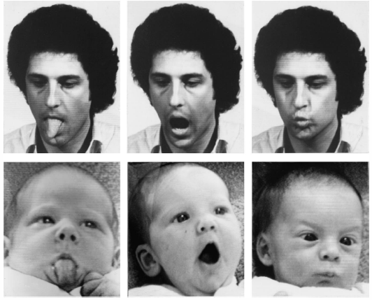
Imitation by Human Children
Meltzoff, A.N. & Moore, M.K.
(1977). Imitation of facial and
manual gestures by human
neonates. Science 198, 75–78.

Slide 35
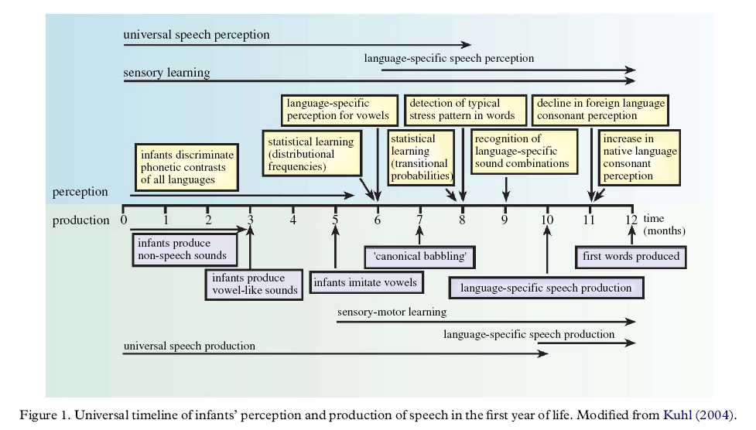
Kuhl, P. K., et al. 2008.
Phonetic learning as a pathway to language. Phil. Trans. R. Soc. B 363.979–1000.
Notes:
Kuhl, Patricia K., Barbara T. Conboy, Sharon Coffey-Corina, Denise Padden, Maritza Rivera-Gaxiola & Tobey Nelson. 2008. Phonetic learning as a pathway to language: new data and native language magnet theory expanded (NLM-e). Phil. Trans. R. Soc. B 363.979–1000.

Slide 36
Saffran, J.R., et al. 1996. Statistical
Learning by 8-Month-Old Infants. Science 274.1926-28.

Slide 37
Saffran, J.R., et al. 1996. Statistical
Learning by 8-Month-Old Infants. Science 274.1926-28.

Slide 38
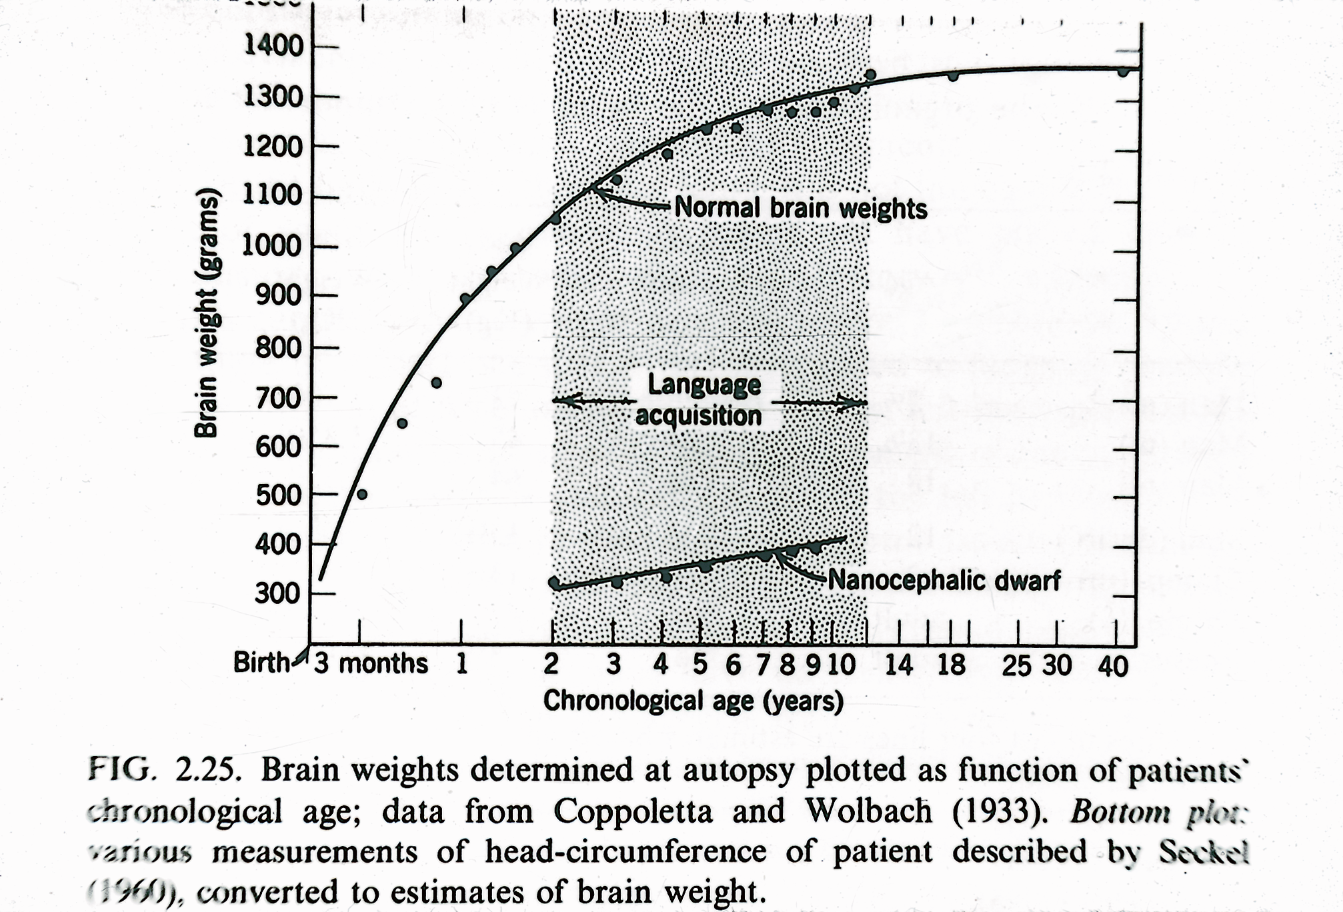

Slide 39
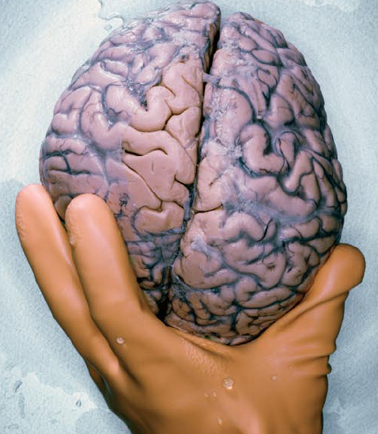
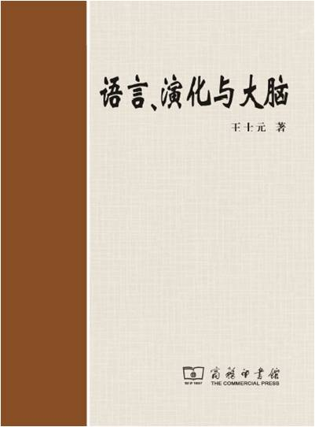
SciAm.Feb.09

Slide 40
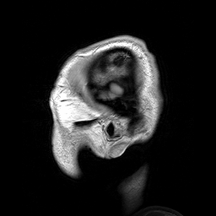
Magnetic
Resonance
Imaging
uploaded
to
Wikipedia
by
Dwayne
Reed

Slide 41
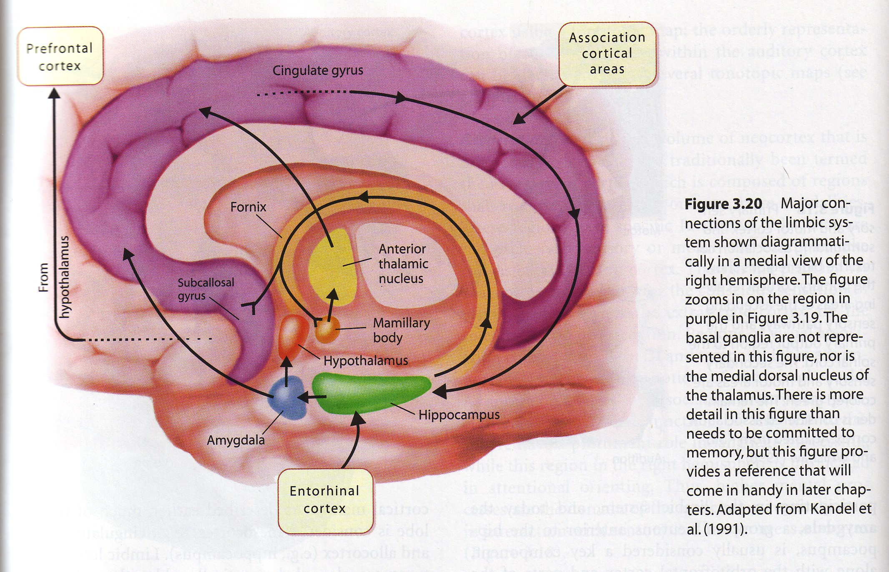
Notes:
Gazzaniga et al. 2002, p. 82

Slide 42
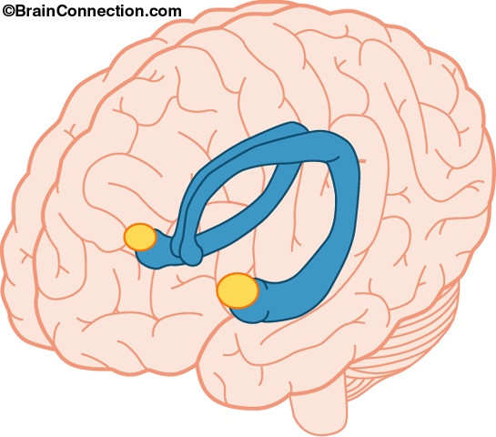
Hippocampus
Amygdala

Slide 43
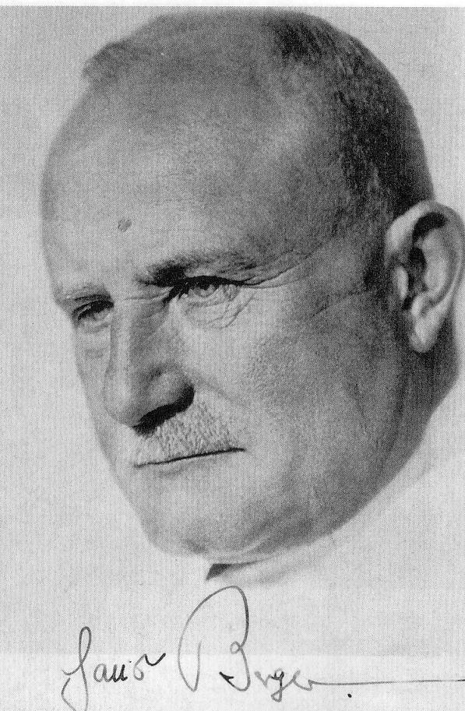
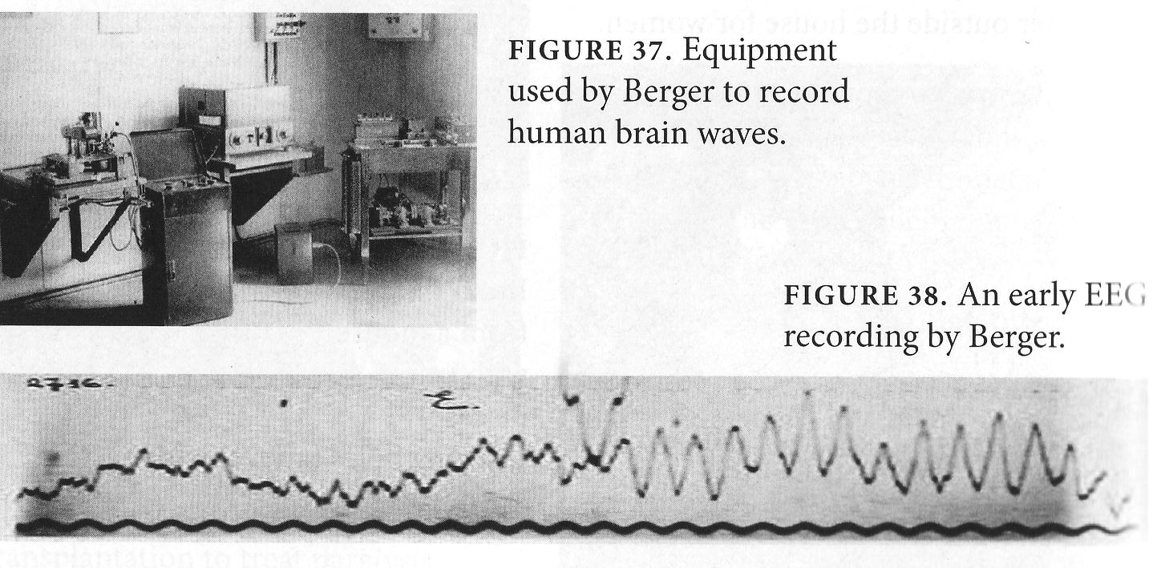

In 1924, Hans Berger made the first recording of electrical activity generated by the human brain. He observed waves in distinct frequency bands:

Slide 44
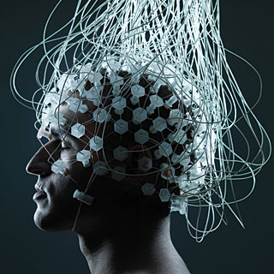
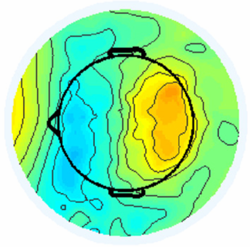
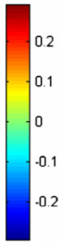
Electroencephalography (EEG)
VOLTAGE
topological distribution
of measurable brain activity

Slide 45
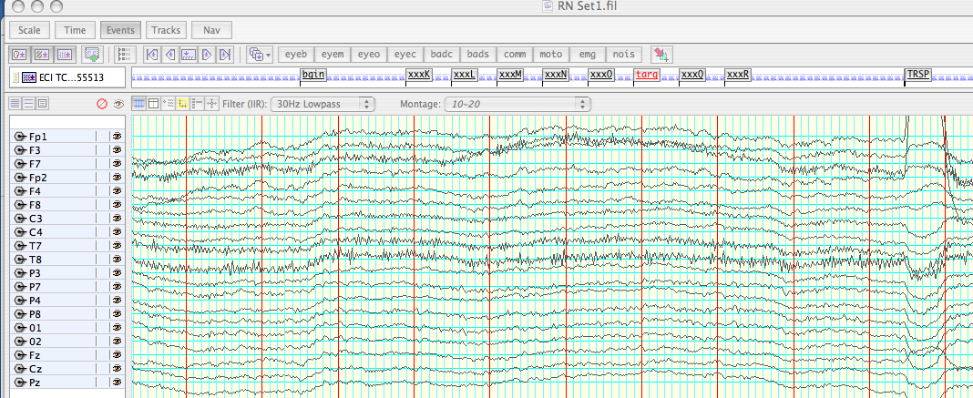
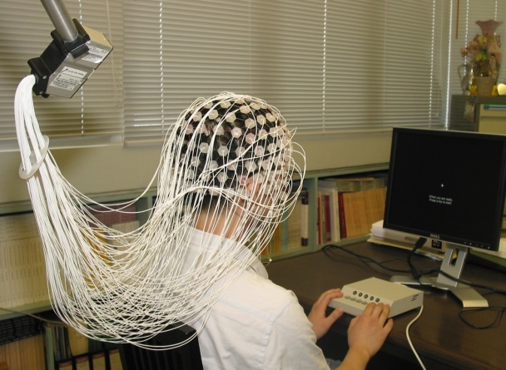
300 ms
+
1st Word
2nd Word
3rd Word
4th Word
5th Word
time
1s
45

Slide 46
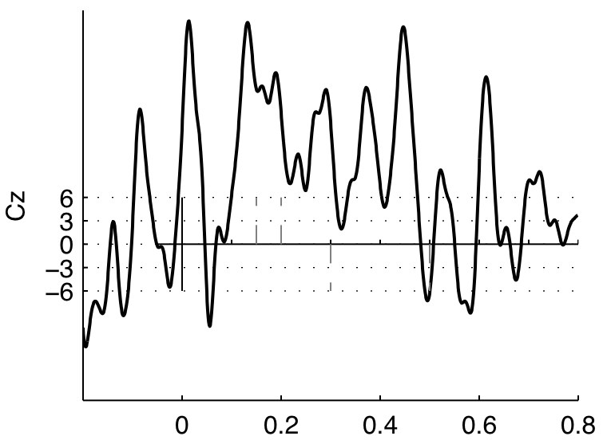
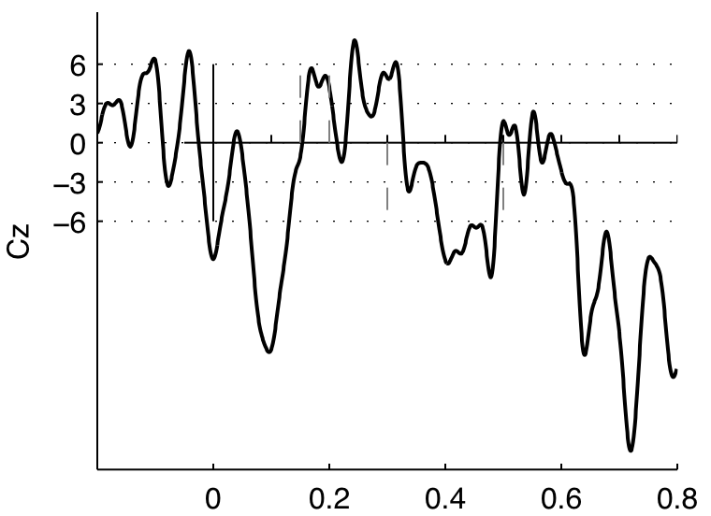
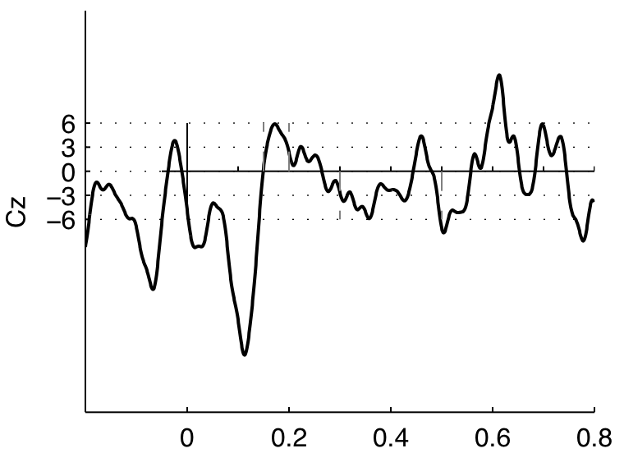
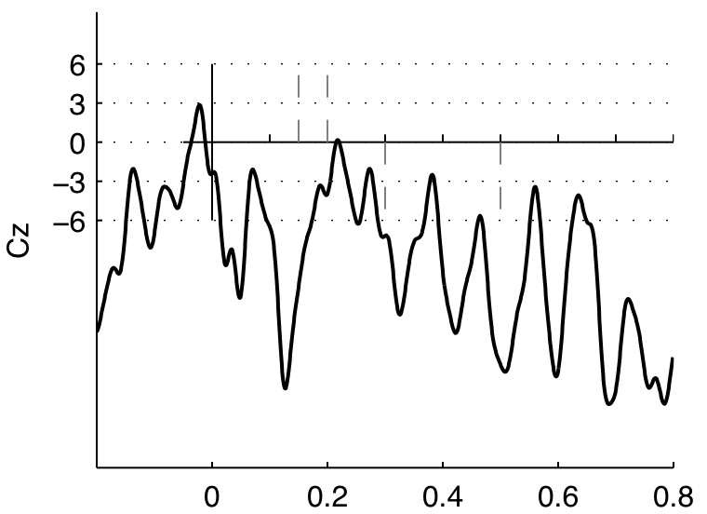
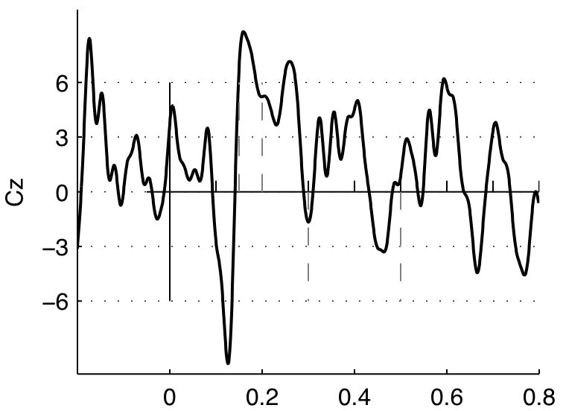
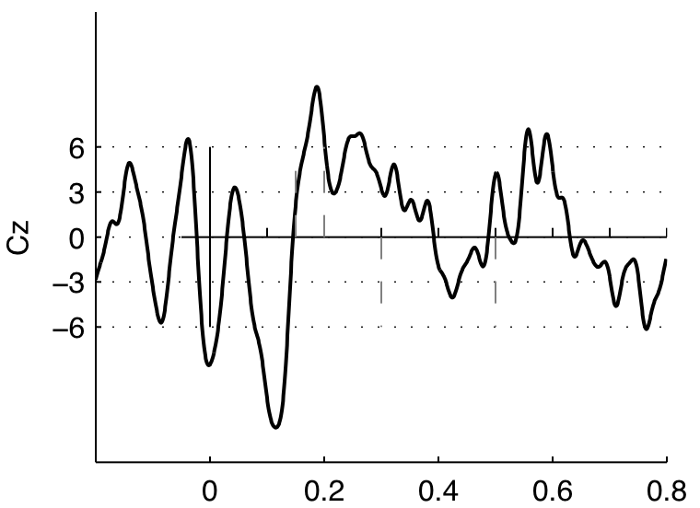
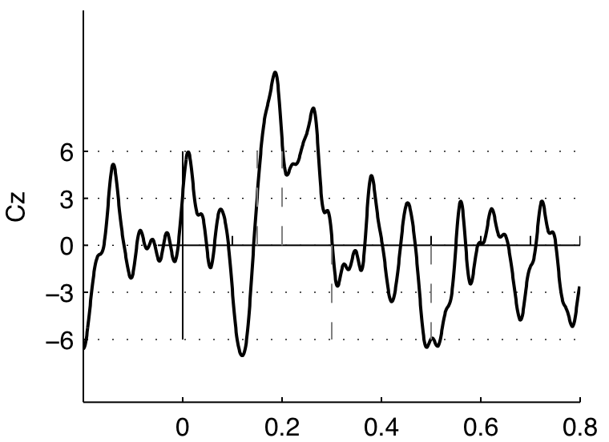
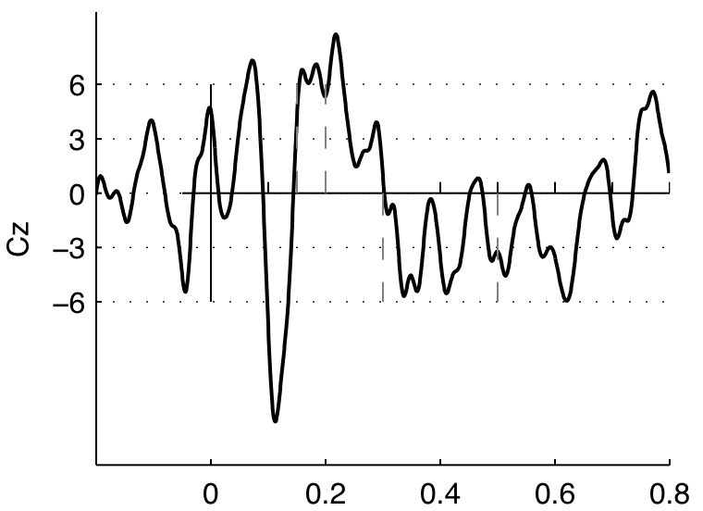
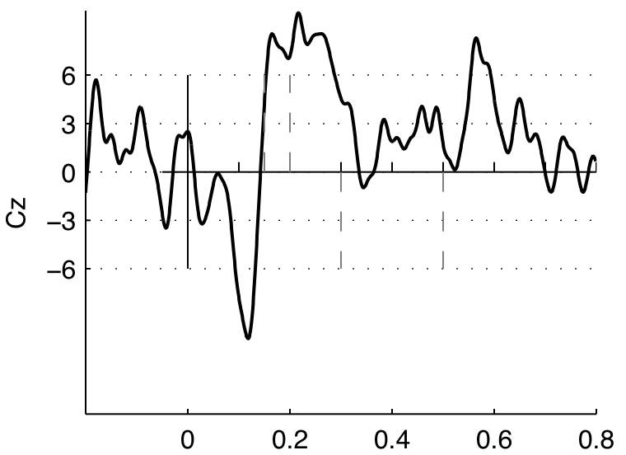
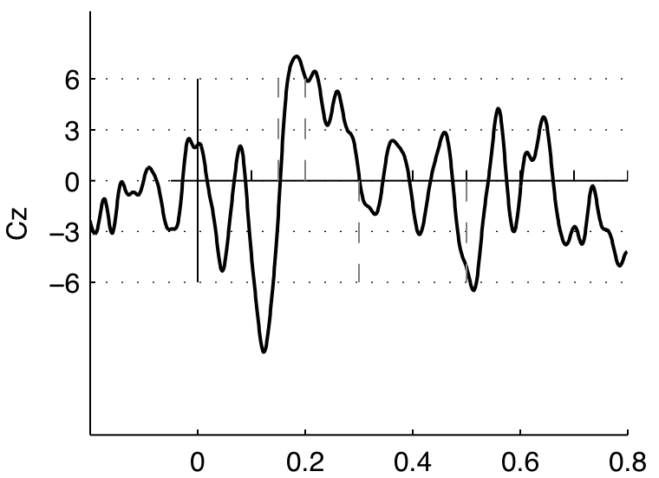
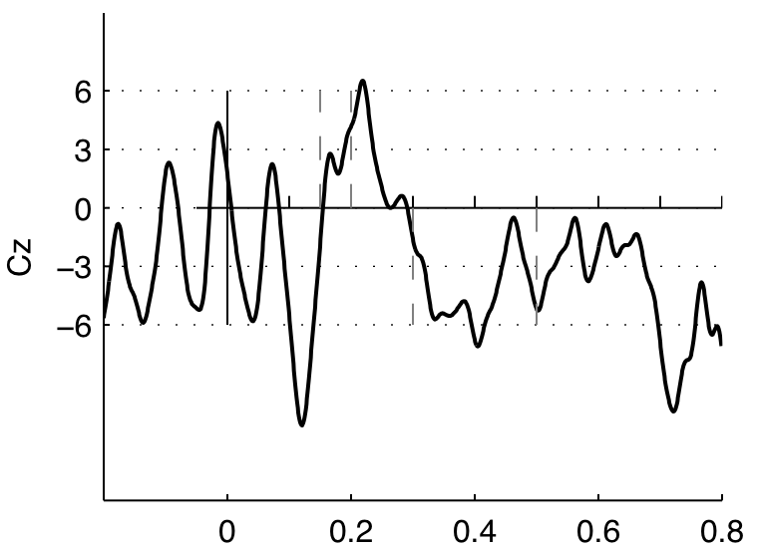


Reducing intra-subject variations
From EEG to single subject ERP:
Averaging over: 1, 2, 3, ... 10, 15, 20, 25 trials
46
Notes:
1, 2, 3, 4, 5, 6, 7, 8, 9, 10, 15, 20, 25
The EEGs/ERPs in p.14 and 15 are from my P200/N400 reading
experiment. They are brain waves to congruent critical words.
Therefore, the last panel of p.15, ERP from 20 subjects, is identical
to the blue curve in p.21 @ Cz.
The EEGs/ERPs in p.14 and 15 are from my P200/N400 reading
experiment. They are brain waves to congruent critical words.
Therefore, the last panel of p.15, ERP from 20 subjects, is identical
to the blue curve in p.21 @ Cz.

Slide 47

Event-related Potentials
(ERP)
P300 component
P200 component
Time-locked to
onset of stimulus:
non-event-related signals
average to zero
Compare ERPS for
multiple conditions
0
200
400
600
ms
Calculate
baseline voltage
N100 component

Slide 48

Kuhl, P. 2004:840.

Slide 49
Kuhl, Patricia K., Rey R. Ramírez, Alexis Bosseler, Jo-Fu Lotus Lin & Toshiaki Imada.
2014. Infants’ brain responses to speech suggest Analysis by Synthesis. PNAS.
“We show that 7-mo-old infants activate auditory and motor brain areas similarly for native and nonnative sounds;
by 11–12 mo, greater activation in auditory brain areas occurs for native sounds, whereas greater activation in motor brain areas occurs for nonnative sounds, matching the adult pattern.”
7個月的嬰兒不會辨別母語和外語的聲音。聽覺腦區和運動腦區的反應相似。
而11-12個月的嬰兒聽母語時聽覺腦區的反應比較強，聽外語時運動腦區反應比較強。基本和成人的反應相同。

Slide 50

Friederici, A.D. 2011:1371.
Low Heute hat der Opa dem Jungen den Lutscher geschenkt.
Medium Heute hat dem Jungen der Opa den Lutscher geschenkt.
High Heute hat dem Jungen den Lutscher der Opa geschenkt.
Notes:
FIGURE 6. Syntactic complexity effect in the IFG. Activation in Broca’s area (BA 44) increases systematically
as the syntactic complexity of the structure of scrambled sentences increases. Plotted are the results of a
region of interest analysis for BA 44. A: activation location. B: activation over time for low, medium, and highly
complex sentences. [Adapted from Friederici et al. (69).]

Slide 51

Ingalhalikar, et al. 2013.
Sex differences in the structural connectome of the human brain.
PNAS1316909110.Fig.2A.

Slide 52

Dekaban, A.S. & D.Sadowsky. 1978. Changes in brain weights during the span of human life. Annals of Neurology 4.350.

Slide 53
Over the past decades we have made good progress toward understanding language and the brain, with help of the computer and language sciences. However, current knowledge is unfortunately very skewed in two important ways:
(1) Research has concentrated on the young, even newborn infants, while neglecting the other end of the lifespan. With the world population ageing rapidly, especially in China, because of policies in birth control, a great deal need to be done to understand how the brain loses it powers over the years, and to find ways of predicting dementia and Alzheimer’s Disease, and of reducing damage as early as possible.
(2) Research has concentrated on the WEIRD populations of Europe and North America. Much of the methods developed for diagnosis and findings reported is not appropriate for populations where the cultures and languages are markedly different in content and in structure. The brain is a product of culture and language; a great deal need to be done on cognition in the Chinese brain, and in designing diagnostic methods and in discovering biomarkers.
=================
WEIRD = Western, Educated, Industrialized, Rich, Democratic. See Henrich, J. et al. 2010. Most people are not WEIRD. Nature 466.29.

Slide 54

Walhovd, Kristine B., et al. 2011. Consistent neuroanatomical age-related volume differences across multiple samples. Neurobiology of Aging 32.916-32.

Slide 55

Walhovd, Kristine B., et al. 2011. Consistent neuroanatomical age-related
volume differences across multiple samples. Neurobiology of Aging 32.916-32.
N=883; f=528; m=355.

Slide 56

Hedden, Trey & John D. E. Gabrieli. 2004. INSIGHTS INTO THE AGEING MIND: A VIEW FROM COGNITIVE NEUROSCIENCE. Nature Reviews Neuroscience 5.87-96.

Slide 57

Hedden, T. & J.D.E.Gabrieli. 2004. Insights
into the ageing mind: a view from cognitive neuroscience. Nature Reviews Neuroscience 5.87-96.
Schaie, K.W. 1996. Intellectual Development in Adulthood:
The Seattle Longitudinal Study. Cambridge University Press.

Slide 58
"President Ronald Reagan completed his second term in office in 1989. Four years later, at a party celebrating his 82nd birthday, he rose before hundred of guests and offered a toast to Margaret Thatcher ...
‘We all froze when he toasted her twice, at length, and in exactly the same words. There was nothing we could do but give her two standing ovations ... while Dutch stood obliviously smiling.’
A year later, the former president was diagnosed with Alzheimer's disease.“ p.196.
quote from Seamon, J. 2015. Memory and Movies. MIT Press.
There are many types and degrees of cognitive impairment. Memory loss may occur years before it is diagnosed in the clinic. Mild Cognitive Impairment, MCI, may persist for many years. It may convert to Alzheimer’s Disease, from which there is no known cure.

Slide 59


Professor Charles Kuen Kao (高錕) was born in Shanghai in 1933. He is the recipient of a Nobel Prize in Physics in 2009, and is known as the “Father of Fibre Optics”.
He has Alzheimer’s Disease, as did his father.

Slide 60
Lock, M. 2013. The Alzheimer Conundrum: Entanglements of Dementia and Aging. Princeton University Press.
p.16: "China is beginning to come to grips with the extent of the problem that their aging society poses. at present, the future of the elderly in China, and for their caregivers, looks exceptionally bleak. China already has a population of elderly of around 178 million (surpassing that of the number of elderly in all the European countries put together). It is estimated that by 2040 people aged 60 and older will make up about 28% of the population - in absolute numbers 397 million people - by far the majority of whom have no old age security. Worries about the impact that the growing ranks of elderly will have on the economy and on individual families have been dubbed in China as the 4-2-1 problem because, in large part as a result of the one-child policy, a single person in China will soon be expected to support two parents and four grandparents. …
p.100: "With this in mind, the National Institute on Aging and the Alzheimer's Association set up advisory meetings composed of individuals from both academia and industry, and it was decided that three working groups should be formed. ... It was striking that virtually every involved expert was associated with an American university and or drug company. ... Despite the dominant American presence in these newer groups, it was explicitly asserted that a balance of expertise existed in and among the three groups, and that they had international representation. ... Immediately before the final round of discussion of revisions took place in preparation for drafting the prepublication documents, two experts from the United Kingdom and one each from Canada, Japan, Australia, and the Netherlands were distributed among the three groups. These researchers, together with Bruno Dubois, 7 in all, formed the international component among the more than 30 Americans."

Slide 61
While science has made steady progress in treating most of the ailments of the body, the structure, function, and impairment of the brain have remained largely unknown until the 20th century. On analogy with the brain, and using its terminology, computer scientists have been developing various models of artificial neural nets, the latest version being Deep Neural Nets, based on recent findings by Geoffrey Hinton (2006). Earlier, Hinton experimented with computer simulations of dyslexia and other brain disorders (1991, 1993). Perhaps now, in light of the remarkable breakthroughs made over these twenty years, in both computer science and neuroscience, the time is ripe for further experiments on parallel investigations of artificial and natural intelligence.
Of particular importance to studies in cognitive impairment are some recent advances at the molecular level. In 2011, Mu & Gage discussed “Adult hippocampal neurogenesis and its role in Alzheimer’s disease”. And in Science Oct.30,2015, there is a news report on “Lifelong memories may reside in nets around brain cells”, based on work being done in the laboratory of Roger Tsien, (錢永健), winner of a Nobel Prize; the work suggests a key role for Perineural Networks for storing long term memories, probably involving glia cells.
Cognitive impairment due to ageing is a pressing problem, especially in China. Computational linguistics can contribute fundamentally to knowledge of language and the brain. I hope many young scholars will take up this urgent challenge.

Slide 62
珍贵的机会做重要的研究就在眼前！
语言是人类最关键的发明，帮助我们累积信息与知识、彼此沟通、思考问题、回想过去、计划与创造未来 …, 没有语言就不可能有种种的文化、文明。
人的大脑是整个生物界里最复杂、最厉害的工具。它与语言相互刺激、共同演化，引领着计算机科学的进展。神经科学的革命性发现给我们绝佳的机会研究两者间的关系。目前全球人口正在迅速老化，需要计算语言学的参与，共同解决这个迫切的问题。
近年的西方研究偏重WEIRD的人群, 不能代表整个人类。中国有丰富的学术传统、多彩的语言资料、多元的民族文化。我们应当珍惜目前难得的机会, 接受挑战，对科学、对社会做出一些
有意义的贡献 。

Slide 63
Thank you !
谢谢 ！
3 q !
pdf available from:
wsywang@polyu..edu.hk

Slide 64


My first home computer, purchased in 1974.
Communicated by teletype.

Slide 65

Notes:
Hawkins and Blakeslee 2004, p. 161

Slide 66
Wang, W.S-Y. (ed.) 1986.
Language, Writing
& the Computer,
Readings from
Scientific American.
W. H. Freeman.

Slide 67
Code mixing in Hong Kong
Guarantee-m-guarantee ge a?
唔 嘅 呀
Gua-m-guarantee-ga?
保证不保证的啊?
So-mat.je-rry-a? 道什么歉啊?
乜 嘢 (咩) 呀

Slide 68

Chung, S.C., et al. 2006. Effects of gender, age, & body parameters on the ventricular volume of Korean people. Neuros.Lett. 395.155–58.
Male increase 73%.
Female increase 43%.

Slide 69


Slide 70


