Slide 1
Deep Generative Models, Algorithms and a Probabilistic Programming Library
Jun Zhu
dcszj@mail.tsinghua.edu.cn
Department of Computer Science and Technology
Tsinghua University
CCL, Nanjing, 2017

Slide 2
Outline
Basics of Generative Models
Deep Generative Models
Tea Break
Semi-supervised Learning
ZhuSuan: a Probabilistic Programming library
Conclusions & QA

Slide 3
Discriminative (Deep) Learning
Learn a (differentiable) function mapping from input to output
Gradient back-propagation
$$x$$
$$f(x;θ)$$
$$y$$

Slide 4
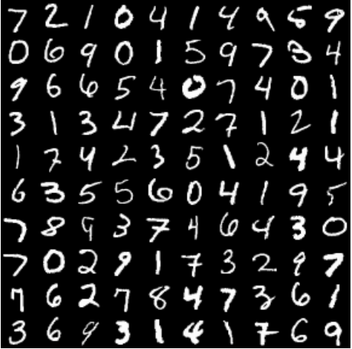
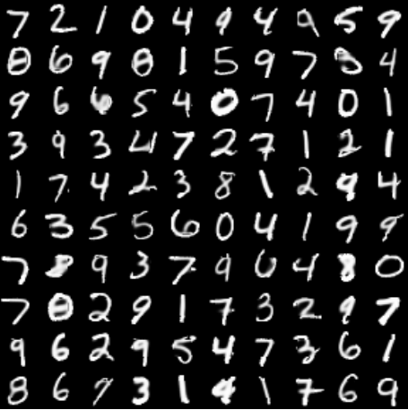
Generative Modeling
Have training examples
Want a model that can draw samples:
where $p_{model}\left(x\right)≈p_{data}(x)$
$$x∼p_{data}(x)$$
$$x^{′}∼p_{model}(x)$$
$$x∼p_{data}(x)$$
$$x^{′}∼p_{model}(x)$$

Slide 5
Why generative models?
“What I cannot create, I do not understand.”
-- Richard Feynman

Slide 6
Why generative models?
Leverage unlabeled datasets, which are often much larger than labeled ones
Unsupervised learning
e.g., clustering, density estimation, feature extraction, dimension reduction, data generation
Semi-supervised learning
e.g., classification, information extraction, learning-to-rank, network analysis, opinion mining
Conditional generative models
Speech synthesis: Text ⇒ Speech
Machine Translation: French ⇒ English
Image captioning: Image ⇒ Text

Slide 7
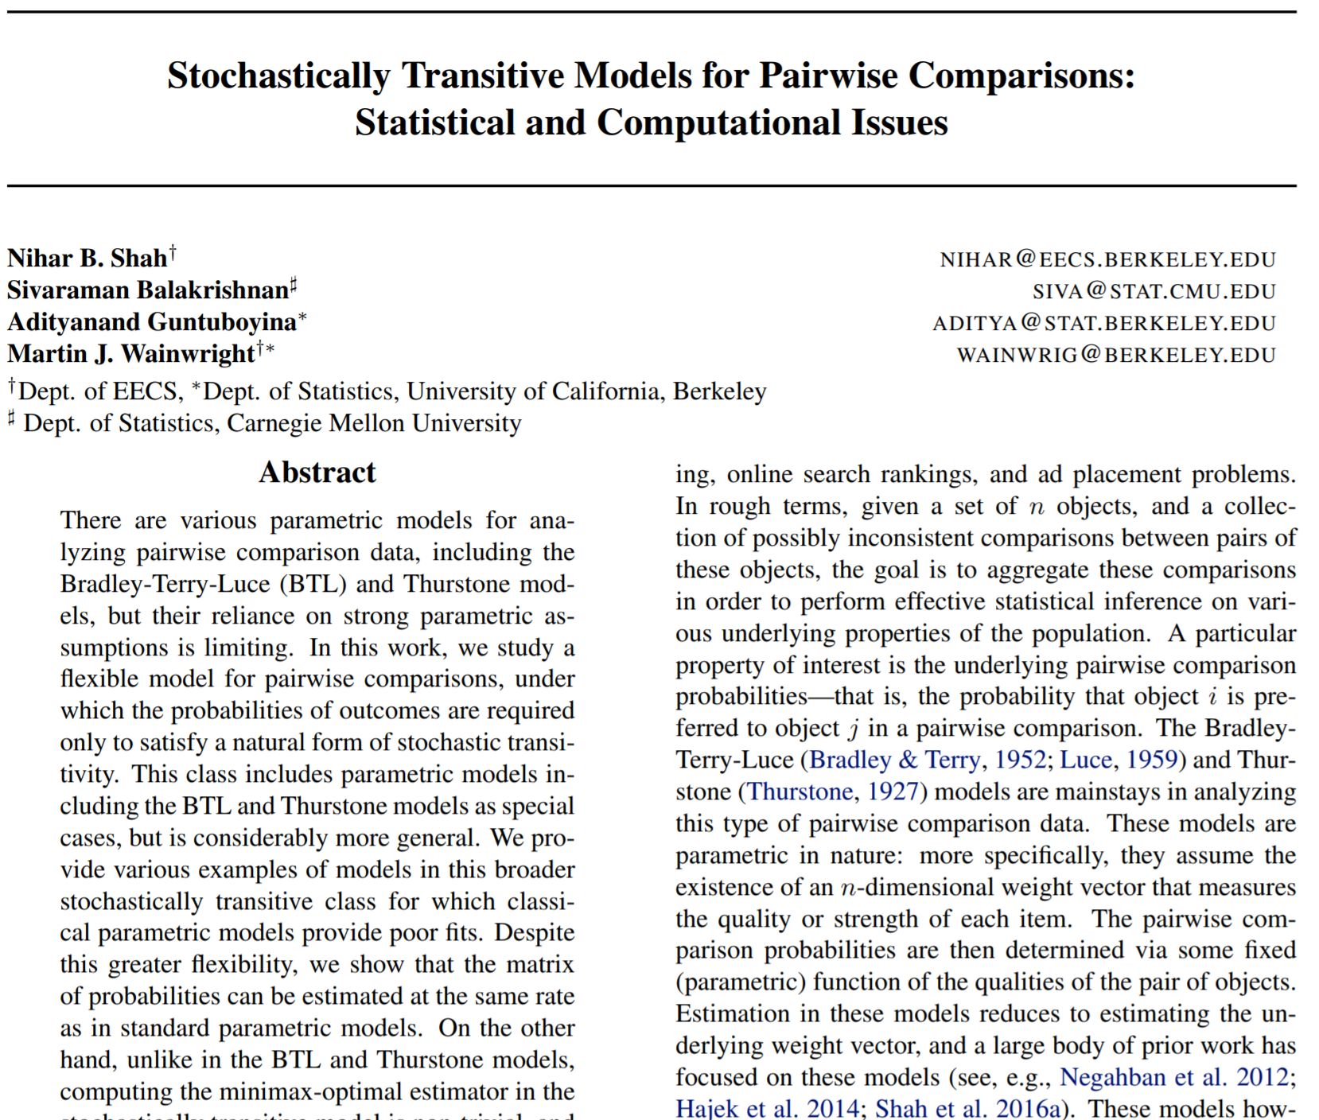
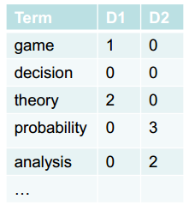
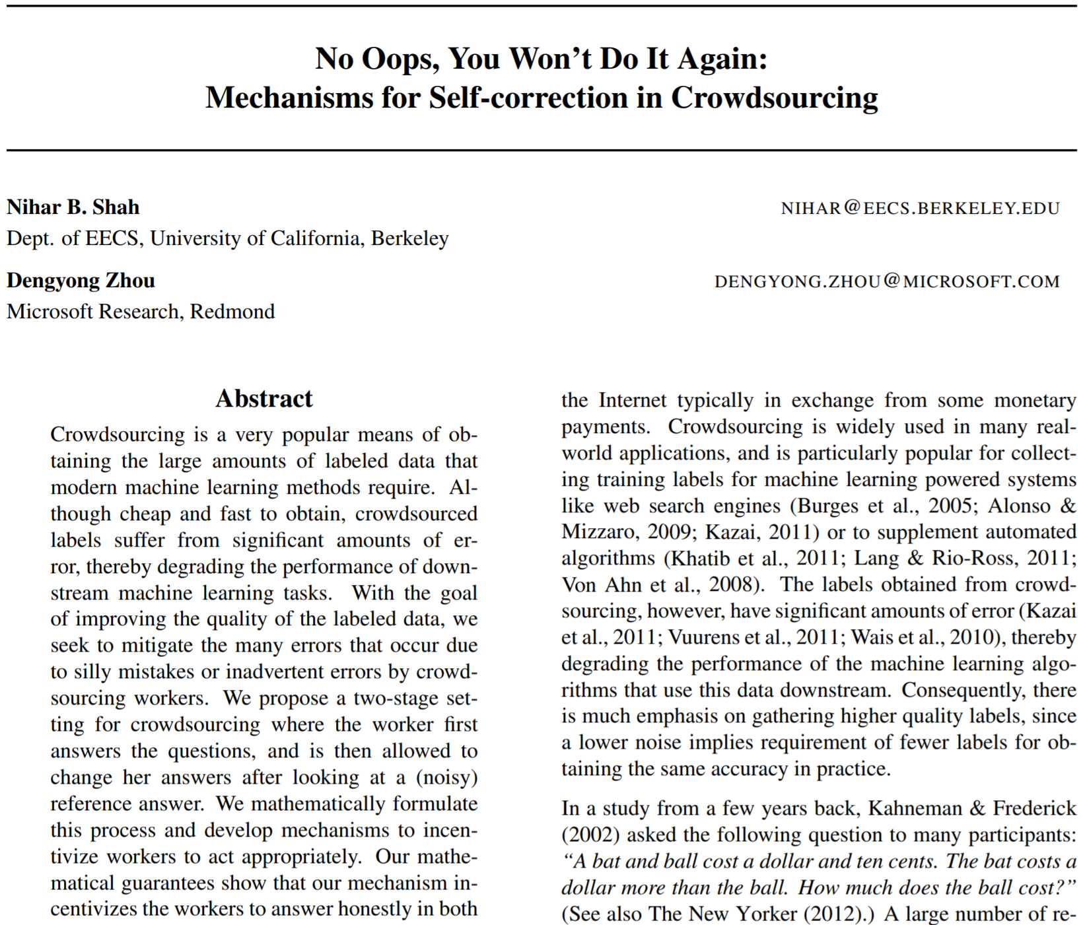
Generative models are everywhere …
A simple unigram language model
Observations (e.g., bag-of-words)
$$x=\{x_{1},…,x_{d}\}$$

Slide 8
Generative models are everywhere …
A simple unigram language model
Observations (e.g., bag-of-words)
Joint distribution (likelihood)
Graphical representation
parameters ignored
$$x=\{x_{1},…,x_{d}\}$$
retrieval 0.02
text 0.01
learning 0.02
sports 0.01
…
$$p\left(x;θ\right)=\prod{p\left(x_{i} ;θ\right) }$$
$$θ:$$
x
$$x_{i}$$
$$i=1:d$$

Slide 9
Generative models are everywhere …
Learn a simple generative model
Given a set of observations
Maximize the log-likelihood
Simple closed-form solutions:
count frequency for discrete multinomial
empirical mean/variance for Gaussian distribution
$$X=\{x_{1},…,x_{N}\}$$
$$\max_{θ} log p\left(X;θ\right)=\sum{log p\left(x_{i} ;θ\right)}$$
retrieval 0.05
text 0.02
learning 0.01
sports 0.01
…

Slide 10
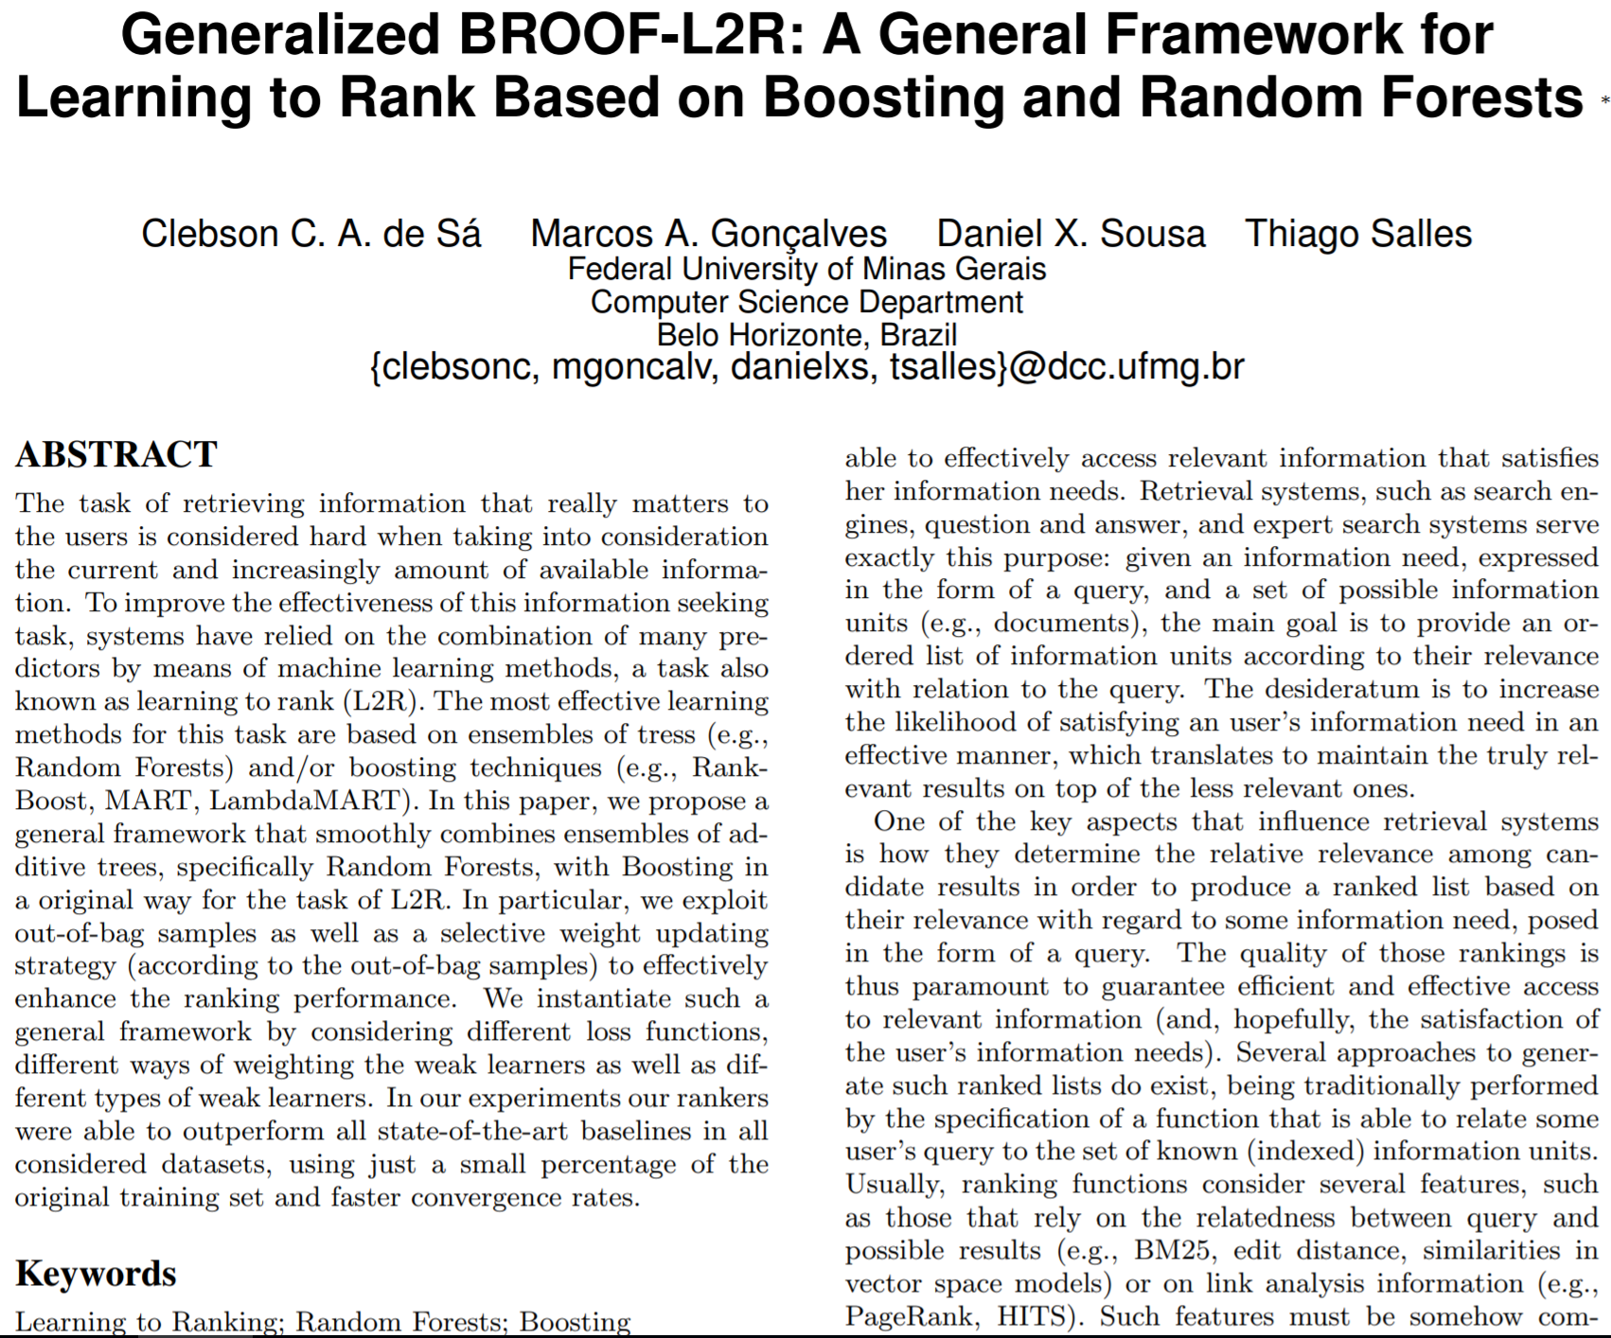
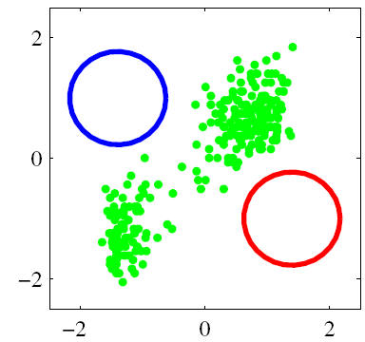
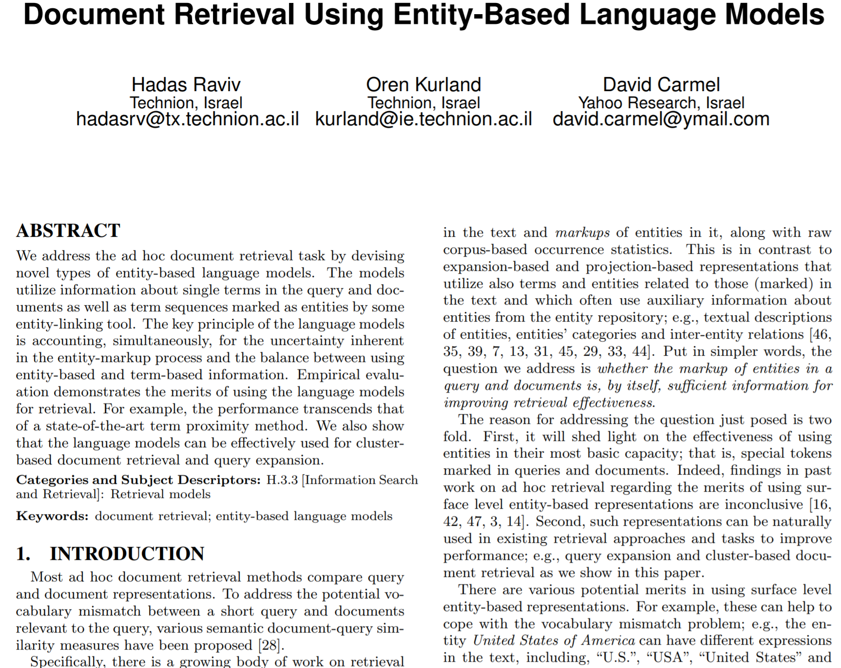
Generative models are everywhere …
A fully-observed model is not sufficient
Data has hidden structures
A simple distribution is not sufficient

Slide 11
Generative models are everywhere …
Mixture model --- a simple generative model with hidden factors
Ideally, if we can separate the data into different groups
T1=“SIGIR”
T2=“ICML”
retrieval 0.05
text 0.02
learning 0.01
sports 0.01
…
learning 0.03
theory 0.02
algorithm 0.01
deep 0.01
…

Slide 12
Generative models are everywhere …
Mixture model --- a simple generative model with hidden factors
Graphical model representation
z
$$p(z)$$
$$p\left(x,z\right)=p(z)p(x|z;θ)$$
x
$$p(x|z;θ)$$

Slide 13
Generative models are everywhere …
Mixture model --- a simple generative model with hidden factors
Infer the latent Z for a particular input x:
z
$$p(z)$$
Bayes’ Rule:
$$p\left(z|x\right)=\frac{p(x,z)}{p(x)}$$
$∝p(z)p(x|z;θ)$
x
$$p(x|z;θ)$$

Slide 14
Generative models are everywhere …
Mixture model --- a simple generative model with hidden factors
EM algorithm to learn the unknown language models
E-step: Infer the hidden Z
M-step: Update the parameters
T1=“SIGIR”
T2=“ICML”
retrieval 0.05
text 0.02
learning 0.01
sports 0.01
…
learning 0.03
theory 0.02
algorithm 0.01
deep 0.01
…

Slide 15
Outline
Basics of Generative Models
Deep Generative Models
Tea Break
Semi-supervised Learning
ZhuSuan: a Probabilistic Programming library
Conclusions & QA

Slide 16
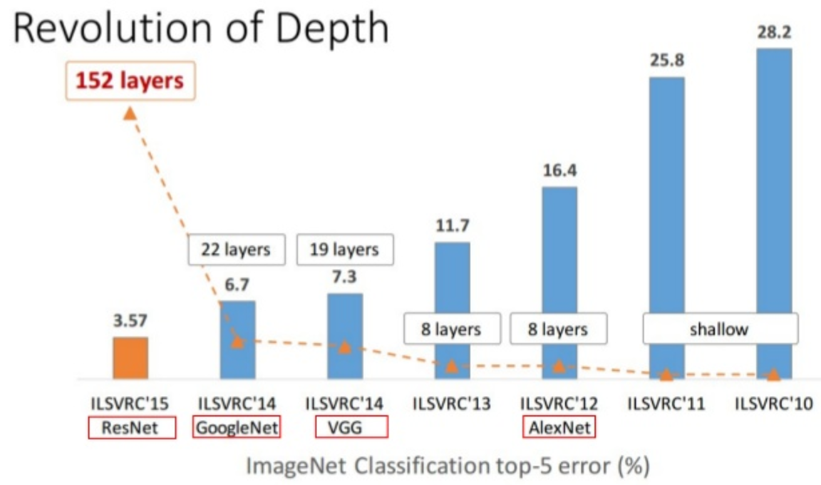
Lessons to go deep
Revolution of depth

Slide 17
Two ways to build deep generative models
Traditional one
Hierarchical Bayesian methods
More modern one
Deep generative models

Slide 18
Hierarchical Bayesian Models

Slide 19
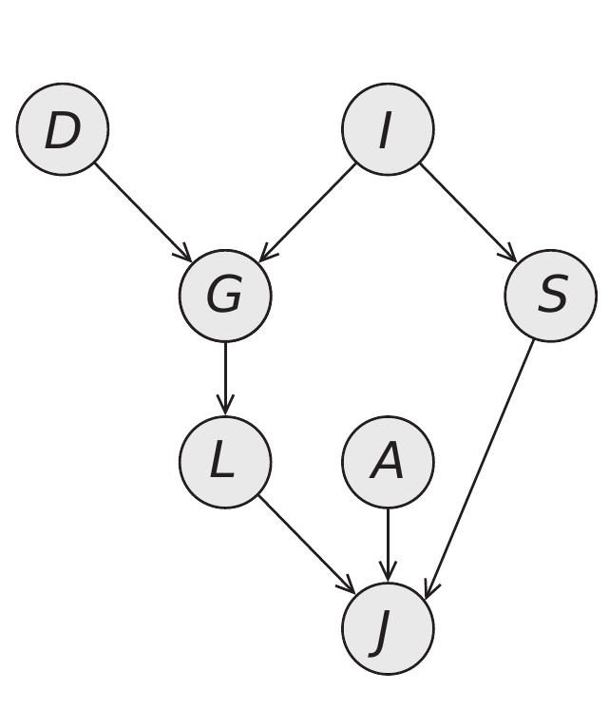
Hierarchical Bayesian Modeling
Build a hierarchy throng distributions in analytical forms
$$\text{P}\left(\text{D}\text{, }\text{I}\text{, }\text{G}\text{, }\text{S}\text{, }\text{L}\text{, }\text{A}\text{, }\text{J}\right)\text{ = }\text{P}\left(\text{D}\right)\text{P}\left(\text{I}\right)\text{P}\left(\text{G} | \text{D}\text{, }\text{I}\right)\text{P}\left(\text{S} | \text{I}\right)⋅$$
$$\text{P}\text{(}\text{L}\text{|}\text{G}\text{)}\text{P}\text{(}\text{J}\text{|}\text{L}\text{, }\text{A}\text{, }\text{S}\text{)}$$
Simple, Local Factors: a conditional probability distribution

Slide 20
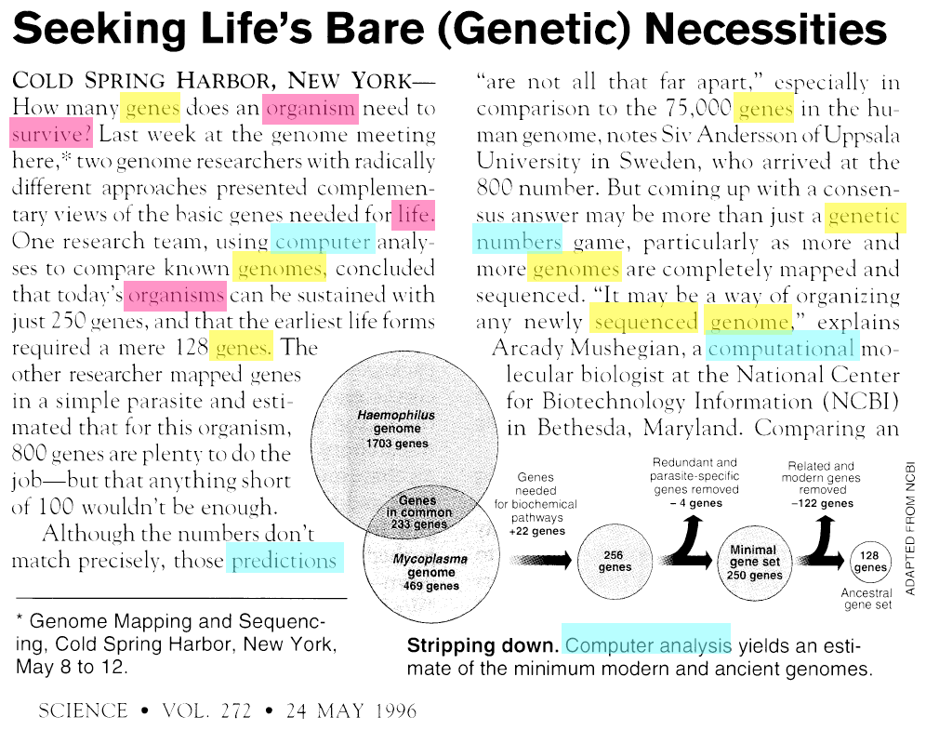
Multiple Topics exist in a Document
Go deeper into a single document
[Slides courtesy: D. Blei]
Notes:
In fact, each document may exhibit multiple topics to different degrees.

Slide 21
Latent Dirichlet Allocation (LDA)
[Slides courtesy: D. Blei]

Slide 22
Latent Dirichlet Allocation
[Slides courtesy: D. Blei]

Slide 23
Latent Dirichlet Allocation
[Slides courtesy: D. Blei]

Slide 24
Latent Dirichlet Allocation (LDA)
A Bayesian model for text document analysis
Inference finds the posterior distribution
mixing
proportion
topic
assignment
words
topics
$$p\left(Θ,Φ, Z | W,α,β\right)∝\prod_{k}{p\left(φ_{k} | β\right)}\prod_{d}{p\left(θ_{d} | α\right)\left(\prod_{n}{p\left(z_{dn} | θ_{d}\right)p\left(w_{dn} | z_{d},Φ\right)}\right)}$$

Slide 25
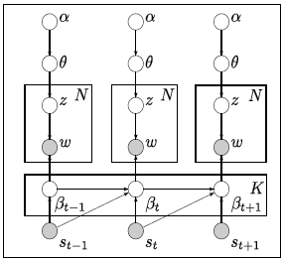
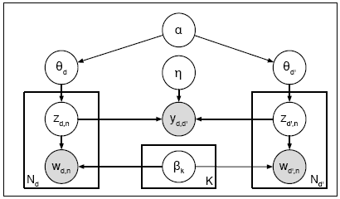
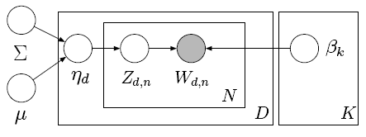
LDA has been widely extended …
LDA can be embedded in more complicated models,
capturing rich structures of the texts
Extensions are either on
Priors: e.g., Markov process prior for dynamic topic models, logistic-normal prior for corrected topic models, etc
Likelihood models: e.g., relational topic models, multi-view topic models, etc.
Tutorials were provide by D. Blei at ICML, SIGKDD, etc. (http://www.cs.princeton.edu/~blei/topicmodeling.html)

Slide 26
Applications
Data visualization
Natural language processing
Recommendation system
Computer vision
Information retrieval
and many more
Alternative views
Clustering
Matrix factorization
Discrete PCA

Slide 27
Learning with Big Data
Data can be very large
The ClueWeb12 dataset (webpages)
#docs (D): billion
#vocabulary (V): million
#topics (K): million
#tokens (T): 100 billion
Raw size (html): 27TB
Text: 700GB
Our recent work:
WarpLDA on CPU clusters (VLDB 2016)
SaberLDA on GPUs (ASPLOS 2017)
Scalable dynamic topic models (WWW 2016)
Online Bayesian passive-aggressive learning (JMLR 2017)
Scalable CTM (NIPS 2013)

Slide 28
Learning with Big Data
Data can be very large
The ClueWeb12 dataset (webpages)
#docs (D): billion
#vocabulary (V): million
#topics (K): million
#tokens (T): 100 billion
Raw size (html): 27TB
Text: 700GB
Our recent work:
WarpLDA on CPU clusters (VLDB 2016)
SaberLDA on GPUs (ASPLOS 2017)
Scalable dynamic topic models (WWW 2016)
Online Bayesian passive-aggressive learning (JMLR 2017)
Scalable CTM (NIPS 2013)

Slide 29
Bayesian Inference for LDA
Collapsed Gibbs Sampling
Topic counts
Token at (d, n):
Sampling each token is O(K)

Slide 30
Bayesian Inference for LDA
LightLDA: Metropolis-Hastings (Yuan et al., 2015)
Target distribution: sample in O(K)
Proposal distributions: sample in O(1)
Acceptance rates: sample in O(1)

Slide 31
Randomly accessed memory size
Cache MISS

Slide 32
WarpLDA
Monte-Carlo EM (delayed update)
E step: sample Z
M step: estimate $Θ, Φ$
Plug in
Same as CGS, but the counts are updated after the sampling
[Chen, Li, Zhu, & Chen, VLDB 2016]

Slide 33
WarpLDA
Current word: in the cache
Document phase
sort the tokens by d
do all Cdk related computation
Word phase
sort the tokens by w
do all Cwk related computation
Others: not stored
Last word: discarded
Next word: in the cache
[Chen, Li, Zhu, & Chen, VLDB 2016]

Slide 34
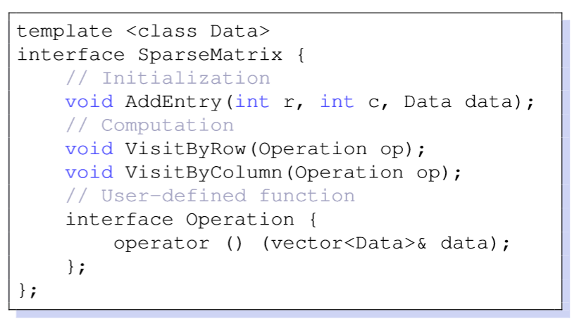
WarpLDA
Distributed sparse matrix computing engine
Document phase
Word phase
[Chen, Li, Zhu, & Chen, VLDB 2016]

Slide 35
WarpLDA
Lower L3 cache miss rate

Slide 36
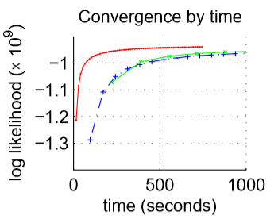
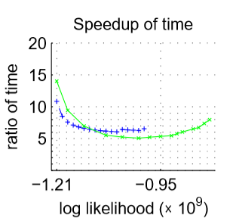
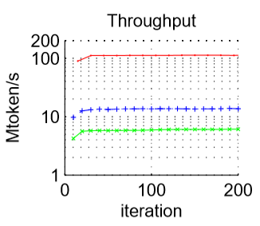
WarpLDA
Much faster convergence than previous methods
Notes:
Single machine results

Slide 37
WarpLDA
Large data and model
The ClueWeb12 dataset
600M documents
200G tokens = 1600GB space to store
1M vocabulary
1M topics
Cdk: 600M * 1M
Cwk: 1M * 1M sparse = 100GB-1TB space to store
Ck: 1M = 8MB to store
- Accessed sequentially
- Can be distributed
- Accessed randomly, but not in cache!
- Not even fit in single node
- Fits in L3 cache

Slide 38
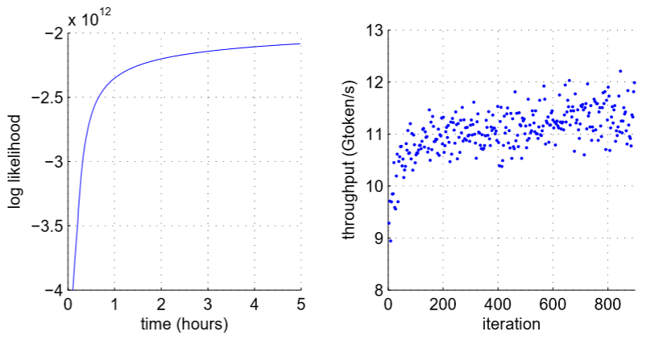
WarpLDA
Very scalable
256 machines on Tianhe-2 achieves 12Gtoken/s
Previous methods: ~100Mtoken/s

Slide 39
WarpLDA
Mines meaningful topics from 600M web pages
机器学习：26 topics
kernel machines learning workshop vector sch nips tutorials call smola
workshop learning conference machine international systems intelligence artificial computational canada
learning machine analysis data algorithms statistics computational theory complexity statistical
清华大学：4 topics
iii iiis tsinghua titled yao itcs titles achievements introduction hrd
university china tsinghua chinese beijing english peking wang shanghai zhang
journal journals international applied tsinghua practice bulletin american issues annals
ihep physics lnt beijing institute peking hep tsinghua energy cas
境外反华势力：24 topics
gong falun persecution china chinese government human reports ngos timeline
gong falun persecution chinese china party jiang practitioners communist government
gong shen yun maureen master ling falun chinese ifb experience

Slide 40
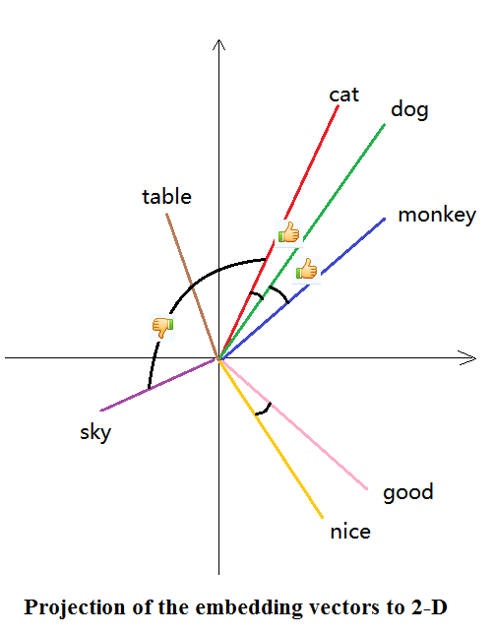
Generative Topic Embedding
Word Embedding
Widely used in NLP applications
Maps words into continuous, low dimensional vectors
Vector direction usually encodes semantics
Embedding methods
Paragraph Vector, CNN, …
LDA + Embedding?
Gaussian LDA
[Li et al., ACL 2016]

Slide 41
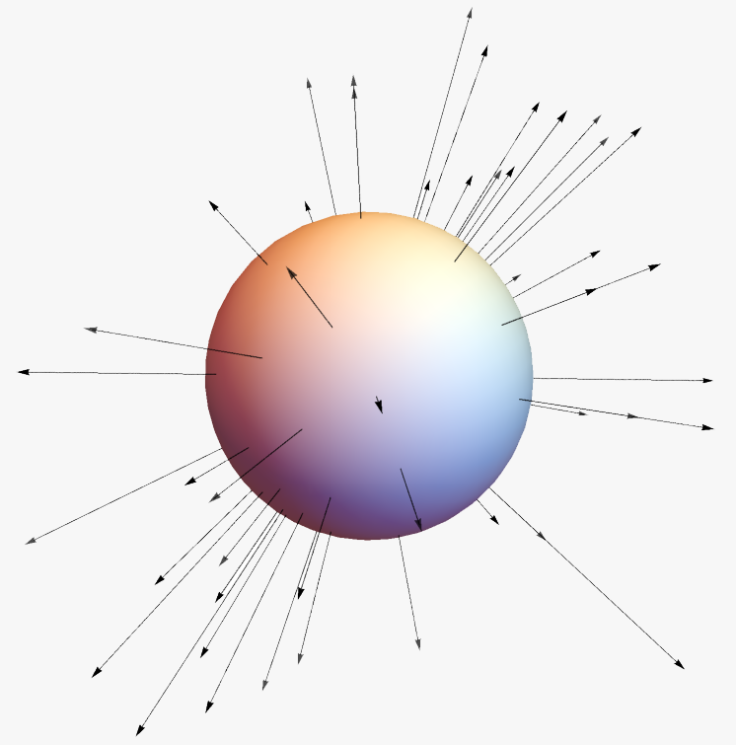
Bag-of-Vectors View of a Document
Represent each word by its embedding vector
A doc = a set of vectors shooting in different directions
Vectors form clusters
Directions containing more vectors ≈ typical semantics

Slide 42
Topic Embeddings in a Single Document
Find a typical vector for a cluster of vectors
Left graph: two typical vectors ,
Typical vectors ≈ major semantics = Topics
Topic embeddings represent the document concisely
Minor semantics are ignored

Slide 43
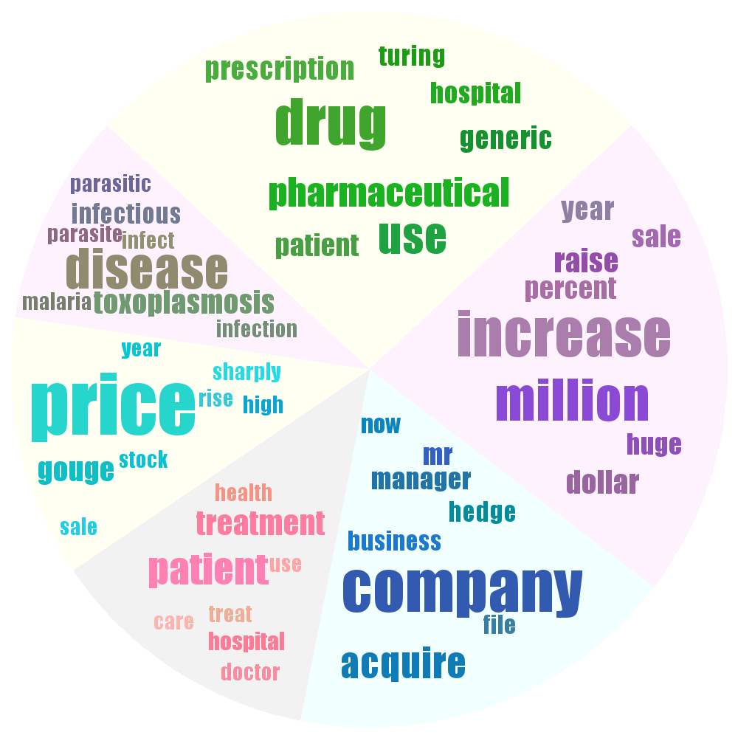
Topic Embeddings Illustrated
On a news article about a pharmaceutical company acquisition

Slide 44
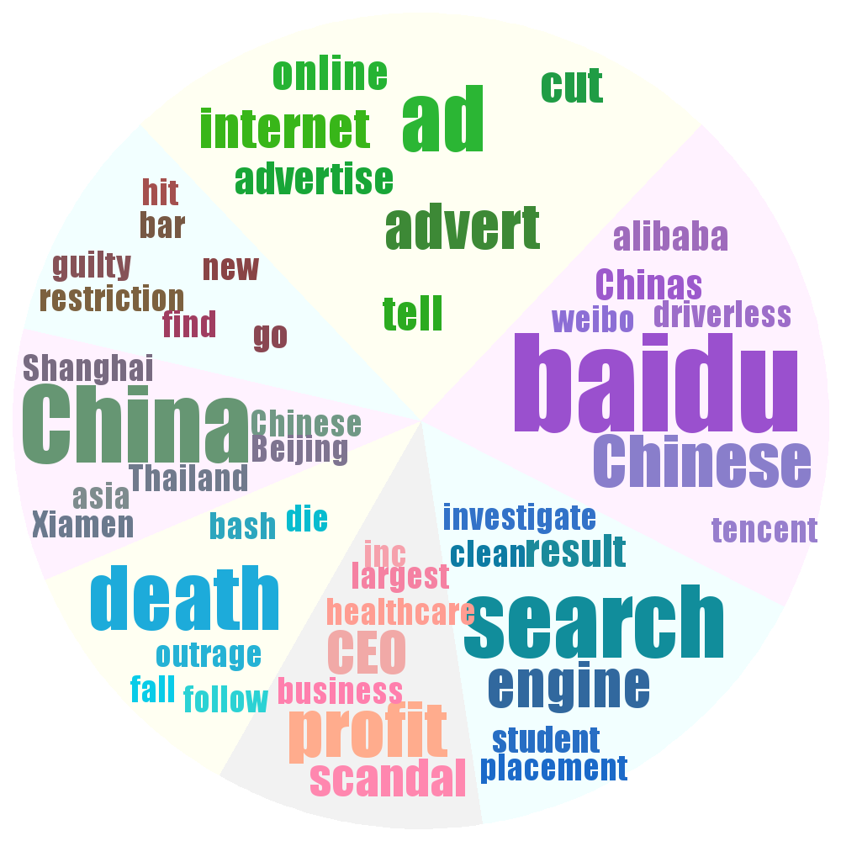
Topic Embeddings Illustrated (2)
16944 tweets after Baidu Ads scandal (Wei Zexi incident)

Slide 45
The Topic in a Topic Model
Topic (a.k.a. Topic-word distribution)
Each word in a document has a latent topic
Each topic is a categorical distribution of words
$$p\left(w_{1} | t_{k}\right)=p_{k1},⋯,p\left(w_{W} | t_{k}\right)=p_{kW}$$
Most topics may have some vague semantics
Sports, electronics, computer science…
Semantically more related words have higher prob
Disadvantage
Each word needs a probability as a parameter
K*(W-1) parameters – too many!

Slide 46
Continuous Representation of Topics
Probability of each word $w_{i}$ under topic $k$:
$$p\left(w_{i} | t_{k}\right)=\frac{P(w_{i})\exp{\{v_{w_{i}}^{T}t_{k}\}}}{\sum_{j}{P(w_{j})\exp{\{v_{w_{j}}^{T}t_{k}\}}}}$$
$P(w_{i})$: prior prob of $w_{i}$
$v_{w_{i}}$: pretrained word embedding
Predict a word probability by the dot-product of the topic embedding and the word embedding
Semantically more related words have higher prob
Ensures topic coherence
Topic embedding: $t_{k}$ (100~500 dimensional)
Parameter number: 500*K

Slide 47
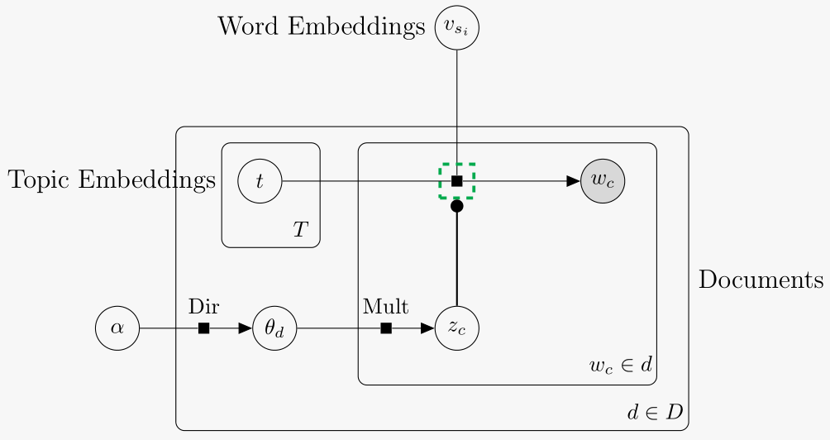
Graphical Model
Topic-word distribution (softmax)
Major difference with LDA: formulation of topic-word distribution

Slide 48
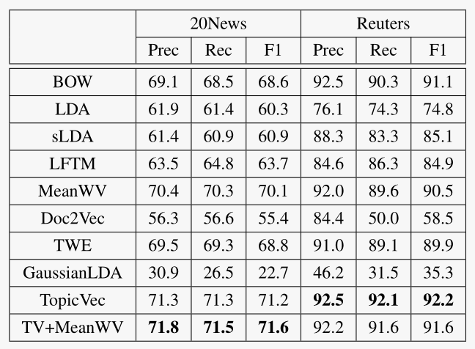
Evaluation on Document Classification
It measures how much semantic info is preserved
TopicVec: Topic proportions as features
TopicVec & TV+WV are best
MeanWV (mean word embedding) is not always helpful for TopicVec

Slide 49
Deep Generative Models

Slide 50
Deep Generative Models
More flexible by using differential function mapping between random variables
If z is uniformly distributed over (0, 1), then has the distribution
where
This trick is widely used to draw samples from exponential family distributions (e.g., Gaussian, Exponential)

Slide 51
Deep Generative Models
More flexible by using differential function mapping between random variables
DGMs learn a function transform with deep neural networks
z
Cause => Disease
Topics => Docs
Objects => Images
Words => Phonemes
$$f_{DNN}$$
x

Slide 52
An example with MLP
1D latent variable z; 2D observation x
Idea: NN + Gaussian (or Bernoulli) with a diagonal covariance
z
$$z∼N(0, 1)$$
$$θ$$
: deterministic function
$$μ_{1}$$
$$σ_{1}^{2}$$
$$μ_{2}$$
$$σ_{2}^{2}$$
: random sampling
$$x_{1}$$
$$x_{2}$$
$$x_{i}|z∼N\left(μ_{i}, σ_{i}^{2}\right)$$

Slide 53
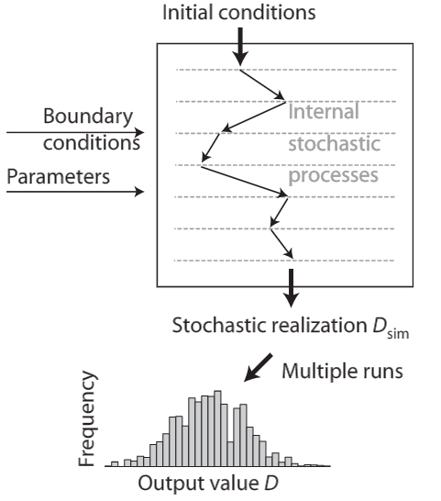
Implicit Deep Generative Models
Generate data with a stochastic process whose likelihood function is not explicitly specified (Hartig et al., 2011)

Slide 54
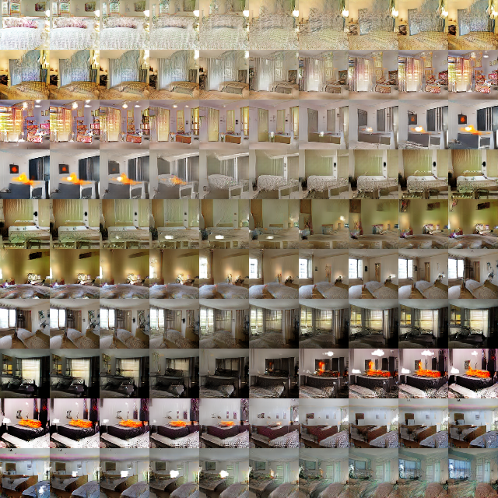
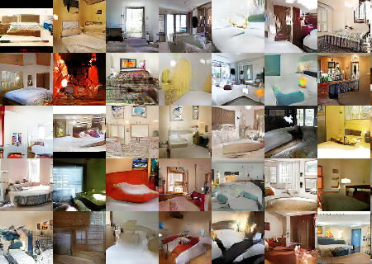
Deep Generative Models
[Image Generation:
Generative Adversarial Nets,
Goodfellow13 & Radford15]
z
$$f_{DNN}$$
x

Slide 55
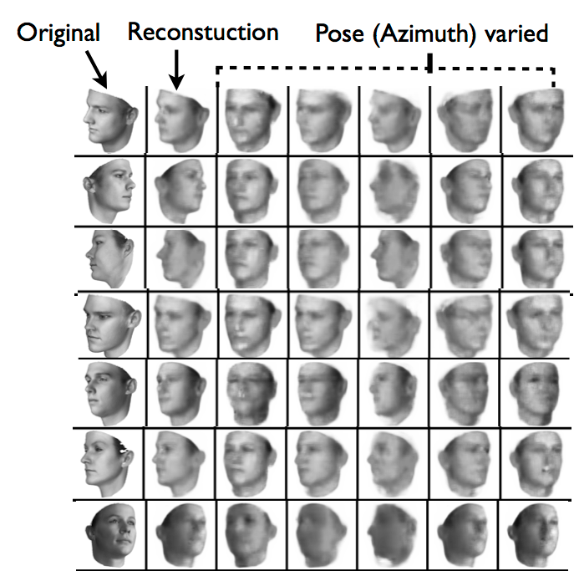
Deep Generative Models
z_{pos}
z_{others}
$$f_{DNN}$$
x
[Image Understanding: Variational Autoencoders, Kingma13 & Tejas15 & Eslami16]
Notes:
Reference的位置从左边移到了左下角，来适应变窄了的版面。

Slide 56
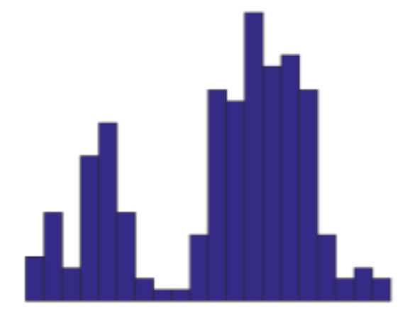
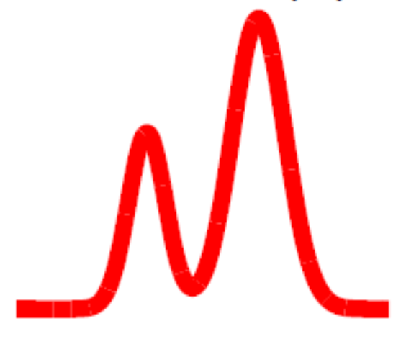
Learning Deep Generative Models
Given a set D of unlabeled samples, learn the unknown parameters (or a distribution)
Find a model that minimizes
data D={$x_{i}$}
models p$(x|θ)$
Notes:
High-level abstract form of generative models

Slide 57
Learning Deep Generative Models
Maximum likelihood estimation (MLE):
has an explicit likelihood model
Minimax objective (e.g., GAN)
a two-player game to reach equilibrium
Moment-matching:
draw samples from p:
Kernel MMD:
rich enough to distinguish any two distributions in certain RKHS
$$\hat{θ}=argmax p\left(D | θ\right)$$
$$\hat{D}={\left\{y_{i}\right\}}_{i=1}^{M}, {where y}_{i}∼p(x|θ)$$
Notes:
High-level abstract form of generative models

Slide 58
Variational Bayes
Consider the log-likelihood of a single example
Log-integral/sum is annoying to handle directly
Derive a variational lower bound $L\left(θ, φ,x\right)$
$$\log{p(x;θ)}=\log{∫p\left(z,x;θ\right)dz}$$
$$\log{p\left(x;θ\right)=L\left(θ, φ,x\right)+KL\left(q\left(z | x;φ\right)\right\|p(z|x;θ))}$$
$$L\left(θ, φ,x\right)=E_{q(z|x;φ)}\left[\log{p\left(z,x;θ\right)−\log{q\left(z | x;φ\right)}}\right]$$
= $E_{q(z|x;φ)}\left[\log{p\left(x|z;θ\right)+\log{p(z;θ)}−\log{q\left(z | x;φ\right)}}\right]$
= $E_{q(z|x;φ)}\left[\log{p\left(x|z;θ\right)}\right]−KL(q\left(z | x;φ\right)‖p\left(z;θ\right))$
reconstruction term
prior regularization

Slide 59
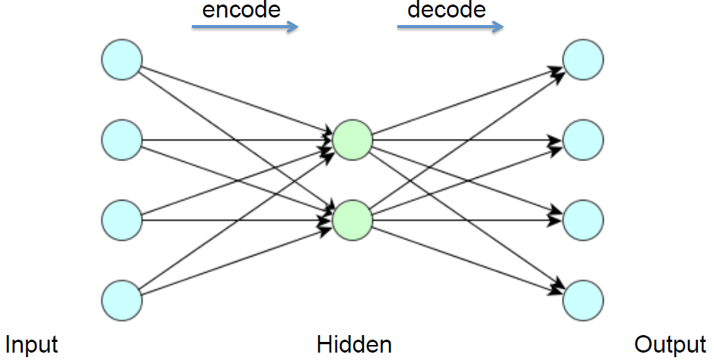
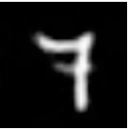
Recap: Auto-Encoder
Encoder:
Decoder:
Training: minimize the reconstruction error (e.g., square loss, cross-entropy loss)
Denoising AE: randomly corrupted inputs are restored to learn more robust features
$$h=s(Wx+b)$$
$$x^{′}=s(W^{′}h+b^{′})$$

Slide 60
Auto-Encoding Variational Bayes (AEVB)
What’s unique in AEVB is that the variational distribution is parameterized by a deep neural network
We call it an inference (recognition, encoder) network or a Q-network
All the parameters are learned jointly via SGD with variance reduction
$$q\left(z | x;φ\right)≈p\left(z | x;θ\right)$$
z
$$q\left(z | x;φ\right)$$
generation path
inference path
x
x
[Kingma & Welling, ICLR 2013; Rezende et al., ICML 2014]

Slide 61
The Encoder Network
A feedforward NN + Gaussian
$$q\left(z | x;φ\right)=N\left(μ(x;φ), σ^{2}(x;φ)\right)$$
z
$$μ$$
$$σ^{2}$$
$$φ$$
: deterministic function
: random sampling
$$x_{1}$$
$$x_{2}$$

Slide 62
The Complete Auto-encoder
The Q-P network architecture:
z
$$μ$$
$$σ^{2}$$
$$θ$$
$$φ$$
$$μ_{1}$$
$$σ_{1}^{2}$$
$$μ_{2}$$
$$σ_{2}^{2}$$
$$x_{1}$$
$$x_{2}$$
$$x_{1}$$
$$x_{2}$$
: deterministic function
: random sampling

Slide 63
Stochastic Variational Inference
Variational lower-bound for a single example
Variational lower-bound for a set of examples
Use stochastic gradient methods to handle large datasets
Random mini-batch
for each i, infer the posterior ; As we parameterize as a neural network, this in fact optimizes $φ$
However, calculating the expectation and its gradients is non-trivial, often intractable
$L\left(θ, φ,x\right)$ = $E_{q(z|x;φ)}\left[\log{p\left(x|z;θ\right)}\right]−KL(q\left(z | x;φ\right)‖p\left(z;θ\right))$
$$L\left(θ, φ,D\right)=\sum_{i}{E_{q(z_{i}|x_{i};φ)}\left[\log{p\left(x_{i}|z_{i};θ\right)}\right]−KL(q\left(z_{i} | x_{i};φ\right)‖p\left(z_{i};θ\right))}$$
$$q(z_{i}|x_{i};φ)$$

Slide 64
Example with Gaussian Distributions
Use N(0,1) as prior for z; $q(z|x;φ)$ is Gaussian with parameters $\left(μ(x;φ), σ^{2}(x;φ)\right)$determined by NN
The KL-divergence
Exercise: finish the derivation
$$z$$
$$μ$$
$$σ^{2}$$
$−KL(q\left(z | x;φ\right)\left\|p\left(z;θ\right)\right)=\frac{1}{2}$ $\left(1+\log{σ^{2}}−μ^{2}−σ^{2}\right)$
$$φ$$
$$x_{1}$$
$$x_{2}$$

Slide 65
Example with Gaussian Distributions
Use N(0,1) as prior for z; $q(z|x;φ)$ is Gaussian with parameters $\left(μ(x;φ), σ^{2}(x;φ)\right)$determined by NN
The expected log-likelihood
If the likelihood is Gaussian
The expectation is still hard to compute
because of nonlinearity functions
$$z$$
$$E_{q(z|x;φ)}\left[\log{p\left(x|z;θ\right)}\right]$$
$$μ$$
$$σ^{2}$$
$$−\log{p\left(x_{i} | z_{i}\right)}=\sum_{j}{\frac{1}{2}\log{σ_{j}^{2}+\frac{{\left(x_{ij}−μ_{xi}\right)}^{2}}{2σ_{j}^{2}}}}$$
$$φ$$
$$x_{1}$$
$$x_{2}$$

Slide 66
Example with Gaussian Distributions
Use N(0,1) as prior for z; $q(z|x;φ)$ is Gaussian with parameters $\left(μ(x;φ), σ^{2}(x;φ)\right)$determined by NN
The expected log-likelihood
Approximate via Monte Carlo methods
An unbiased estimator
$$z$$
$$E_{q(z|x;φ)}\left[\log{p\left(x|z;θ\right)}\right]$$
$$μ$$
$$σ^{2}$$
$$E_{q(z|x;φ)}\left[\log{p\left(x|z;θ\right)}\right]≈\frac{1}{L}\sum_{k}{\log{p\left(x | z^{\left(k\right)}\right)}}$$
$$φ$$
$$z^{(k)}∼q(z|x;φ)$$
$$x_{1}$$
$$x_{2}$$

Slide 67
Example with Gaussian Distributions
The KL-regularization term (closed-form):
Easy to calculate gradient
The expected log-likelihood term (MC estimate)
Gradient needs back-propagation!
However, $z^{(k)}$ is a random variable, we can’t take gradient over a randomly drawn number
$−KL(q\left(z | x;φ\right)\left\|p\left(z;θ\right)\right)=\frac{1}{2}$ $\left(1+\log{σ^{2}}−μ^{2}−σ^{2}\right)$
$$z$$
$$μ$$
$$σ^{2}$$
$$E_{q(z|x;φ)}\left[\log{p\left(x|z;θ\right)}\right]≈\frac{1}{L}\sum_{k}{\log{p\left(x | z^{\left(k\right)}\right)}}$$
$$φ$$
$$z^{(k)}∼q(z|x;φ)$$
$$x_{1}$$
$$x_{2}$$

Slide 68
Reparameterization Trick
Backpropagation not possible through random sampling
$$f$$
$$q(z|x;φ)$$
$$z$$
$$∼q(z|x;φ)$$
$$φ$$
$$x$$
: deterministic node
: random node
$$z^{(k)}∼N\left(μ\left(x,φ\right), σ^{2}\left(x,φ\right)\right)$$
$$\{−1.5, −0.5, 0.3, 0.6,1.5, …\}$$
Cannot back-propagate through a
randomly drawn number

Slide 69
Reparameterization Trick
Backpropagation not possible through random sampling
$$f$$
Backprop
$$f$$
$$z$$
$$∼q(z|x;φ)$$
$$∂f/∂z_{j}$$
$$z$$
$$=g(φ,x,ε)$$
$$φ$$
$$∂f/∂φ_{i}$$
$$φ$$
$$ε$$
$$∼p(ε)$$
$$x$$
$$x$$
: deterministic node
: random node
$$ε^{(k)}∼N(0,1)$$
$$z^{(k)}∼N\left(μ\left(x,φ\right), σ^{2}\left(x,φ\right)\right)$$
$$z^{(k)}=μ\left(x,φ\right)+σ\left(x,φ\right)⋅ε^{(k)}$$
Cannot back-propagate through a
randomly drawn number
Z has the same distribution, but now can back-prop
Separate into a deterministic part and noise

Slide 70
The General Form
The VAE bound
Monte Carlo estimate:
Again, we cannot back-prop through the randomly drawn numbers
$$L\left(θ, φ,x\right)=E_{q(z|x;φ)}\left[\log{p\left(z,x;θ\right)−\log{q\left(z | x;φ\right)}}\right]$$
$${=E}_{q(z|x;φ)}\left[\log{\frac{p\left(z,x;θ\right)}{q\left(z | x;φ\right)}}\right]$$
$$L\left(θ, φ,x\right)≈\frac{1}{L}\sum_{k}{\log{\frac{p\left(z^{(k)},x;θ\right)}{q\left(z^{(k)} | x;φ\right)}}}$$
$$z^{(k)}∼q(z|x;φ)$$

Slide 71
Reparameterization Trick
Backpropagation not possible through random sampling
$$f$$
Backprop
$$f$$
$$z$$
$$∼q(z|x;φ)$$
$$∂f/∂z_{j}$$
$$z$$
$$=g(φ,x,ε)$$
$$φ$$
$$∂f/∂φ_{i}$$
$$φ$$
$$ε$$
$$∼p(ε)$$
$$x$$
$$x$$
: deterministic node
: random node
$$ε^{(k)}∼p(ε)$$
$$z^{(k)}=g\left(φ, x,ε^{\left(k\right)}\right)$$
$$z^{(k)}∼q(z|x;φ)$$
Cannot back-propagate through a randomly
drawn number
Z has the same distribution, but now can back-prop
Separate into a deterministic part and noise
Notes:
More general form

Slide 72
Reparam-Trick Summary
The VAE bound
Reparameterized as
where $ε$is a simple distribution (e.g., standard normal) and $g$ is a deep NN
The gradients are
Back-prop is applied over the deep NN
Similar for $φ$
$$L\left(θ, φ,x\right)=E_{q(z|x;φ)}\left[\log{\frac{p\left(z,x;θ\right)}{q\left(z | x;φ\right)}}\right]$$
$$L\left(θ, φ,x\right)=E_{p(ε)}\left[\log{\frac{p\left(g\left(x,ε,φ\right),x;θ\right)}{q\left(g\left(x,ε,φ\right) | x;φ\right)}}\right]$$
$$∇_{θ}L\left(θ, φ,x\right)=E_{p(ε)}\left[∇_{θ}\log{\frac{p\left(g\left(x,ε,φ\right),x;θ\right)}{q\left(g\left(x,ε,φ\right) | x;φ\right)}}\right]$$

Slide 73
Importance Weighted Auto-Encoder (IWAE)
The VAE lower bound of log-likelihood
A better variational lower bound (IWAE)
This is a lower-bound of the log-likelihood
When K=1, recovers the VAE bound
When , recovers the log-likelihood
A monotonic sequence:
$$L\left(θ, φ,x\right)=E_{q(z|x;φ)}\left[\log{\frac{p\left(z,x;θ\right)}{q\left(z | x;φ\right)}}\right]$$
$$L_{K}\left(θ, φ,x\right)=E_{q(z|x;φ)}\left[\log\left(\frac{1}{K}\sum_{k=1:K}{\frac{p\left(z^{(k)},x;θ\right)}{q\left(z^{(k)} | x;φ\right)} }\right)\right]$$
where $z^{(k)}∼q(z|x;φ)$
$$K=∞$$
$$L_{K}\left(θ, φ,x\right)≤L_{K+1}\left(θ, φ,x\right), ∀θ,φ,x$$
[Burda et al., arXiv, 2015]

Slide 74
Reparametrization Trick
The IWAE bound:
Reparameterization form:
The gradient can be calculated as in VAE
$$L_{K}\left(θ, φ,x\right)=E_{q(z|x;φ)}\left[\log\left(\frac{1}{K}\sum_{k=1:K}{w\left(z^{\left(k\right)},x;θ\right) }\right)\right]$$
where $z^{(k)}∼q(z|x;φ)$
$$w\left(z^{\left(k\right)},x;θ,φ\right)=\frac{p\left(z^{(k)},x;θ\right)}{q\left(z^{(k)} | x;φ\right)}$$
$$L_{K}\left(θ, φ,x\right)=E_{p(ε) }\left[\log\left(\frac{1}{K}\sum_{k=1:K}{w\left({g(ε}^{\left(k\right)},x,φ),x;θ\right) }\right)\right]$$
where $ε^{(k)}∼p(ε)$

Slide 75
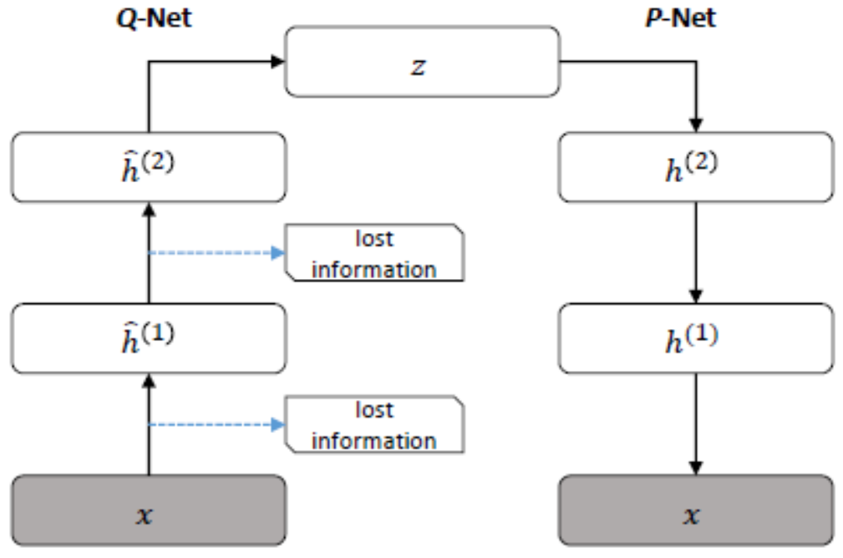
Symmetric Q-P Network
Problem: detail information is lost during abstraction

Slide 76
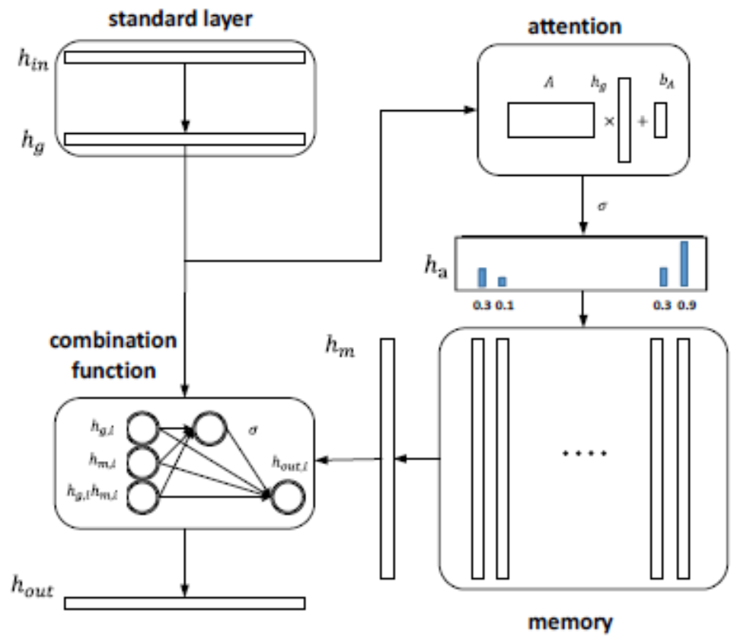
A Layer with Memory and Attention
[Li, et al., ICML 2016]
Notes:
Memory and learning are so closely connected that people often confuse them with each other. But the specialists who study them consider them two distinct phenomena.
These specialists define learning as a process that will modify a subsequent behaviour. Memory, on the other hand, is the ability to remember past experiences.You learn a new language by studying it, but you then speak it by using your memory to retrieve the words that you have learned.
Memory is essential to all learning, because it lets you store and retrieve the information that you learn. Memory is basically nothing more than the record left by a learning process.
Thus, memory depends on learning. But learning also depends on memory, because the knowledge stored in your memory provides the framework to which you link new knowledge, by association. And the more extensive your framework of existing knowledge, the more easily you can link new knowledge to it.

Slide 77
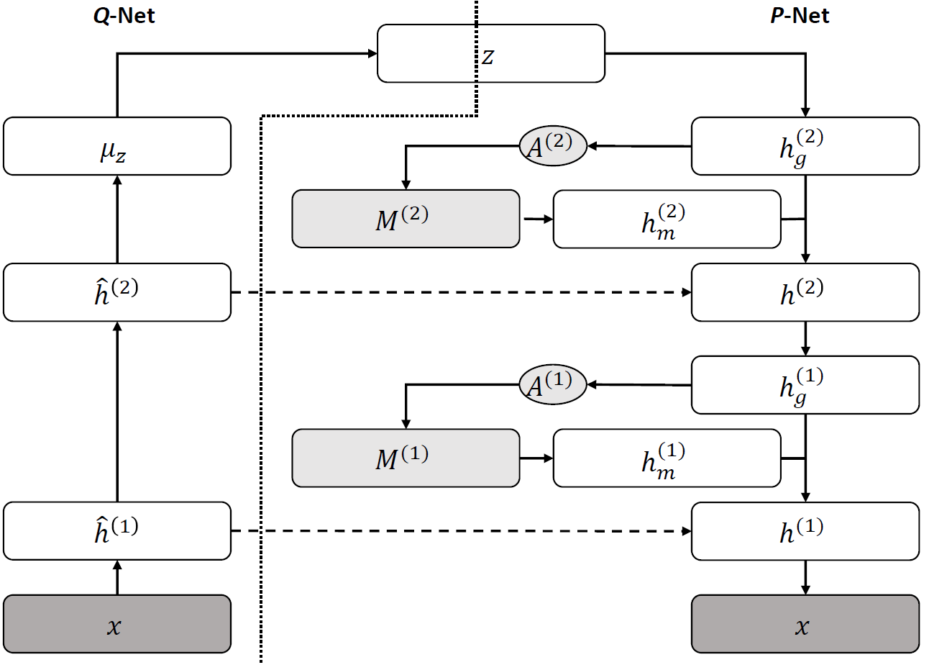
A Stacked Deep Model with Memory
Asymmetric architecture

Slide 78
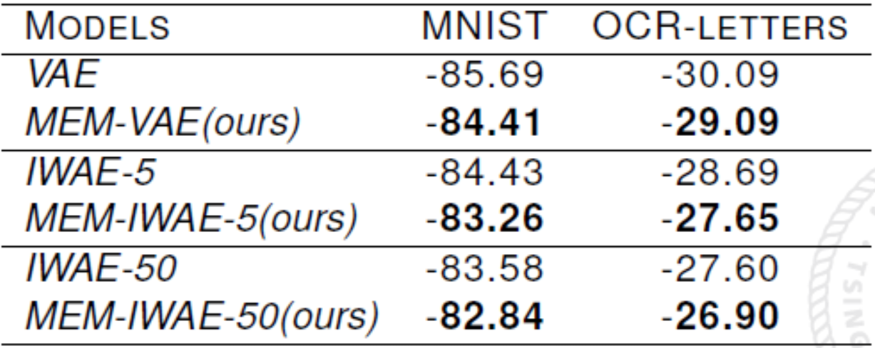
Some Results
Density estimation
Better than symmetric VAE networks
Comparable with state-of-the-art with much fewer parameters

Slide 79
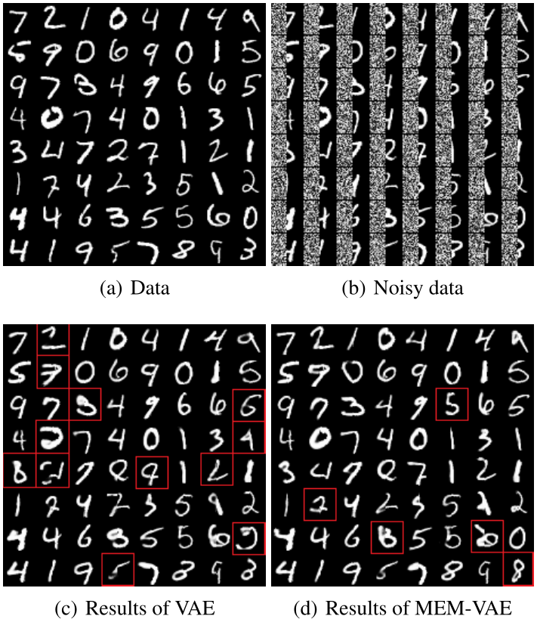
Missing Value Imputation

Slide 80
Learnt Memory Slots
Average preference over classes of the first 3 slots:
Corresponding images:

Slide 81
Generative Adversarial Networks (GAN)
A game between two players:
A discriminator D
A generator G
D tries to discriminate between:
A sample from the data distribution.
And a sample from the generator G.
G tries to “trick” D by generating samples that are hard for D to distinguish from data.
[Goodfellow et al., NIPS 2014]

Slide 82
GAN – architecture
The generator-network G is a DGM
It generates samples from random noise
z
$$G$$
x

Slide 83
GAN – architecture
The discriminator-network D is a binary classifier
It aims to assign the correct label to both training samples and the samples from G
This is a supervised learning task (binary classification)!
y
y=1
y=0
$$D$$
x
x from training set
x from DGM

Slide 84
GAN - objective
The discriminator-network D is a binary classifier
It aims to assign the correct label to both training samples and the samples from G
Maximum likelihood estimation (MLE) is the natural choice!
D(x) = p(y=1|x)
aka. cross-entropy loss minimization
$$\max_{D}{E_{p_{data}(x)}\left[\log{D(x)}\right]+E_{p(z)}\left[\log\left(1−D\left(G\left(z\right)\right)\right)\right]}$$
x from training set
G(z) from generator

Slide 85
GAN - objective
The generator aims to fool the discriminator D
Generated samples should be identified as “real” by D
Maximize the likelihood of being real:
Or minimize the likelihood of being fake:
$$\max_{G}{E_{p(z)}\left[\log\left(D\left(G\left(z\right)\right)\right)\right]}$$
G(z) is a sample from generator
$$\min_{G}{E_{p(z)}\left[\log\left(1−D\left(G\left(z\right)\right)\right)\right]}$$

Slide 86
GAN – objective
Minimax objective function
Optimal strategy of the discriminator for any $p_{model}(x)$ is
Assume infinite data, infinite model capacity, direct updating generator’s distribution
Unique global optimum
Optimum corresponds to data distribution
$$\min_{G}{\max_{D}{E_{p_{data}(x)}\left[\log{D(x)}\right]+E_{p(z)}\left[\log\left(1−D\left(G\left(z\right)\right)\right)\right]}}$$
$$D\left(x\right)=\frac{p_{data}(x)}{p_{data}\left(x\right)+p_{model}(x)}$$

Slide 87
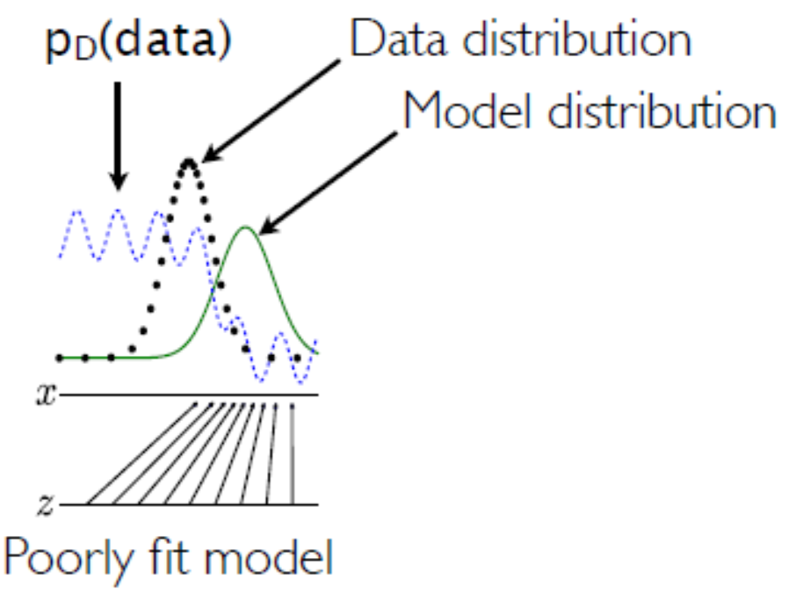
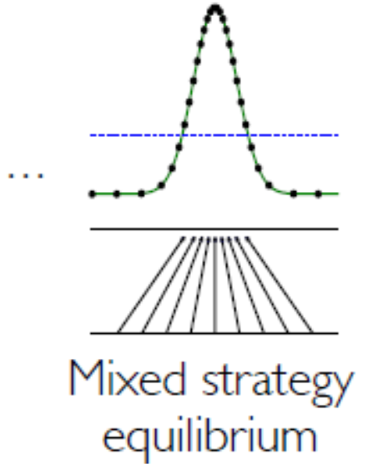
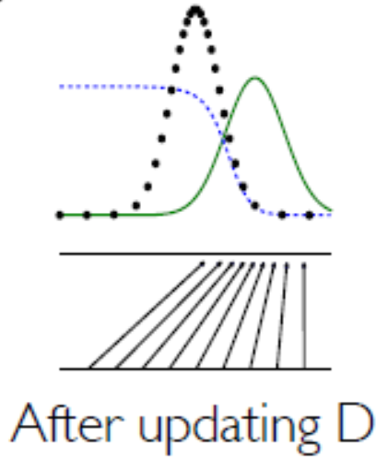
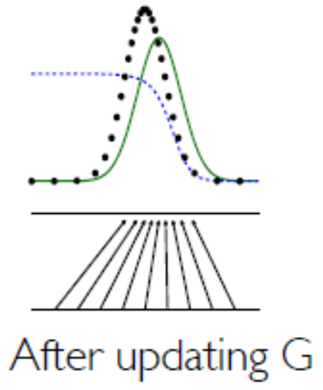
GAN – learning process
An adversarial pair near convergence: D is partially accurate
Update discriminator distribution D according to the optimal strategy
Update generator distribution to be more similar to data distribution
Iterate until convergence

Slide 88
Practice
Early stopping of discriminator training to avoid overfitting
Multiple updates of D
One update of G
Gradient saturation

Slide 89
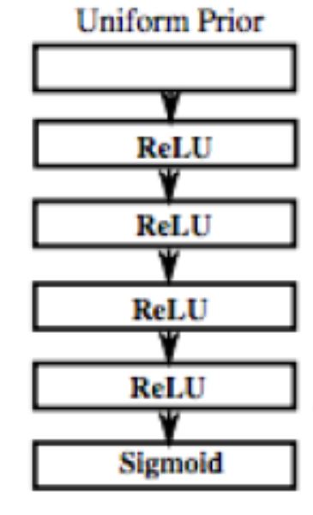
Moment-Matching DGMs
Moment-matching:
draw samples from p via DGM:
Kernel MMD:
Rich enough to distinguish any two distributions in certain RKHS
Back-propagation to update the parameters
$$y_{i}=f\left(ε_{i};θ\right), { ε}_{i}∼Uniform(0,1)$$
$$\hat{D}={\left\{y_{i}\right\}}_{i=1}^{M}$$
[Li et al., ICML 2015]
Notes:
High-level abstract form of generative models

Slide 90
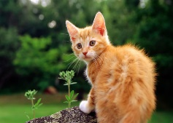
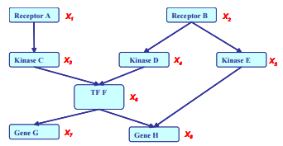
Conditional Models
We’re more interested in conditional distributions in many cases
Predictive modeling:
Better performance with fewer training samples
Contextual generation:
Building large networks:
p
$$y=cat$$
$$x=$$
p
$$x=cat with glass$$
$$and tie$$
$$y=$$

Slide 91
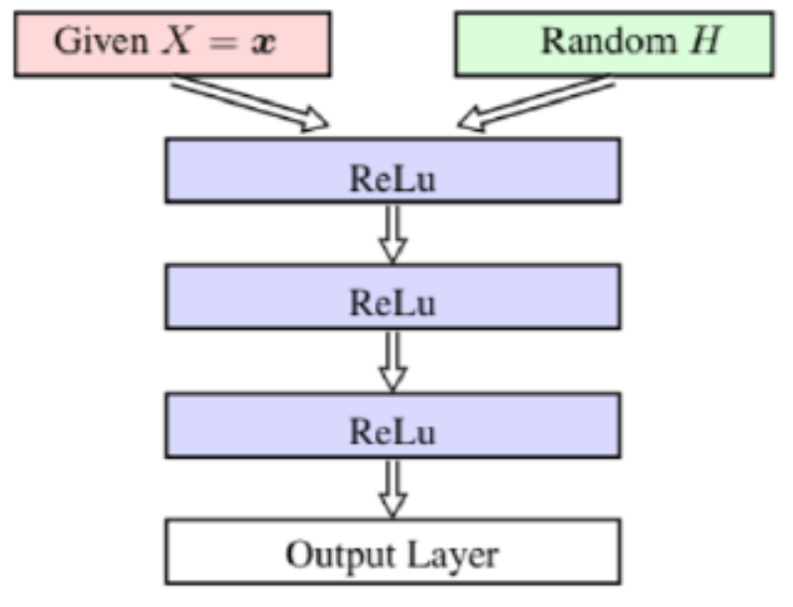
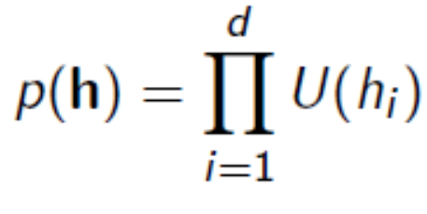
Conditional Moment-Matching Networks
Two sets of data samples (one from training set, one from the mdoel)
A DGM:
[Ren et al., NIPS 2016]

Slide 92
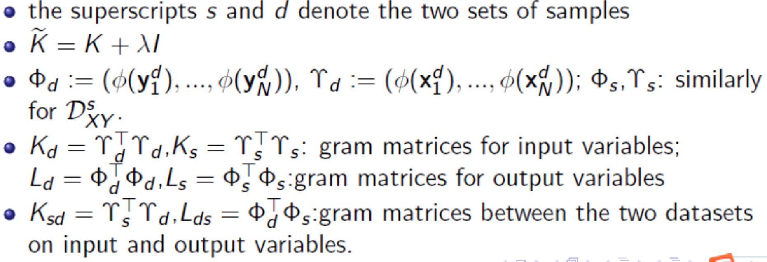
Conditional Moment-Matching Networks
We define conditional max-min discrepancy (CMMD):
[Ren et al., NIPS 2016]

Slide 93
Connections with MMD
MMD:
CMMD:
[Ren et al., NIPS 2016]

Slide 94
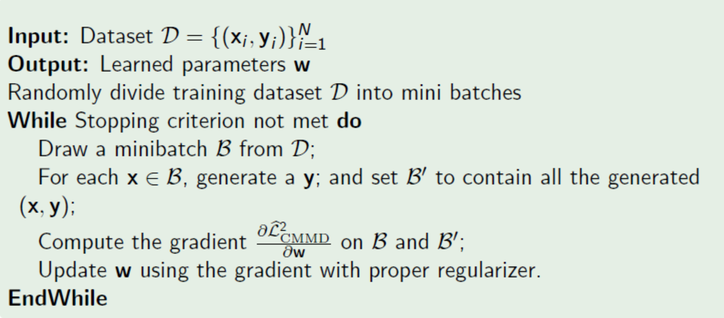
Mini-batch Training Algorithm
BP to compute the gradients:
[Ren et al., NIPS 2016]

Slide 95
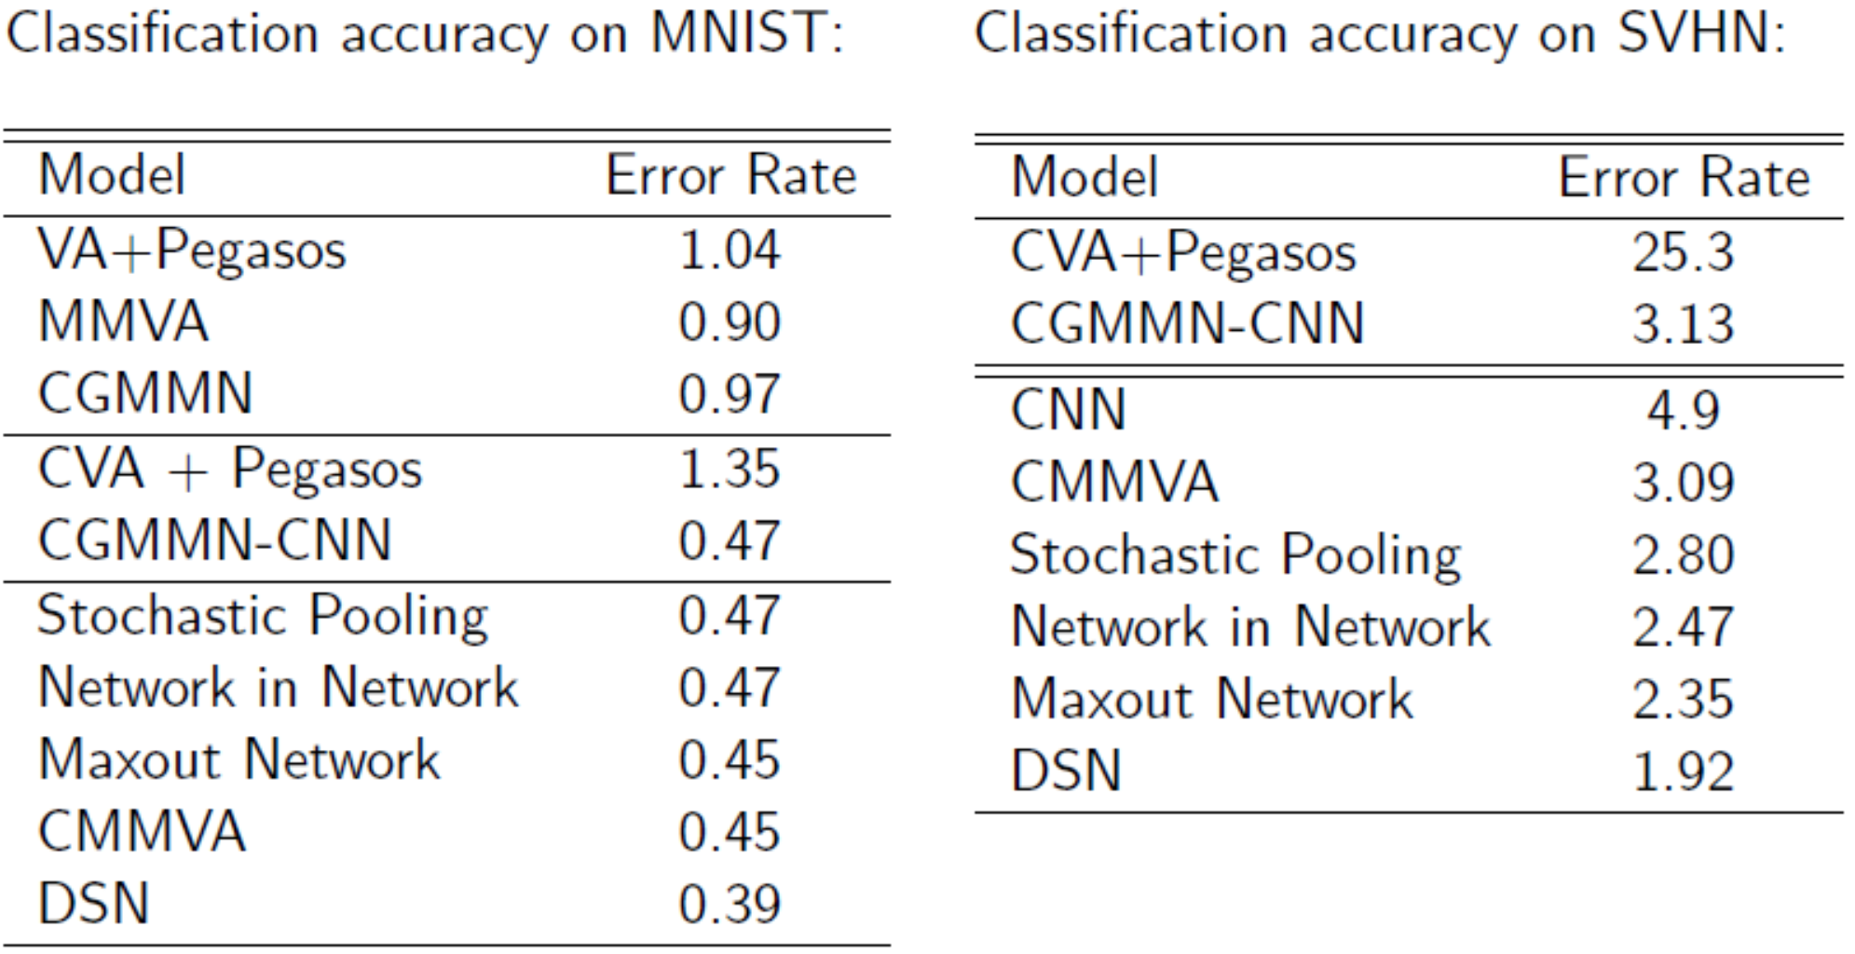
Some Results – Classification

Slide 96
Some Results – Generation

Slide 97
Some Results – Bayesian Dark Knowledge
Distilling the knowledge (Hinto et al., 2015) & Bayesian dark knowledge (Korattikara et al., 2015)
Bayes prediction is expensive!
Teach a student network for prediction
Notes:
Update the list!

Slide 98
Some Results – Bayesian Dark Knowledge
Notes:
Update the list!

Slide 99
Outline
Basics of Generative Models
Deep Generative Models
Semi-supervised Learning
ZhuSuan: a Probabilistic Programming library
Conclusions & QA

Slide 100
Semi-supervised Learning
A toy example

Slide 101
Representation Matters
PCA embedding of learned representations by different DGM models on CIFAR10

Slide 102
Representation Matters
t-SNE embedding of learned representations by different DGM models on CIFAR10

Slide 103
Triple Generative Adversarial Nets
A minimax game for semi-supervised learning
GAN is for unsupervised learning
We aim to learn the joint distribution
We need three players
factorization form with conditionals
Two generators to generate (x,y)
A discriminator to distinguish fake (x,y)
$p_{model}(x)=p_{data}(x)$
$p_{model}(x,y)=p_{data}(x,y)$
A classifier
$$p\left(x,y\right)=p\left(x\right)p\left(y | x\right)$$
$=p\left(y\right)p\left(x | y\right)$
A class-conditional generator
[Li et al., NIPS 2017]

Slide 104
Triple-GAN
The network architecture
Both C and G are generators
D is the discriminator
CE: cross-entropy loss for learning classifier
[Li et al., NIPS 2017]

Slide 105
A minimax game
The optimization problem
The hyper-parameter a is often set at 1/2
The standard supervised loss can be incorporated
[Li et al., NIPS 2017]

Slide 106
Major theoretical results

Slide 107
Some Practical Tricks for SSL

Slide 108
Some Results
Semi-supervised classification

Slide 109
Some Results
Class-conditional generation

Slide 110
Some Results
Disentangle class and style

Slide 111
Some Results
Latent space interpolation on MNIST

Slide 112
Some Results
Latent space interpolation on SVHN

Slide 113
Some Results
Latent space interpolation on CIFAR10

Slide 114
Learning Problem
A supervised deep generative model
$$z_{K}$$
$$z\sim p\left(z | α\right)$$
…
$$z_{1}$$
$$x\sim p\left(x | z,β\right)$$
$$x$$

Slide 115
Variational Objective
Unsupervised data fitting
$$z_{K}$$
…
$$z_{1}$$
$$x$$
p(

Slide 116
Classification Loss
Hinge-loss of an averaging classifier
$$z_{K}$$
…
$$z_{1}$$
$$x$$
$$f\left(y;x\right)=E_{q}[η_{y}^{T}z]$$
$$R\left(q\left(η, Z\right);X\right)=\sum_{n=1}^{N}{\max_{y}{(Δℓ_{n}\left(y\right)+f\left(y;x_{n}\right)−f\left(y_{n};x_{n}\right))}}$$

Slide 117
Doubly stochastic subgradient descent
A doubly stochastic generalization of Pegasos (Shalev-Shwartz et al., 2011)
Stochastic unbiased estimate of the objective by random mini-batches:
Stochastic estimate of the per-sample variational bound with a Q-network and its subgradient (unbiased)

Slide 118
2-Layer MLP: Q-P network architecture
*Same as in Auto-Encoding Variational Bayes (VA) [Kingma & Welling, 2014]

Slide 119
5-Layer CNN: Q-P network architecture

Slide 120
Classification Performance
MNIST
SVHN
Notes:
SVHN: street-view house numbers

Slide 121
Imputation examples

Slide 122
Classification with Missing Values

Slide 123
Semi-supervised Learning
Unlabeled data is abundant, while labeled data is expensive
Explore the patterns of unlabeled data to help supervised learning
A deep conditional generative model
Weak coupling between
labeled and unlabeled data
Strong coupling between
labeled and unlabeled data

Slide 124
Learning Objective
The overall objective
The hyper-parameters: alpha is fixed at 0.1; others searched via validation error
Fixed across all the datasets
Generative loss
on unlabeled
data
hinge loss
on labeled
data
Label balance
posterior
regularization
Hat loss on
unlabeled
data

Slide 125
Some Results
1000 samples lead to comparable performance as the best fully supervised GAN
The fully supervised MMCVA is state-of-the-art

Slide 126
Some Results
State-of-the-art: Ensemble-10-GANs – an ensemble of 10 improved-GANs

Slide 127
Disentangle Class and Style
Generate samples by conditioning on class label and a style vector z (with few labeled training data)

Slide 128
Outline
Basics of Generative Models
Deep Generative Models
Semi-supervised Learning
ZhuSuan: a Probabilistic Programming library
Conclusions & QA

Slide 129
Bayesian inference
$$p\left(z|x\right)=\frac{p(x,z)}{p(x)}$$
Given Disease, what is the Cause?
Given Object, what are the Components?
Given Docs, what are the Topics?
Find Cause of Disease
Extract Topics from Docs
Identify Objects from Images
Recognize Words in Speeches
z
$$f_{DNN}$$
x
Notes:
版面做了调整，来适应变窄了的版面。

Slide 130
A thousand lines of details are missed …
ZhuSuan saves your time!
http://zhusuan.readthedocs.io

Slide 131
ZhuSuan
One-Stop Shop for Bayesian methods and Deep Learning
z
$$f_{DNN}$$
A new-life to Chinese 5th greatest innovation; The oldest calculating machine
x

Slide 132
Towards Bayesian Deep Learning
Conjoin the complimentary advantages of deep learning
and Bayesian methods
Bayesian DL
unified framework
efficient alg.s
learning w/ small-data
structure learning/inference
Nature, 2016
cover paper
Science, 2015
cover paper
Deep Learning
data-driven, high-acc,
black-box, heavy tuning
Bayesian Methods
knowledge-driven,
robust, small-data,
interpretable, flexible

Slide 133
ZhuSuan
ZhuSuan is a python library for generative models, built upon TensorFlow.
Unlike existing DL libraries, which are mainly for supervised tasks, ZhuSuan is featured for:
its deep root into Bayesian Inference
supporting various kinds of generative models: traditional hierarchical Bayesian models & recent deep generative models.
z
$$f_{DNN}$$
x

Slide 134
ZhuSuan
With ZhuSuan, users can enjoy
powerful fitting and multi-GPU training of deep learning
while at the same time they can use generative models to
model the complex world
exploit unlabeled data
deal with uncertainty by performing principled Bayesian inference
generate new samples
z
$$f_{DNN}$$
x

Slide 135
Model Primitives: BayesianNet
A DAG representing a Bayesian Network
Two types of nodes:
Deterministic nodes: Can be composed of any Tensorflow operations.
Stochastic nodes: Use StochasticTensor's from ZhuSuan’s library.
Start a BayesianNet environment
z
$$f_{DNN}$$
x
import zhusuan as zs
with zs.BayesianNet() as model:
# build the model
Notes:
概率图从左端移到，来适应变窄了的版面。

Slide 136
Example: Variational Autoencoders
import tensorflow as tf
from tensorflow.contrib import layers
import zhusuan as zs
with zs.BayesianNet() as model: z_mean = tf.zeros([n, n_z]) z_logstd = tf.zeros([n, n_z]) z = zs.Normal('z', z_mean, z_logstd) h = layers.fully_connected(h, 500) x_logits = layers.fully_connected(
h, n_x, activation_fn=None) x = zs.Bernoulli('x', x_logits)
z
$$f_{DNN}:2L MLP$$
x
Notes:
版面作了调整，来适应变窄了的版面。

Slide 137
Inference in Old Days
Variational Inference (Too much math!!!)
MCMC
(Many dynamics!!!)
z
$$p(z|x)$$
$$f_{DNN}$$
$$q_{φ}\left(z\right)∈some family$$
x
Variational posterior
True
posterior
Extremely painful for a single model!
Notes:
版面作了调整——把概率图挪到了上方，Too much maths和Many dyanmics新开了一行——来适应变窄了的版面。

Slide 138
Inference in ZhuSuan
Turn painful math deviations into Easy (Probabilistic) Programming

Slide 139
3-Step Variational Inference in ZhuSuan
with zs.BayesianNet() as variational: # build variational ...
qz_samples, log_qz = variational.query(
‘z’, outputs=True, local_log_prob=True)
Build variational posterior
as BayesianNet
Call variational objectives
lower_bound = zs.sgvb(log_joint, observed={‘x’: x},
latent={‘z’: [qz_samples, log_qz]})
optimizer = tf.train.AdamOptimizer(learning_rate=0.001)
run_op = optimizer.minimize(-lower_bound)
With tf.Session() as sess:
for iter in range(iters):
sess.run(run_op)
Run gradient descent!

Slide 140
Example: Variational Autoencoders
Structured variational posterior as a BayesianNet ALSO.
import tensorflow as tf
from tensorflow.contrib import layers
import zhusuan as zs
with zs.BayesianNet() as variational:
x = tf.placeholder([None, n_x], tf.float32) h = layers.fully_connected(x, 500) z_mean = layers.fully_connected(
h, n_z, activation_fn=None) z_logstd = layers.fully_connected(
h, n_z, activation_fn=None) z = zs.Normal('z', z_mean, z_logstd)

Slide 141
Variational Inference Algorithms
ZhuSuan supports a broad class of variational objectives, ranging from widely used evidence lower bounds to recent state-of-arts.
Works for continuous latent variables
zs.sgvb: Stochastic gradient variational Bayes.
zs.iwae: Importance weighted lower bounds.
Works for both continuous and discrete latent variables
zs.nvil: Variance reduced score function estimator/REINFORCE.
zs.vimco: Variance reduced multi-sample score function estimator.
* This is like optimization algorithms (SGD, momentum, Adam, etc.) in deep learning software. Users need not dive into the technical details of these algorithms because ZhuSuan provides easy-to-use APIs for users to directly try on their generative models.

Slide 142
Use HMC like a TensorFlow optimizer
# like creating the variable to optimize over.
z = tf.Variable(0.)
Create the variable to store
samples
# like optimizer = tf.train.AdamOptimizer(…)
hmc = zs.HMC(step_size=1e-3, n_leapfrogs=10)
Initialize HMC
# like optimize_op = optimizer.minimize(…)
sample_op, hmc_info = hmc.sample(
log_joint, observed={‘x’: x}, latent={‘z’: z})
Call sample() method to
return a sample operation
with tf.Session() as sess:
for iter in range(iters):
# like sess.run(optimize_op)
_ = sess.run(sample_op)
Run the sample operation
like an optimizer!
Notes:
代码的注释，从绿色字体改成土黄色。

Slide 143
Applications: ZhuSuan as a Research Platform
ZhuSuan is featured for both Bayesian Statistics and Deep Learning.
State-of-the-Art models can be found in ZhuSuan’s examples.
Bayesian Logistic Regression
Bayesian Neural Nets for Multivariate Regression
(Convolutional) Variational Autoencoders (VAE)
Semi-supervised learning for images with VAEs
Deep Sigmoid Belief Networks
Generative Adversarial Networks (GAN)
Topic Models
More to come …

Slide 144
ZhuSuan: GitHub Page
Contributions & Stars
Welcome!
github.com/thu-ml/zhusuan
Notes:
两张网页截图加了阴影，为了和白色背景区分。版面做了调整，二维码和welcome字样移到了下端。

Slide 145
ZhuSuan: Online Documents
zhusuan.readthedocs.io
Notes:
同前一页。

Slide 146
Summary
Deep Generative models are powerful tools
simple language models
hierarchical Bayesian models
deep generative models
ZhuSuan provides a Python programming library
deep root into Bayesian inference
support deep generative models

Slide 147
References
D. Blei, A. Ng, and M. Jordan, Latent Dirichlet Allocation, Journal of Machine Learning Research, 2003.
J. Chen, K. Li, J. Zhu, and W. Chen, WarpLDA: a Cache Efficient O(1) Algorithm for Latent Dirichlet Allocation, VLDB 2016.
S. Li, T. Chua, J. Zhu, C. Miao, Generative Topic Embedding: a Continuous Representation of Documents. ACL 2016.
J. Chen, J. Zhu, Z. Wang, X. Zheng, and B. Zhang. Scalable Inference for Logistic-Normal Topic Models, NIPS, 2013;
J. Zhu, N. Chen, and E. P. Xing. Bayesian inference with posterior regularization and applications to infinite latent SVMs. Journal of Machine Learning Research, 15(May):1799-1847, 2014.
J. Zhu, A. Ahmed, and E. Xing. MedLDA: maximum margin supervised topic models. Journal of Machine Learning Research, (13):2237–2278, 2012.
J. Zhu, N. Chen, H. Perkins, and B. Zhang. Gibbs max-margin topic models with data augmentation. Journal of Machine Learning Research, 15(May):1073-1100, 2014.

Slide 148
References
P.J. Diggle and R.J. Gratton. Monte Carlo Methods of Inference for Implicit Statistical Models. Journal of the Royal Statistical Society. Series B, 1984
F. Hartig, J.M. Calabrese, B. Reineking, T. Wiegand and A. Hu. Statistical inference for stochastic simulation models--theory and application. Ecology Letters, 2011.
Kingma, D. P. and Welling, M. Auto-encoding variational Bayes. In ICLR, 2013.
Rezende, D. J., Mohamed, S., and Wierstra, D. Stochastic backpropagation and approximate inference in deep generative models. In ICML, 2014.
Burda, Y., Grosse, R., and Salakhutdinov, R. Importance weighted autoencoders. In arXiv:1509.00519, 2015.
Goodfellow, I. J., Abadie, J. P., Mirza, M., Xu, B., Farley, D. W., S.ozair, Courville, A., and Bengio, Y. Generative adversarial nets. In NIPS, 2014
Li, C., Zhu, J., and Zhang, B. Learning to generate with memory. In ICML, 2016
Li, C., Zhu, J., and Zhang, B. Max-margin deep generative models. In NIPS, 2015
Li, C., Xu, K., Zhu, J., and Zhang, B. Triple Generative Adversarial Networks. In NIPS, 2017
Ren, Y., Li, J., Luo, Y., and Zhu, J. Conditional generative moment-matching networks, NIPS, 2016.
J. Shi, J. Chen, J. Zhu, S. Sun, Y. Luo, Y. Gu, Y. Zhou. ZhuSuan: a Library for Bayesian Deep Learning. arXiv preprint, arXiv:1709.05870 , 2017

Slide 149
Thanks!
ZhuSuan: A Library for Bayesian Deep Learning. J. Shi, J. Chen, J. Zhu, S. Sun, Y. Luo, Y. Gu, Y. Zhou. arXiv preprint, arXiv:1709.05870 , 2017
Online Documents: http://zhusuan.readthedocs.io/

Slide 150
Applications: Semi-supervised Learning with Generative models
Disentangle styles and categories
on raw image space
<1% labeled data on SVHN (1,000/~700,000)
Max-margin deep generative models for semi-supervised learning (Li et al., ArXiv 2016)

Slide 151
Applications: Semi-supervised Learning with Generative models
Advance previous state-of-the-art results
on natural images (CIFAR10) substantially
First GAN-based model to generate
data in a specific class in SSL
Triple Generative Adversarial Nets (Li et al., ArXiv 2017)
Notes:
柱状图的颜色换了。

Slide 152
Variational Bayes
Consider the log-likelihood of a single example
Log-integral/sum is annoying to handle directly
Derive a variational lower bound $L\left(θ, φ,x\right)$
$$\log{p(x;θ)}=\log{∫p\left(z,x;θ\right)dz}$$
$$\log{p\left(x;θ\right)=L\left(θ, φ,x\right)+KL\left(q\left(z | x;φ\right)\right\|p(z|x;θ))}$$
$$L\left(θ, φ,x\right)=E_{q(z|x;φ)}\left[\log{p\left(z,x;θ\right)−\log{q\left(z | x;φ\right)}}\right]$$
= $E_{q(z|x;φ)}\left[\log{p\left(x|z;θ\right)+\log{p(z;θ)}−\log{q\left(z | x;φ\right)}}\right]$
= $E_{q(z|x;φ)}\left[\log{p\left(x|z;θ\right)}\right]−KL(q\left(z | x;φ\right)‖p\left(z;θ\right))$
reconstruction term
prior regularization

Slide 153
Recap: Auto-Encoder
Encoder:
Decoder:
Training: minimize the reconstruction error (e.g., square loss, cross-entropy loss)
Denoising AE: randomly corrupted inputs are restored to learn more robust features
$$h=s(Wx+b)$$
$$x^{′}=s(W^{′}h+b^{′})$$

Slide 154
Auto-Encoding Variational Bayes (AEVB)
What’s unique in AEVB is that the variational distribution is parameterized by a deep neural network
We call it an inference (recognition, encoder) network or a Q-network
All the parameters are learned jointly via SGD with variance reduction
$$q\left(z | x;φ\right)≈p\left(z | x;θ\right)$$
z
$$q\left(z | x;φ\right)$$
generation path
inference path
x
x
[Kingma & Welling, ICLR 2013; Rezende et al., ICML 2014]

Slide 155
The Encoder Network
A feedforward NN + Gaussian
$$q\left(z | x;φ\right)=N\left(μ(x;φ), σ^{2}(x;φ)\right)$$
z
$$μ$$
$$σ^{2}$$
$$φ$$
: deterministic function
: random sampling
$$x_{1}$$
$$x_{2}$$

Slide 156
The Complete Auto-encoder
The Q-P network architecture:
z
$$μ$$
$$σ^{2}$$
$$θ$$
$$φ$$
$$μ_{1}$$
$$σ_{1}^{2}$$
$$μ_{2}$$
$$σ_{2}^{2}$$
$$x_{1}$$
$$x_{2}$$
$$x_{1}$$
$$x_{2}$$
: deterministic function
: random sampling

