Slide 1
自然语言处理国际前沿动态综述@CCL2018
CCL每年都有都有国际前沿动态报告。所以，我重点介绍过去一年的最新热点
孙薇薇
北京大学
Best paper或提名
Presentation的时候人山人海

Slide 2
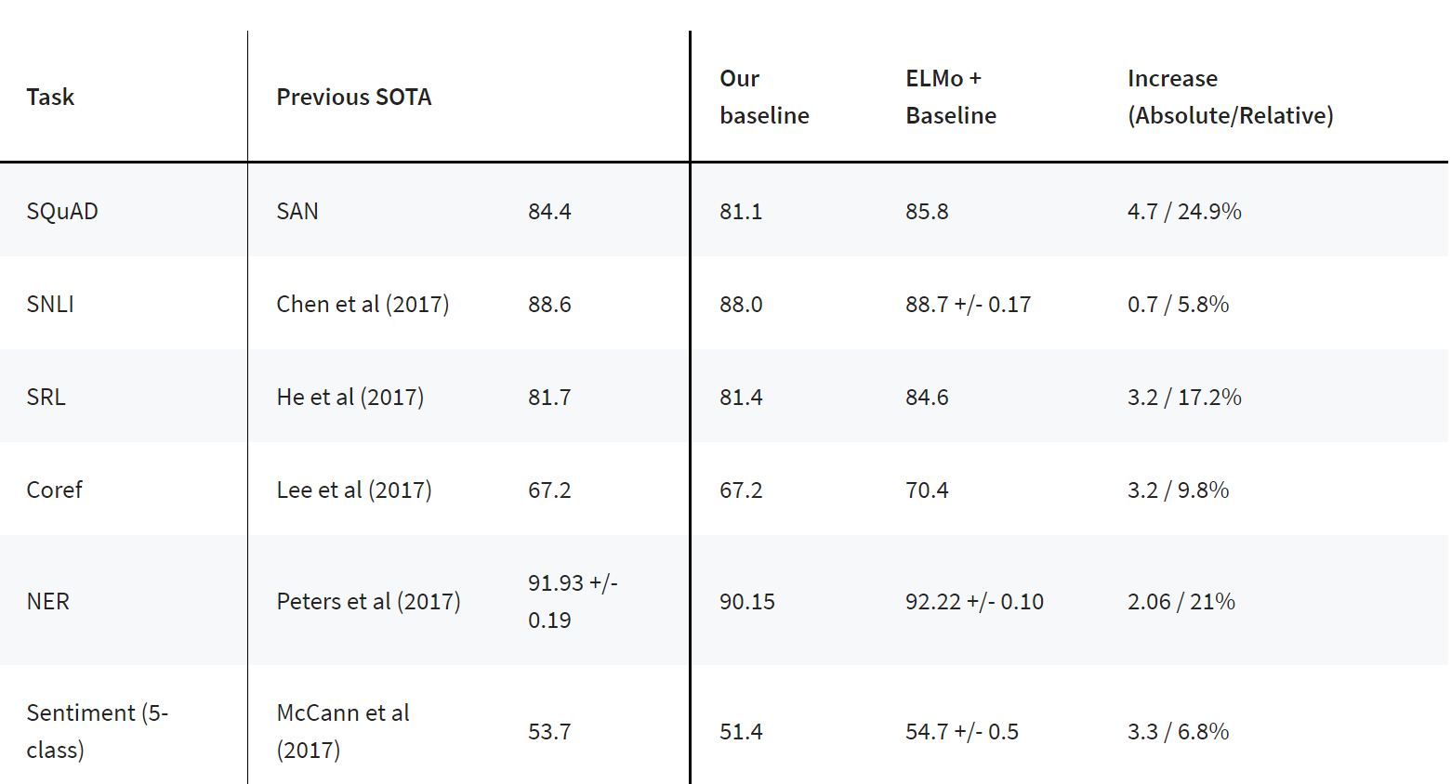
汤，亦或石头
两种论文
简单问题复杂化
复杂问题简单化

Slide 3
这才是
人民群众喜闻乐见的
技术
哪都能用
哪用哪好

Slide 4
包治百病的ELMO
NAACL 2018 Best Paper

Slide 5
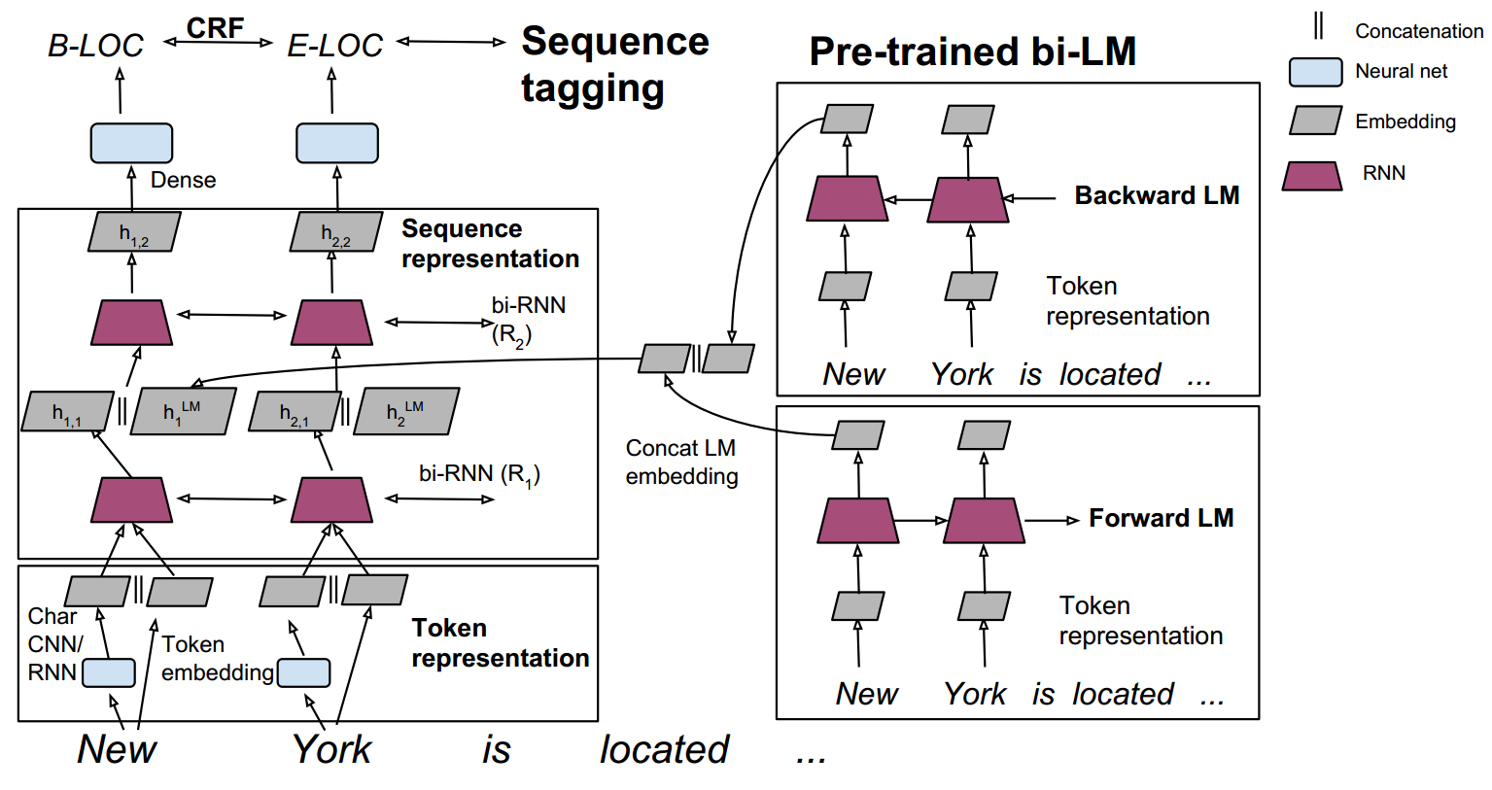
ELMO前身

Slide 6
ELMo本尊

Slide 7
ELMo本尊
各种各样的task
不仅仅是序列标注

Slide 9
保卫地球大作战
Chris Dyer
Emily Bender
Jason Eisner
Mark Johnson

Slide 10
保卫地球大作战
Is linguistic information useful for neural network architectures: can it improve state of the art neural architectures, and how should it be used? Does it help in building models that transfer better to new domains, new languages, new tasks, or for other limited annotated data scenarios?
Are there any better implicit representations that neural networks can extract, whether similar or not to linguistic structures, that can be transferred or shared across tasks and, hence, serve as core language representation layers?

Slide 11
LISA: Linguistically-Informed Self-Attention
EMNLP 2018 Best Paper

Slide 12
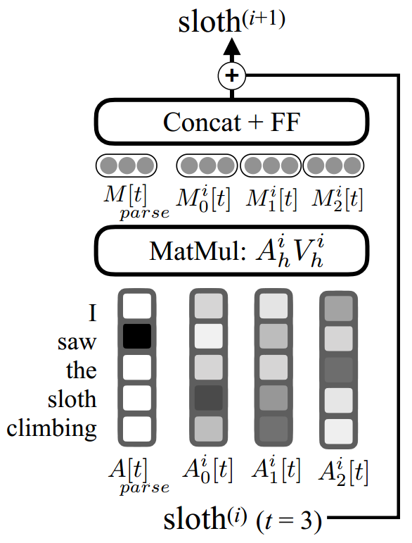
LISA

Slide 13
LISA
结论是：
LISA在背起手的时候很不错
结论是：
ELMo很强大

Slide 14
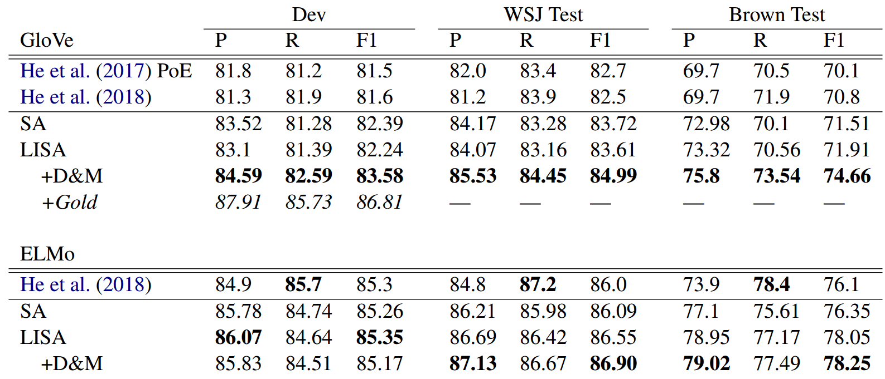
句法分析就这点能耐？
句法分析显著提升了系统鲁棒性

Slide 16
拥抱喵星人
ACL 2018 Best Paper提名

Slide 17
QA-SRL
“标准”SRL：
Arg0/Agent
Arg1/Patient

Slide 18
QA-SRL优点
降低了对标注者“专业性”的要求，使得普通人也可以充当标注者，有利于扩大数据量

Slide 19
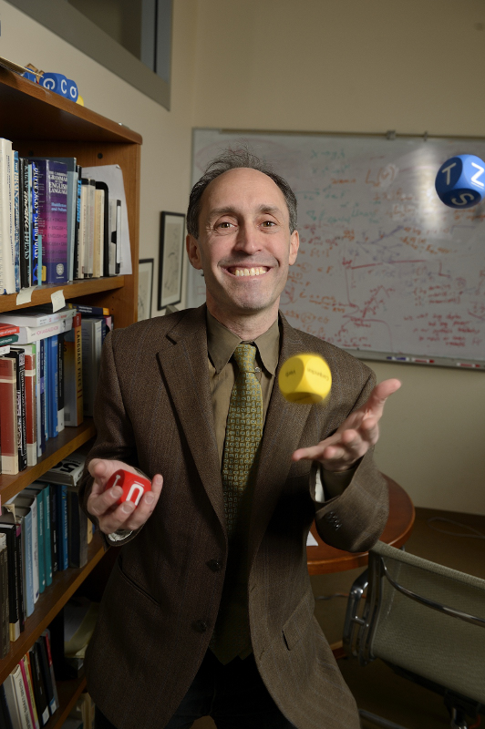
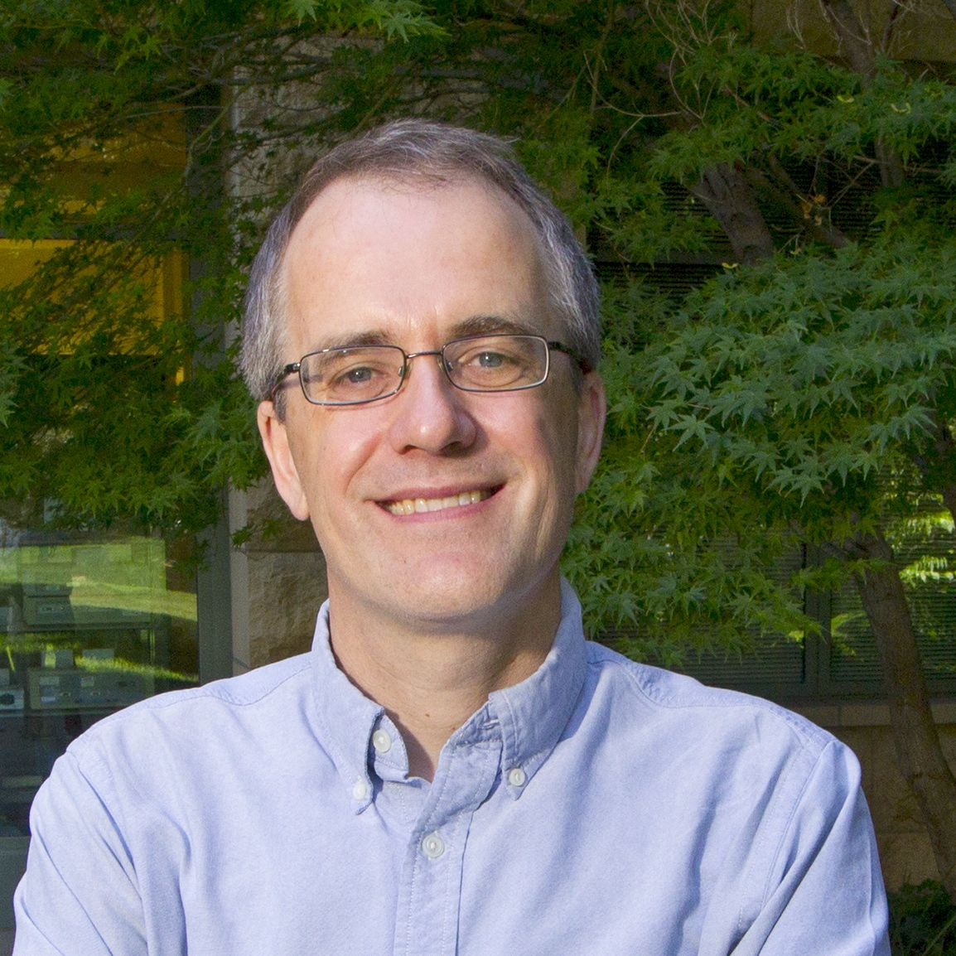
大佬说
ACL2017的论文：找点儿新数据，定义个新任务，然后扔LSTM里
2018
仍然如此

Slide 20
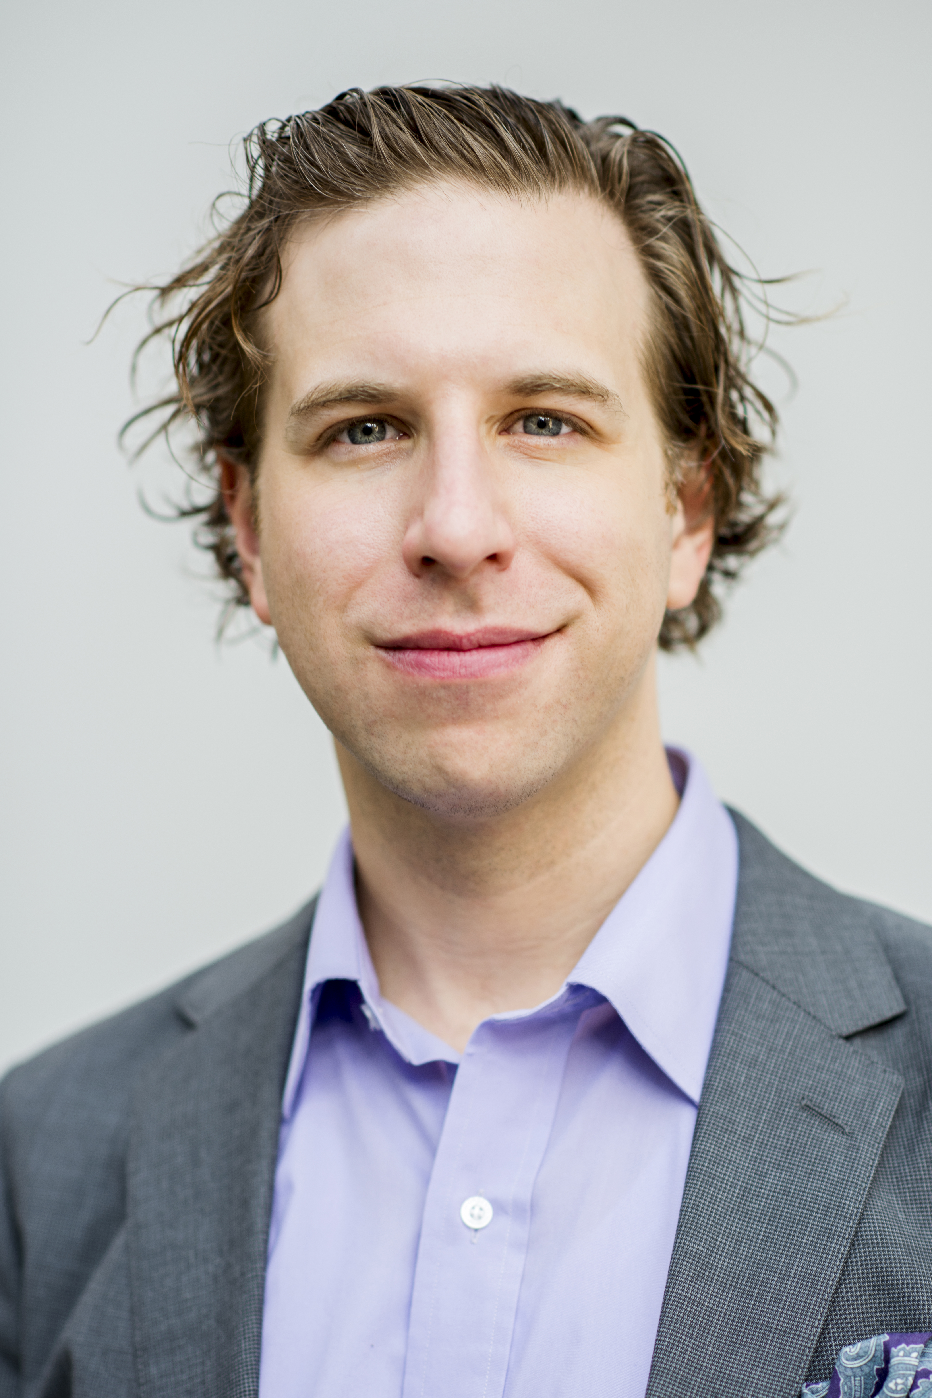
Transfer Learning
ACL 2017 Keynote

Slide 21
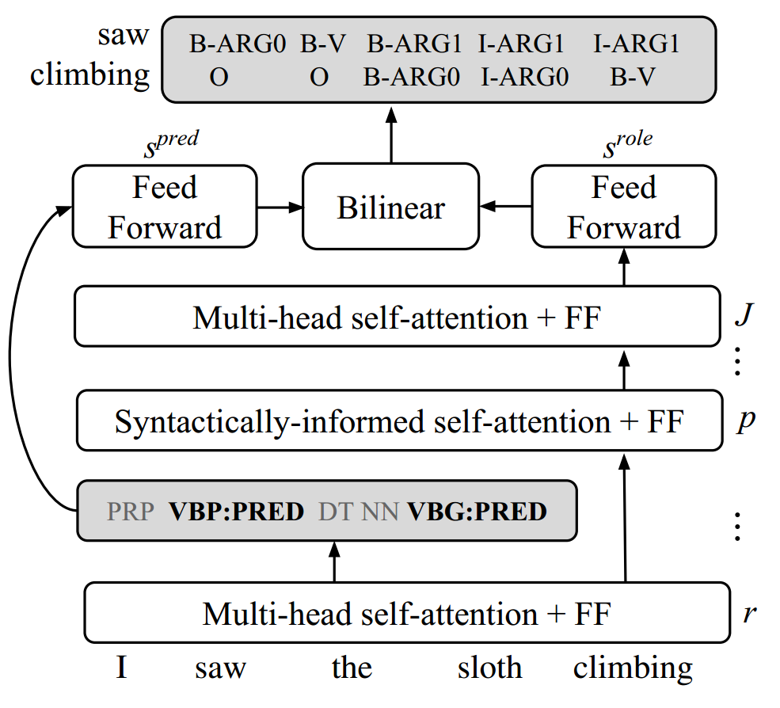
Multitask Learning

Slide 22
What is Computational linguistics?
https://www.aclweb.org
Computational linguistics is the scientific study of language from a computational perspective. […] Work in computational linguistics is in some cases motivated from a scientific perspective in that one is trying to provide a computational explanation for a particular linguistic or psycholinguistic phenomenon; and in other cases the motivation may be more purely technological in that one wants to provide a working component of a speech or natural language system. […]

Slide 23
Computational explaination
ACL 2018 Best Paper

Slide 24
折腾数据很重要
无标注数据（LM）
异质数据（Multitask Learning）
相关数据（MT平行语料）
数据很重要
数据很重要
数据很重要
谢谢大家的耐心聆听

Slide 25
写在“可解释性”之前

